Slide 1
Test Information Distribution Engine (TIDE)
Training Module
2022–2023
Copyright © 2021 Cambium Assessment, Inc. All rights reserved.
Notes:
Welcome to the online training module for the Test Information Distribution Engine, also known as TIDE. This training module includes many examples of TIDE’s features. The TIDE User Guide on the Ohio test portal has additional information about features in TIDE.

Slide 2
Objectives
Preparing for Testing
Activating your new TIDE account and logging in to TIDE
Navigating the TIDE interface
Understanding account permissions
Managing user accounts
Managing student information and test settings
Administering Tests
Managing Test Status Requests
Monitoring test progress
After Testing
Discrepant Record Resolution
Notes:
This presentation will address numerous topics in TIDE, including tasks that typically take place while preparing for testing, during test administration, and after testing has concluded.
At its core, TIDE is a registration system for users who will access CAI systems and students who will take CAI tests. Users of all CAI systems must be added to TIDE before they can access any CAI system. Students must be added to TIDE before they can test in TDS. Classes must be added in TIDE so Reporting can display scores at the classroom, school, district, and state level. During testing, TIDE users can print test tickets, manage test status requests, and monitor test progress. After testing, TIDE users can clean up data and track return shipments of paper testing materials.

Slide 3
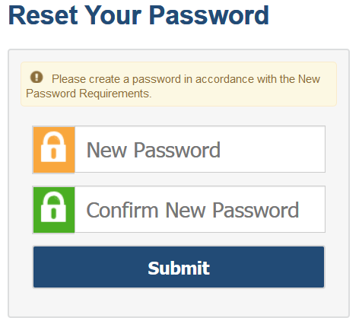
Activating Your Account
Follow the activation link in your email.
Create a password for TIDE that meets the password requirements:
At least 8 characters
At least 1 uppercase letter
At least 1 lowercase letter
At least 1 special character
At least 1 number
Submit your new password.
Notes:
When you are first added to TIDE, you will receive an account activation email containing a temporary link to reset your password. The sender’s address will appear as DoNotReply@cambiumassessment.com
The email contains two important links:
An activation link
A second link to request a new activation email
The activation link is only valid for 15 minutes. After that time, the link will expire, and you will need to click the second link to request a new activation email.
When you click the activation link, the Reset Your Password page will appear. Create the password you will use to access TIDE. If the password you enter is not processing, please ensure that you have met all system password requirements.
Your TIDE password must contain at least 8 characters, 1 uppercase letter, 1 lowercase letter, 1 special character, and 1 number.
If you do not reset your password, you will not be able to access the system.
If your password meets all requirements, click Submit.

Slide 4
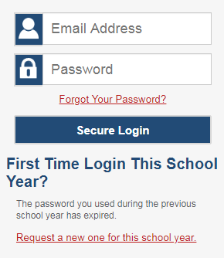
Logging in to TIDE
Notes:
After activating your account, you will have access to the various systems located on the test portal.
To access TIDE, go to the test portal and select the TIDE icon. On the login page, enter your email and password and click Secure Login.

Slide 5
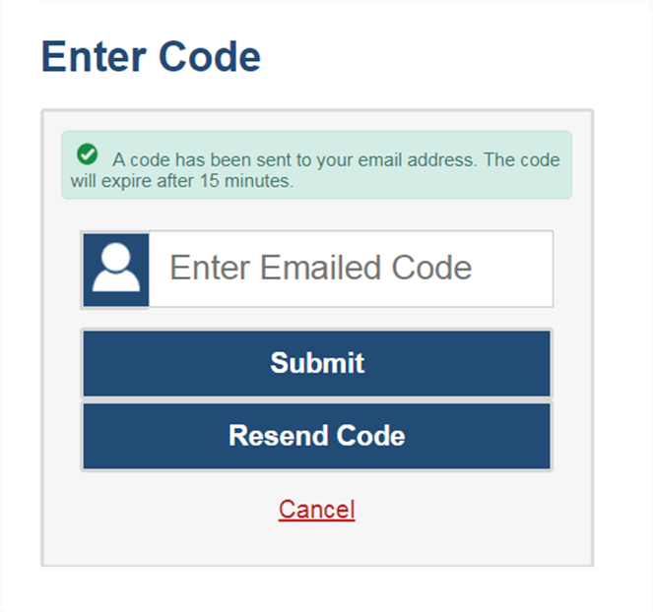
Logging in to TIDE, continued
The system has an authentication process that will be triggered when you log in from a different device or browser or after clearing your browser’s cache.
If you see this screen, an email containing the code will have been sent automatically to your email address.
Enter the code and click Submit.
If you need the code to be resent, click Resend Code.
Notes:
When logging in to the system using a new device or browser, or after clearing the cache on a previously used browser, you will see an Enter Code page.
If you see this screen, will need to enter the code on this page within 15 minutes of receiving the email. If you do not receive a code or do not enter the code within the 15-minute time limit, click Resend Code. Click Submit after entering the authentication code to access the system. You will be taken to the Reset Your Password page.

Slide 6
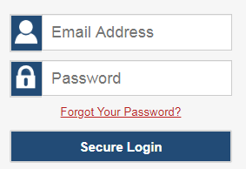
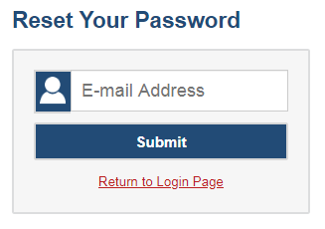
Resetting Your Password
Notes:
If you forget your password, you will need to reset it in order to access TIDE.
You may need to reset your password in the following situations:
You forgot your password.
Your activation link expired.
Your account is locked because you exceeded the account login attempt limit.
It is a new school year.
To reset your password, click the Forgot Your Password? link. You will be taken to the Reset Your Password page. Enter your email address and click Submit. You will receive an email with an activation link. Follow the same steps you would when initially setting up your TIDE account.

Slide 7
Logging in to TIDE, continued
Notes:
At the beginning of a new school year, your TIDE password and security details will be automatically reset. You will receive an email from DoNotReply@cambiumassessment.com to notify you of this occurrence. To reset your password and security details, go to the test portal and select the TIDE icon. On the login page select Request a new one for this school year. The Reset Your Password page will appear, and you will follow the same steps to reset your password mentioned previously in this module.

Slide 8
Roles and Permissions
Each user in TIDE has a role, such as a District Test Coordinator or Test Administrator. Each role has an associated list of permissions to access certain features within the Cambium Assessment systems, including the Centralized Reporting System (CRS) and the Data Entry Interface (DEI).
District Level Users
District Test Coordinator (DTC)
District Administrator (DA)
District Reporting User (DRU)
EMIS Coordinator (EC)
Information Technology Center (ITC)
Building Level Users
Building Test Coordinator (BTC)
Building Reporting User (BRU)
Teacher Level Users
Teacher (TE)
Test Administrator (TA)
For a detailed list of user roles and associated permissions, see the Online User Role Matrix which can be found on the test portal.
Notes:
Your TIDE account is assigned a role, and that role has certain permissions. For example, a district-level user may be able to perform tasks that are not available to a school-level user.
Permissions also limit the scope of data access. A district-level user can work with data pertaining to that district, and a school-level user can work with data pertaining to that school.

Slide 9
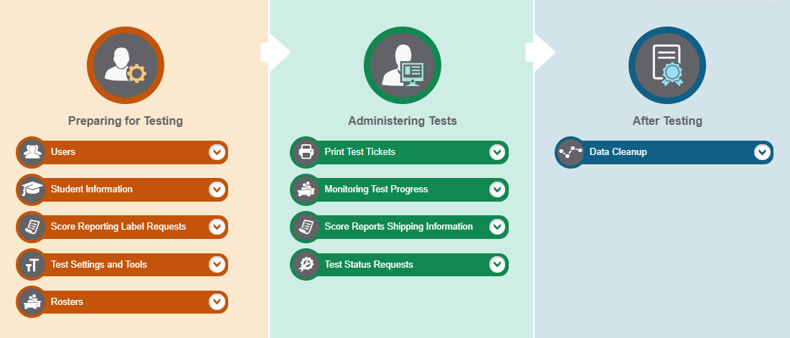
TIDE Home Page
Notes:
The TIDE home page appears after you log in. The home page is designed to reflect the stages of the testing process as directly and simply as possible. Each of TIDE’s three sections lists menus for the tasks available in that section. For example, the Users menu contains options for adding users; viewing, editing, or exporting users; and uploading users. To expand a task menu and view its set of related tasks, click the down arrow on the end of that menu. To perform a task, click the name of that task listed in the menu.

Slide 10
TIDE Tasks: Preparing for Testing
Notes:
Tasks in the Preparing for Testing section are typically performed before testing begins. This category includes tasks for managing records for users, students, test settings, and rosters. This category also includes a task for placing orders for paper testing materials.
TIDE can group students into rosters. A roster is a collection of students sharing a similar characteristic who are assigned to a specific teacher. Rosters typically represent classrooms, but they can also be used to group students with special needs or students participating in particular activities or programs. Once scores are calculated, users can visualize how a roster of students performed as a group.

Slide 11
TIDE Tasks: Administering Tests
Notes:
Tasks in the Administering Tests section are typically performed during the test window.
Test coordinators may use TIDE to invalidate a test, reset a test, or reopen a test.
In this section, you may also monitor test progress, generate test participation reports, and print test tickets.

Slide 12
TIDE Tasks: After Testing
Notes:
In the After Testing section, you can perform data cleanup operations such as resolving test discrepancies.
Users can use TIDE to track return packages containing student answer documents.

Slide 13
TIDE Banner
Notes:
A banner appears at the top of each TIDE page showing the current test administration and your current user role. On the left, there is a drop-down list for accessing other Cambium Assessment applications. You will also find a Help button that displays the TIDE User Guide, an Inbox button, a Manage Account/Administration drop-down list where you may set up your account details, and a Log Out button.

Slide 14
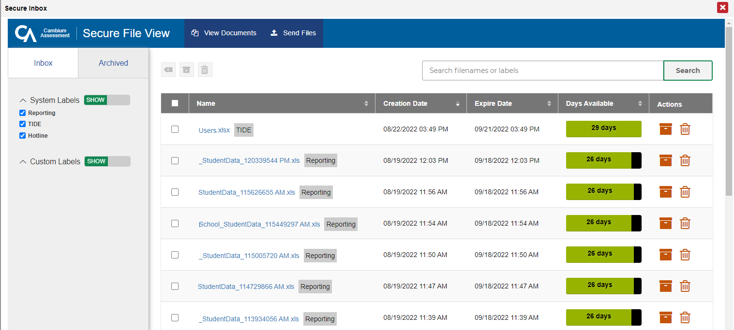
Inbox: View Documents
Notes:
To access secure documents and files you have previously exported in TIDE and other Cambium Assessment systems, click the Inbox button in the banner. Note that files are displayed in the order that they are generated, uploaded, or archived. The Inbox displays the name of the file, creation and expiration dates, days available, and an actions column. To show system and custom labels, select Show on the corresponding toggle bar and mark checkboxes for the label(s) you wish to display. To hide labels, select Hide on the appropriate toggle bar.
For more information on the Inbox and its features, see the TIDE User Guide.

Slide 15
TIDE Banner: Manage Account
Notes:
The Manage Account drop-down list allows you to change the role you are using in TIDE (if you have been assigned multiple roles), update your contact information, and reset your password.

Slide 16
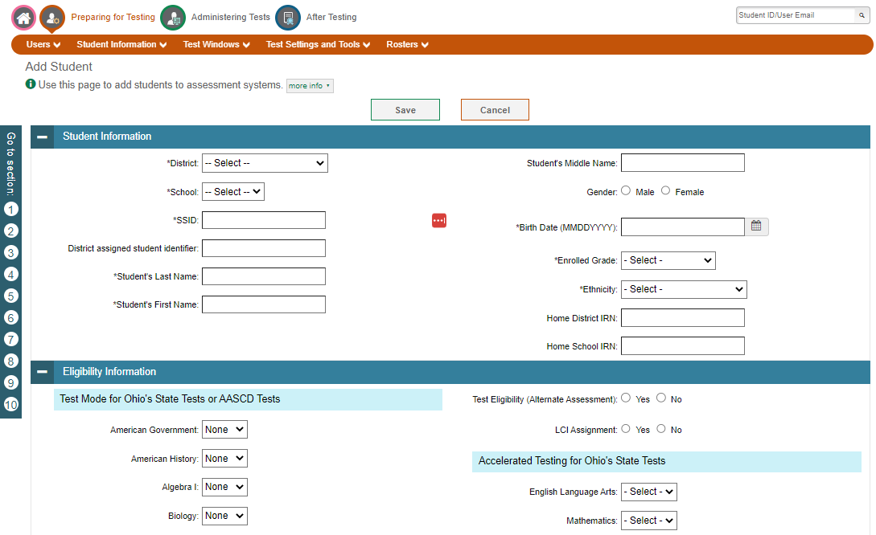
Navigation Toolbars
Notes:
When you enter any task page, a navigation toolbar appears at the top of the page. This toolbar allows you to access each task and action that was available on the dashboard. To view the task menus for a particular TIDE category, click the icon for that category above the toolbar.
Some pages in TIDE are divided into multiple panels. Each panel contains a group of related settings and fields that you can edit. You can click the minus sign in the upper-left corner of a panel to collapse it or click the plus sign in a collapsed panel to expand it. Additionally, a floating Go to section toolbar appears on the left side of each page with multiple panels. This toolbar includes a numbered button for each panel in the form. You can hover over a button to display the label of the associated panel and click the button to jump to that panel.

Slide 17
Help Text
Notes:
Most pages in TIDE have help text that describes the page and how to use it. To show or hide help text on a page, click the gray more info link under the page title.
To read more-detailed information about the page that you are currently viewing, click the Help button in the banner.

Slide 18
Quick Search
Notes:
To quickly search for a user or student to view or edit, enter the user’s email address or student’s SSID in the search box. Then, click the magnifying glass to the right of the search box.
If you are searching for a user to view or edit, the View/Edit User form will appear. If you are searching for a student to view or edit, the View/Edit Student form will appear.
When you are finished viewing/editing a student or user, click the Save button.

Slide 19
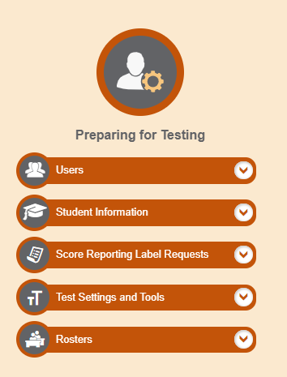
Three Things All TIDE Users Must Know How To Do
You can add new records one at a time
You can view or modify existing records one at a time
You can upload multiple new records or modify existing records in the same file
Notes:
Records for users, students, and rosters must be added to TIDE and kept up to date for the testing process to flow properly. Users not added to TIDE will not have access to any CAI systems, students who are not added will be unable to test, and rosters not added will not be available in Reporting. The process for adding and modifying records are similar for users, students, and rosters. This next section of the module will walk you through how to add records one at a time, how to view or modify existing records one at a time, and how to upload multiple new records or modify existing records in the same file.

Slide 20
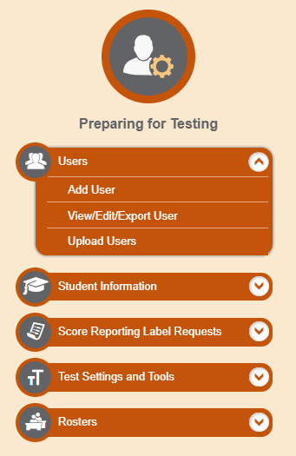
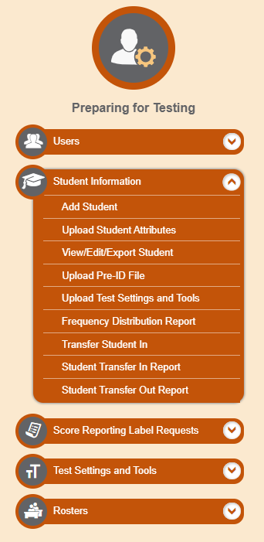
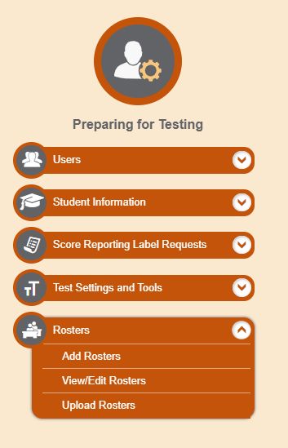
Add Records One at a Time
Notes:
To add records one at a time, start on the TIDE home page. In the Preparing for Testing section, choose the task for which you want to add a new record: users, students, or rosters, then click add.
On the following page, fill out the information, verify its accuracy, and select Save.

Slide 21
Add Users One at a Time
Notes:
When adding users one at a time, enter the email address for the user you want to add. Click + Add user or add roles to user with this email. If the email exists, then options will be available to add multiple roles for the user.
The new user’s email address will serve as their username when they log in to any Cambium Assessment system. The new users you add will receive an activation email from DoNotReply@cambiumassessment.com.

Slide 22
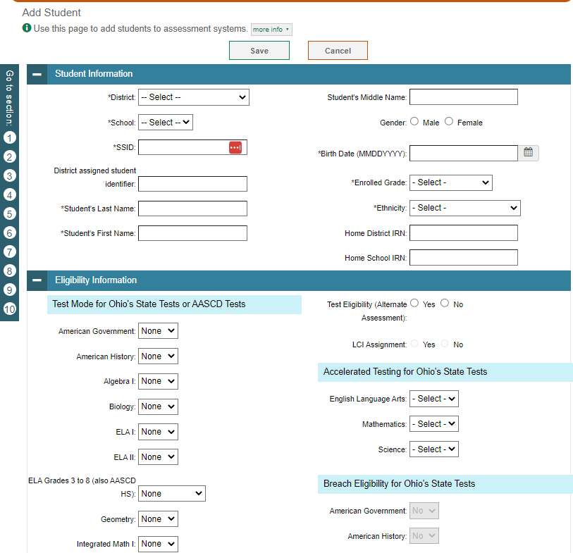
Add Students One at a Time
Notes:
When adding students one at a time, begin by adding information to the Student Information panel. The fields marked with an asterisk are mandatory. This page contains various panels such as Eligibility and Test Settings. Complete the required information in the remaining panels and click Save.

Slide 23
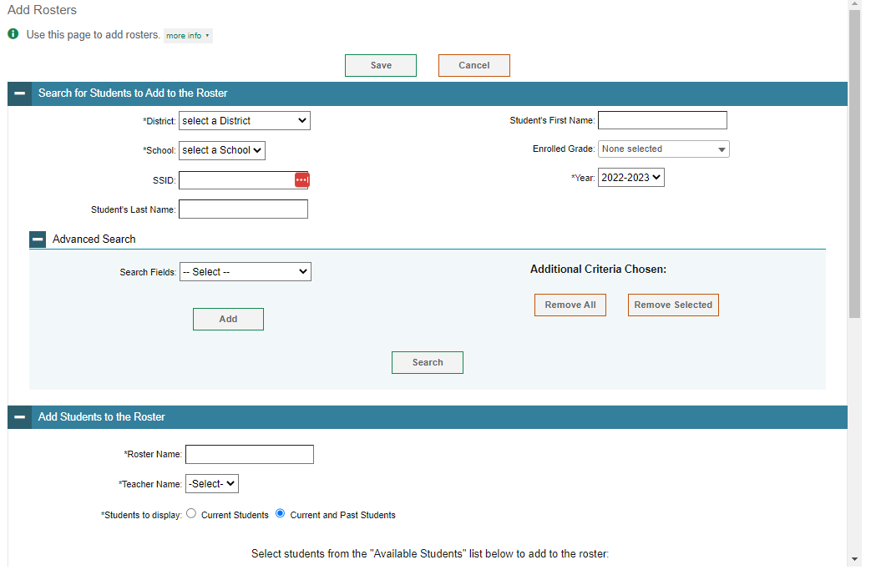
Add Rosters One at a Time
Notes:
The Add Roster page contains two panels, a Search for Students to Add to the Roster panel and an Add Students to the Roster panel.
To search for students, complete the fields under the Search for Students to Add to the Roster panel. The fields marked with an asterisk are mandatory. You can further refine your search by selecting criteria under the Advanced Search section.
Refine the list of available students by completing the fields in the Add Students to the Roster panel. To display current students only, click the Current Students radio button. To display current and past students, click the Current and Past Students radio button. Then click Search.

Slide 24
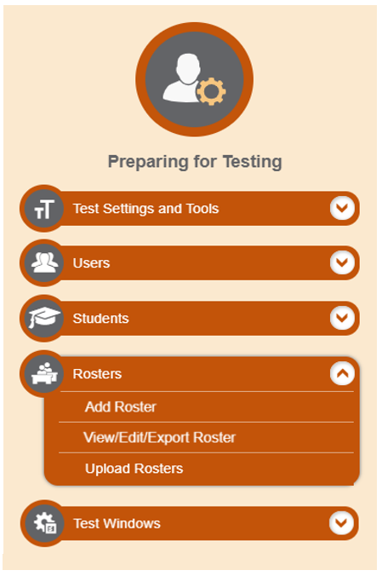
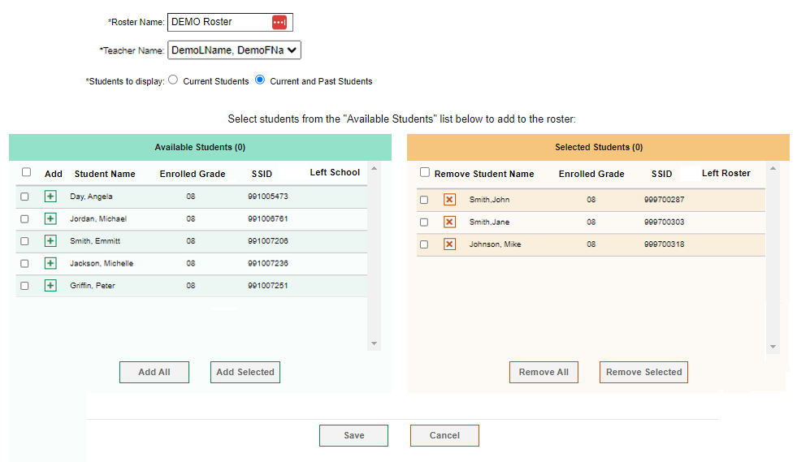
Add Rosters One at a Time, continued
Notes:
In the Add Students to the Roster panel, the students in the left column are available to be added to the roster, and students in the right column are currently in the roster.
First, enter a name for the roster and select the teacher who should be associated with the roster. Select if you want to display Current Students or Current and Past Students.
Next, add students to the new roster. To add a single student to the roster, click the green plus sign next to a student in the left column. You can add multiple students to the roster by marking checkboxes next to the students you want to add and then clicking Add Selected. Add all available students to the roster by clicking Add All.
To remove a single student from the roster, click the orange X next to a student in the right column. You can remove multiple students from the roster by marking checkboxes next to the students you want to remove and then clicking Remove Selected. Remove all students from the roster by clicking Remove All.

Slide 25
Modify Records One at a Time
Notes:
If a record’s information changes after you’ve added the record to TIDE, you must edit the record to match the most up to date information. You can do this by modifying existing records one at a time.
Begin on the TIDE homepage. In the Preparing for Testing section, choose the task for which you want to modify a record: users, students, or rosters, then click View/Edit/Export.

Slide 26
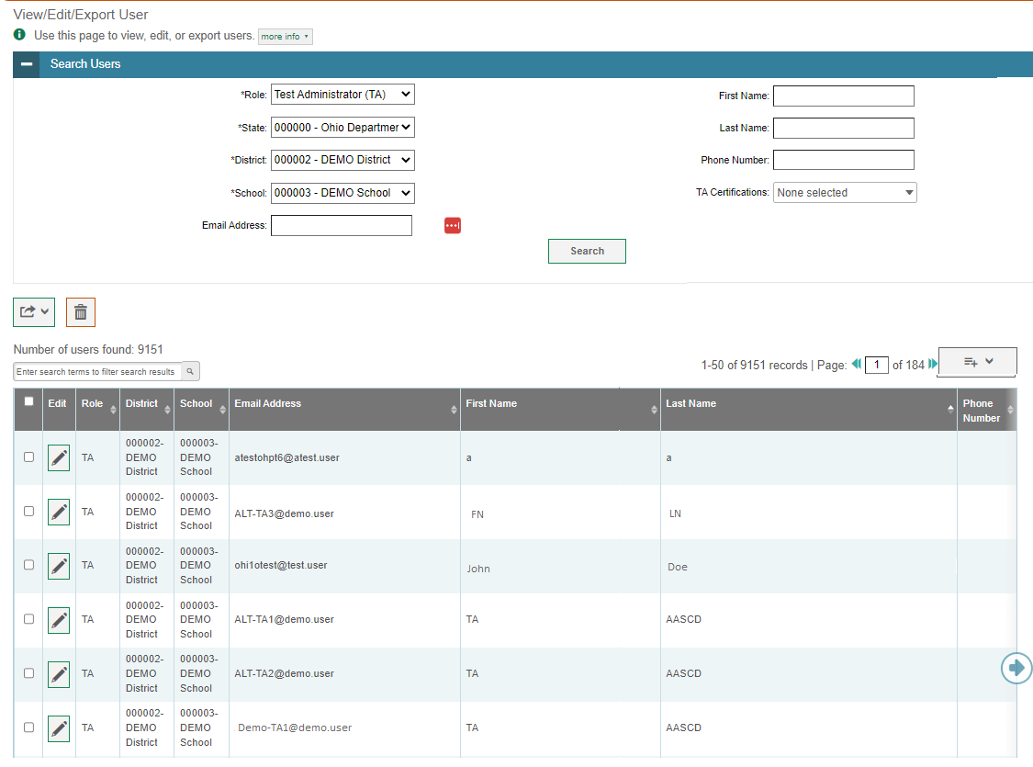
Modify Users One at a Time
Notes:
The View/Edit/Export Users page includes a form for setting selection criteria to retrieve users. In this example, the required criteria are the user’s role, state, and district. Other criteria are optional, such as the first or last name. Your particular version of TIDE may have other fields by which you can retrieve users. Click Search to continue. The search panel will automatically collapse, and your search results will appear below.
After you click Search, TIDE will display all the users satisfying the search criteria. If your user role permits, you can edit a user’s information by clicking the green pencil icon. Another page will appear for you to edit and save information.
To export user information, mark the checkboxes next to the users you wish to export and click the green export button above the search results. A pop-up window will appear with the option to export to the Inbox in either Excel or CSV format.
To delete users from TIDE, mark the checkboxes next to the users you wish to delete and click the orange trash can button above the search results.
To make the search form reappear and search for additional users, click the plus sign in the Search users panel, which appears as a blue bar.
For more-detailed information on managing users, see your TIDE User Guide.

Slide 27
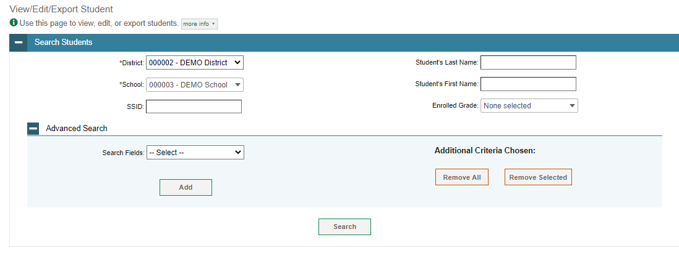
Modify Students One at a Time
Notes:
The View/Edit/Export Students page includes a form for setting selection criteria to retrieve students. Required criteria, such as the district and school in this example, are marked with asterisks. In the School drop-down list, users can begin typing in the Search field to filter results. You can enter part of or your complete school’s name or school IRN in the search field.
Other criteria are optional, such as the SSID and the student’s first or last name.
You can further refine your criteria by entering additional demographic information or test settings in the Additional Search panel.
The students you can retrieve on this page are limited by your role’s scope. For example, if you are a district-level user, you can retrieve only students enrolled within your district. If you are a school-level user, you can only retrieve students enrolled within your school.
Click Search to continue.

Slide 28
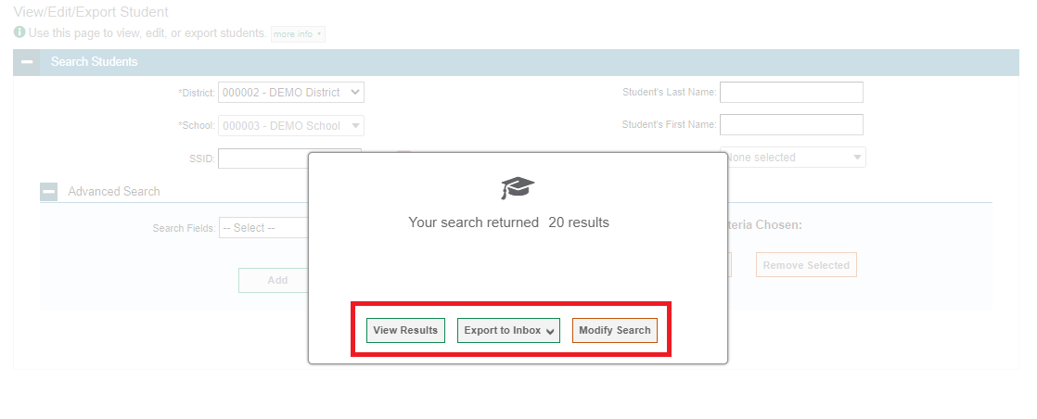
Modify Students One at a Time, continued
Notes:
After you click Search, you will see a message asking whether you would like to view the results of your search, export the list of students to your Inbox, or modify your search criteria and try again. If you choose to export the results to your Inbox, you will receive an email when the file is ready for you to download.

Slide 29
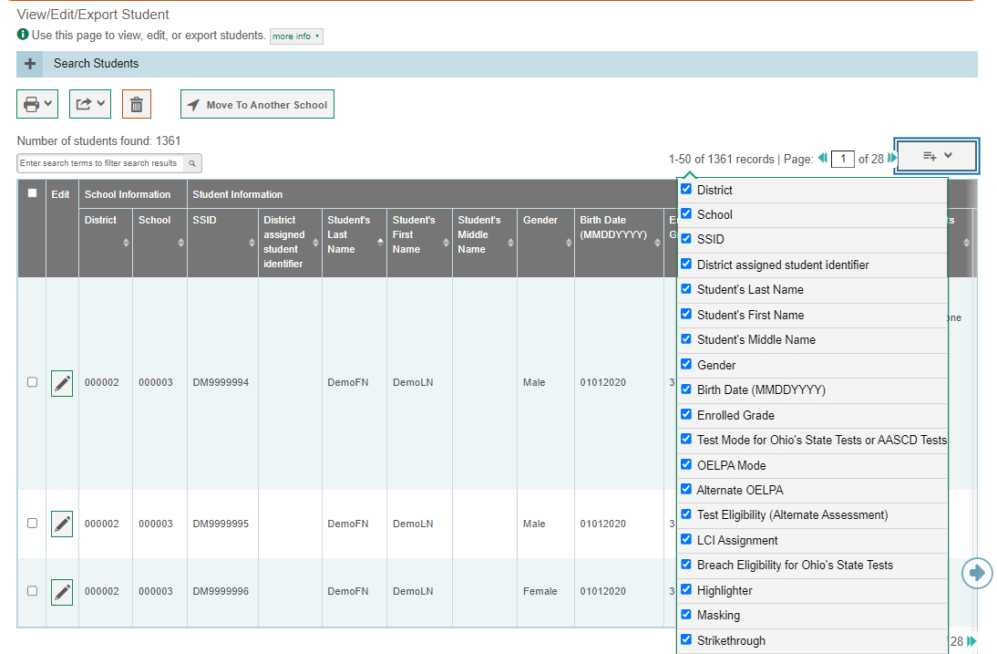
Modify Students One at a Time, continued
Notes:
When you click View Results, TIDE will display all the students satisfying the search criteria. Because not all columns can fit on the screen at once, click the blue arrow on the right side of the screen to scroll right and display more information. To add or delete columns to display, click the drop-down menu at the upper-right corner of the results. You can edit a student’s information, including test settings and accommodations and student test participation data, by clicking the green pencil icon.
You can also view a student’s test participation report and rosters to which students are active.
Print students or delete them from TIDE by selecting the desired students and clicking the Print or Delete button above the search results.
To export the results, mark the checkboxes next to the results you wish to export and click the green export button above the search results. A pop-up window will appear with the option to export to the Inbox in either Excel or CSV format.
To make the search form reappear and search for additional students, click the plus sign in the Search Students panel, which appears as a blue bar.
District-level users can also move selected students from one school to another by clicking Move to Another School.
For more-detailed information on managing students, see your TIDE User Guide.

Slide 30
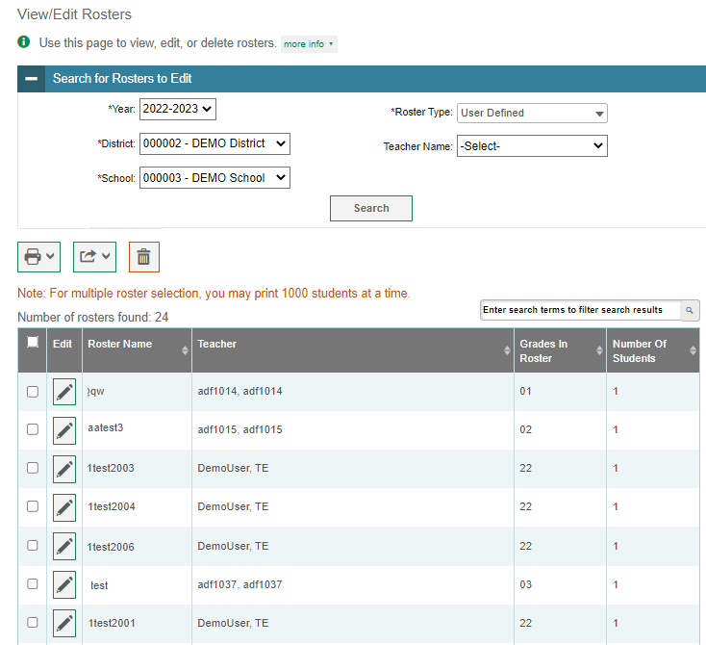
Modify Rosters One at a Time
Notes:
The View/Edit/Export Roster page includes a form for setting selection criteria to retrieve rosters. The year, district, school, and roster type criteria are required. Click Search to display a list of rosters matching your criteria.
Print, export, or delete rosters from TIDE by selecting the desired rosters and clicking the Print, Export, or Delete buttons above the search results.
Click the pencil icon next to a roster to view or edit its details. You may also view rosters to which the student is currently active.
The Edit Roster form will appear. This form is similar to the form used to add rosters, and you may edit the roster name, teacher name, and students to display in the roster in the same way that you would for a new roster.

Slide 31
Add and Modify Multiple Records at Once
Notes:
You also have the option to add and modify multiple records at once. To upload records, you must be familiar with spreadsheet applications or comma-separated value files. When you upload files to TIDE, records not previously set up will be added and records already set up in TIDE will be modified with the updated content from the upload.
Begin on the TIDE homepage. In the Preparing for Testing section, choose the task for which you want to add or modify records: users, students, or rosters. To explain the four-step upload process, we will use the Upload User function. The steps apply in the same way to Upload Students and Upload Rosters tasks.

Slide 32
Add and Modify Multiple Records at Once, continued
Notes:
An upload screen will appear where you can download a template file. Once you have downloaded and filled out the template file, return to the upload screen, select Browse, and upload your file to TIDE. Then select Next.

Slide 33
Add and Modify Multiple Records at Once, continued
Notes:
When you select Next, the upload preview screen will appear. Verify that the information is correct, then select Next.

Slide 34
Add and Modify Multiple Records at Once, continued
Notes:
TIDE will validate the file and display any errors or warnings according to the legend on the page. Click the orange error icons and blue warning icons in the validation results to view the reason that a field is invalid. If a record contains an error, that record will not be included in the upload. If a record contains a warning, that record will be uploaded, but the field with the warning will be invalid.
To complete the upload, click Continue with Upload.
To upload a different file, click Upload Revised File.
To cancel the upload, click Cancel.
If your file contains a large number of records, TIDE will process it offline and send you a confirmation email when complete. While TIDE is validating the file, do not click Cancel, as TIDE may have already started processing some of the records.
To view a file listing the validation results for the upload file, click Download Validation Report in the upper-right corner.

Slide 35
Add and Modify Multiple Records at Once, continued
4
Notes:
When the upload is complete, a Confirmation page will appear with a message that summarizes how many records were uploaded and how many were excluded. Click Upload New Files to upload additional files.

Slide 36
Students
Notes:
TIDE also manages student information and keeps track of which assessments students are eligible to take. The Students task menu allows you to add students; view, edit, or export students; upload students from an external file; and generate frequency distribution reports. We have shown you how to perform most of the tasks in the Students Task Menu. As you plan for testing it is helpful to use the Frequency Distribution Report to double check student information and test settings.

Slide 37
Frequency Distribution Reports
Notes:
A frequency distribution report pulls demographic and enrollment information based on the selected criteria.
To generate a report from the Frequency Distribution Report page, select a district and school from the drop-down lists (if available for your user role). Mark checkboxes in the Select Demographics panel to filter the report for additional demographics and accommodations, as desired.
Click Generate Report to display a frequency distribution report using the selected criteria.

Slide 38
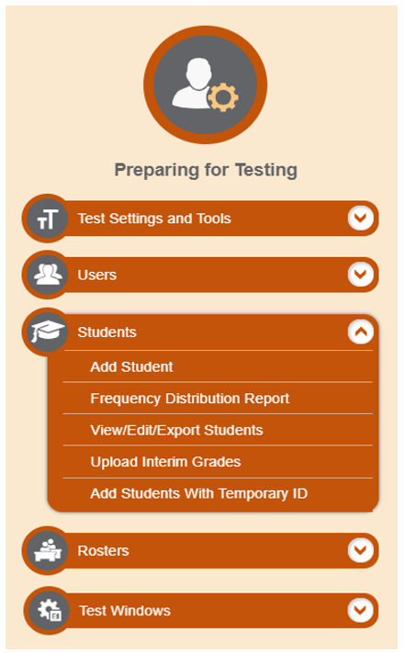
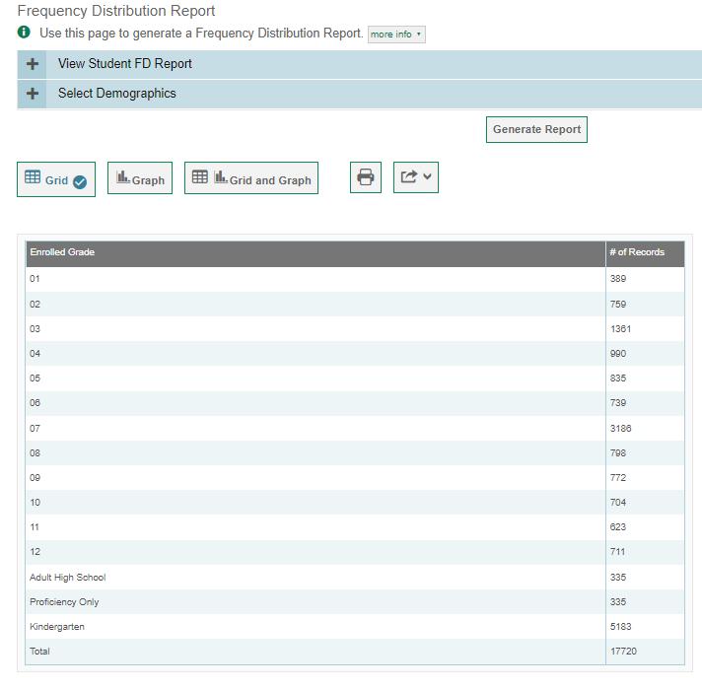
Frequency Distribution Reports, continued
Notes:
TIDE will display the frequency distribution report in grid format. This example shows a report by grade.
To display the report in tabular format, click Grid.
To display the report in graphical format, click Graph.
To display the report in both tabular and graphical format, click Grid and Graph.
To download the report as a PDF file, click the print icon and then save the file to your computer. To export the report in Excel format, click the export button located next to the print button, and choose “Export to Excel” from the drop-down menu.

Slide 39
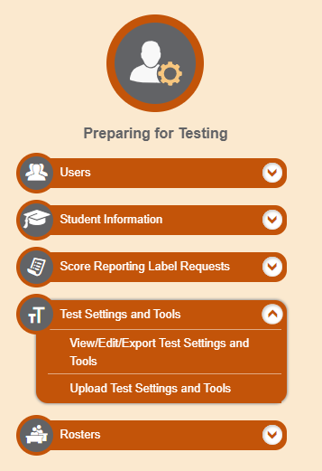
Test Settings and Tools
Notes:
TIDE keeps track of student test settings, such as font size and text-to-speech. The Test Settings and Tools task menu allows you to view, edit, export, or upload test settings and tools.

Slide 40
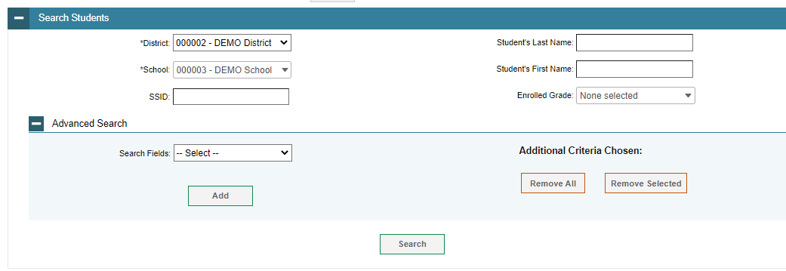
View/Edit/Export Test Settings and Tools
Notes:
The View/Edit/Export Test Settings and Tools page includes a form for setting selection criteria to retrieve a student’s test settings and tools. Required criteria, such as the district and school in this example, are marked with asterisks. Other criteria are optional, such as the SSID and the student’s first or last name.
You can further refine your criteria by entering additional demographic information or test settings in the Advanced Search panel.
The students you can retrieve on this page are limited by your role’s scope. For example, if you are a district-level user, you can retrieve settings for those students enrolled within your district. If you are a school-level user, you can retrieve settings only for those students enrolled within your school.
Click Search to continue. You will see a message asking whether you would like to view the results of your search, export the list of students to your Inbox, or modify your search criteria and try again. If you choose to export the results to your Inbox, you will receive an email when the file is ready for you to download.

Slide 41
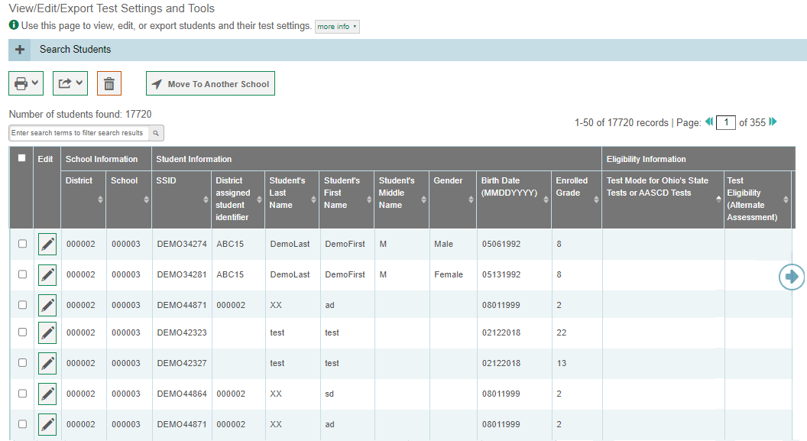
View/Edit/Export Test Settings and Tools Results
Notes:
When you click View Results, TIDE will display all the students satisfying the search criteria. If all columns cannot fit on the screen at once, click the blue arrow on the right side of the screen to scroll right and display more information. You can edit a student’s test settings and accommodations by clicking the green pencil icon.
To make the search form reappear and search for additional students, click the plus sign in the Search for Test Settings and Tools to Edit panel, which appears as a blue bar. For more-detailed information on managing student test settings and tools, see the Ohio TIDE User Guide which can be found on the test portal.

Slide 42
View/Edit/Export Test Settings and Tools Results, continued
Notes:
Print or export student information or delete students from TIDE by selecting the desired students and clicking the Print, Export, or Delete buttons above the search results.
To export the results, mark the checkboxes next to the results you wish to export and click the green export button above the search results. A pop-up window will appear with the option to export to the Inbox in either Excel or CSV format.
District-level users can also move selected students from one school to another by clicking Move to Other School.

Slide 43
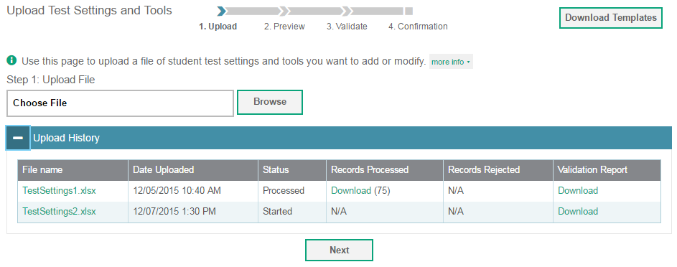
Upload Test Settings and Tools
Notes:
A second way to edit test settings and tools in TIDE is to use the Upload Test Settings and Tools page to compose an upload file in Excel or CSV format and then upload that file. This task is performed by following the same steps you would use to upload new users and students.

Slide 44
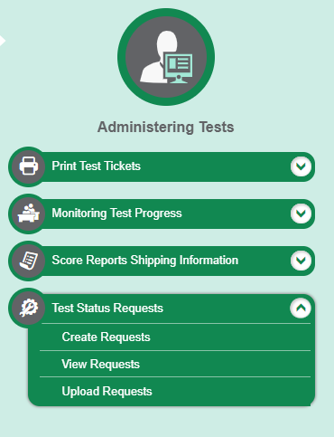
Test Status Requests
Notes:
In the Administering Tests section of the TIDE dashboard, the Test Status Request (TSR) task menu allows you to view pending TSRs; create new TSRs; view, approve, or export TSRs; and upload TSRs.
In the normal flow of a test opportunity, a student takes the test in the test delivery system (TDS) and then submits it. Next TDS forwards the test for scoring, and the Reporting System reports the test scores.
TSRs are a way of interrupting this normal flow. Reasons for TSRs can vary. For example, a student may need to retake a test or have another test opportunity. A test administrator may need to invalidate a test because of a hardware malfunction.

Slide 45
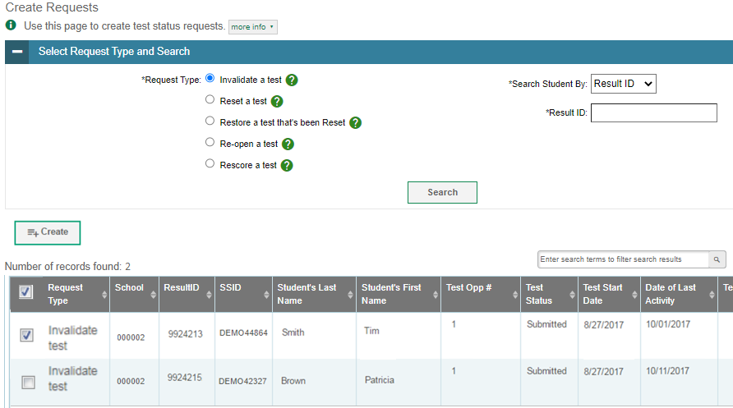
Create Test Status Requests
Notes:
The Create Test Status Requests (TSRs) page is where you can create a TSR for a test.
The first step is to select the type of TSR you want to create. The TIDE User Guide lists the available TSR types and explains the implications of each.
Next, search for the test result for which you wish to create TSR. From the drop-down lists and in the text field, enter your search criteria and click Search. TIDE will display the search results below.
Mark the checkbox next to each test result for which you wish to create a TSR and click Create. A pop-up window will ask you to enter a reason for the TSR. To create the TSR, enter a reason and click Submit.

Slide 46
Status of Appeals
Test Status Request (TSR) Status | Description of Status
Error Occurred | An error occurred while the TSR was being processed.
Item Information Sent | Information regarding a Report Problem with Item TSR was sent to the designated recipients.
Pending Approval | TSR is pending approval.
Processed | TSR was successfully processed and the test opportunity has been updated.
Rejected | Another user rejected the TSR.
Rejected by System | Test delivery system was unable to process the TSR.
Requires Resubmission | TSR must be resubmitted.
Retracted | Originator retracted the TSR.
Submitted for Processing | TSR submitted to test delivery system for processing.
Notes:
After a TSR is created, its status can change throughout its life cycle. This table describes the possible statuses a request can have.

Slide 47
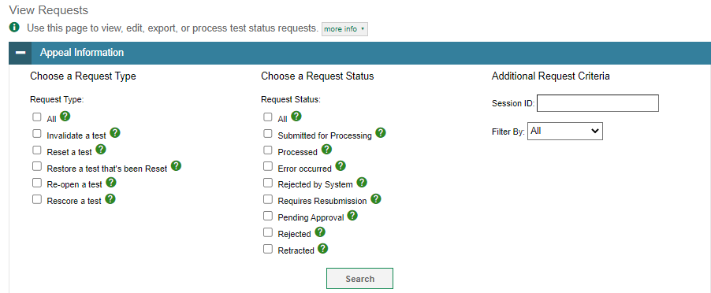
View/Approve/Export Appeals
Notes:
You can review submitted TSRs from the View Requests page. Select a request type and status and enter additional search criteria as desired. Click Search to display requests matching your criteria.
To quickly display all pending requests, click Pending Requests in the task menu. This shortcut lets you skip the selection of search criteria.

Slide 48
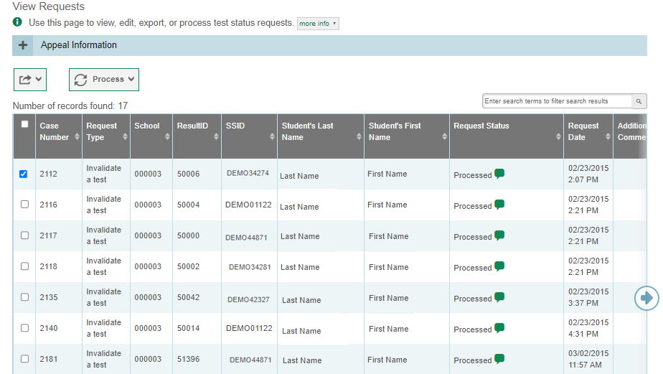
View/Approve/Export Appeals Results
Notes:
When you click Search, the search panel will automatically collapse, and your search results will appear below.
To view the approval and processing status of a TSR, click the green comment icon in the Request Status column.
To approve, reject, retract, or resubmit a TSR, mark the checkbox next to it, click Process, and then select the action you wish to perform.
To export the results, mark the checkboxes next to the results you wish to export and click the green export button above the search results. A pop-up window will appear with the option to export to the Inbox in either Excel or CSV format.
Approving a TSR will update the test opportunities and results accordingly. Rejecting a TSR will continue the processing of test results as if the TSR had never been submitted.

Slide 49
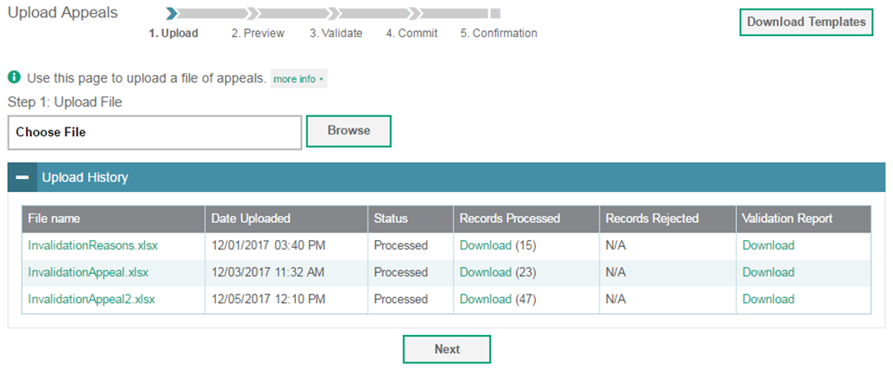
Upload Appeals
Notes:
A second way to create new TSRs in TIDE is to use the Upload Test Status Requests page to compose an upload file in Excel or CSV format and then upload that file. This task is performed by following the same steps used to upload new users and students.

Slide 50
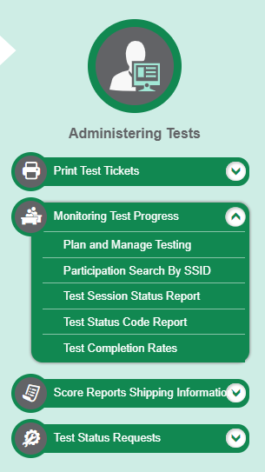
Monitoring Test Progress
Notes:
The tasks available in the Monitoring Test Progress task menu allow you to generate various reports that provide information about a test administration's progress. Note that some reports are not available in real time.
Several types of participation reports are available:
The Plan and Manage Testing report details all of a student’s test opportunities and the status of those test opportunities.
The Participation Search by SSID report shows test participation for specified students.
The Test Session Status Report shows active and inactive test sessions happening in their district.
The Test Status Code Report displays the status for all tests for which a student is eligible.
The Test Completion Rates report summarizes the number and percentage of students who have started or completed a test.

Slide 51
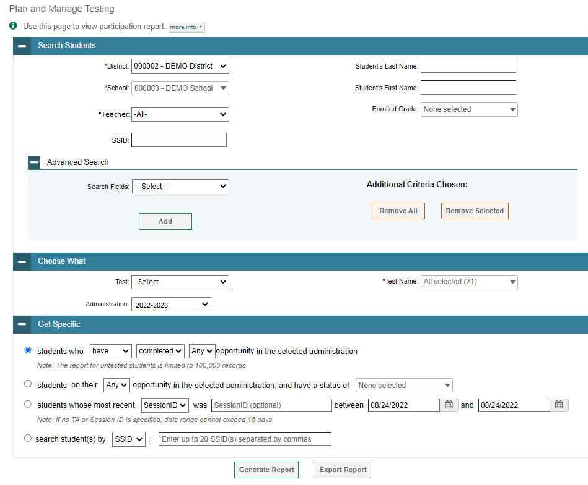
Plan and Manage Testing
Notes:
The Plan and Manage Testing reports detail all of a student’s test opportunities and the status of each test opportunity. Because the report lists testing opportunities, a student can appear more than once on the report.
To generate a report from the Plan and Manage Testing page, in the Search Students panel, select a district, school, and teacher if applicable. The fields marked with an asterisk are mandatory. You can refine your search by adding additional criteria under the Advanced Search section.
Next, select a test instrument and administration in the Choose What panel.
Finally, in the Get Specific panel, choose one of the filter options available and select parameters for that option.
Click Generate Report to view your Plan and Manage Testing report, or click Export Report to open the report in Excel.

Slide 52
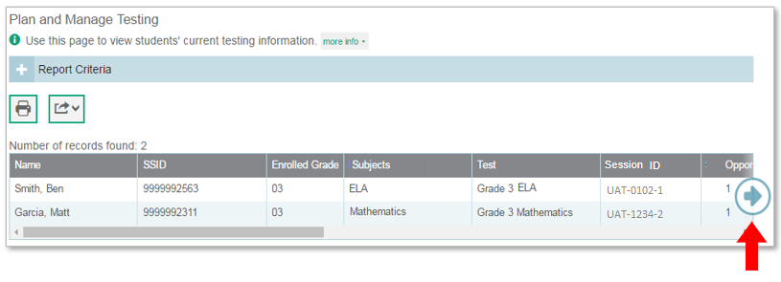
Plan and Manage Testing Results
Notes:
Clicking Generate Report will display the report and collapse the Report Criteria panel. Because not all columns can fit on the screen at once, click the blue arrow on the right side of the screen to scroll right and display more information.

Slide 53
Plan and Manage Testing Examples
Which students have not yet tested?
Which students have paused tests?
Did all students in a test session submit their tests?
Notes:
This slide illustrates some common questions that can be answered using the options available in the Manage Testing Test Filter Report panel.
To find students who have not yet tested, select the first radio button and search for students who have not completed their test opportunity in the selected administration.
To find students who have paused tests, select the third radio button and search for students on their first test opportunity in the selected administration with a status of paused.
To find out if all students in a test session submitted their tests, select the fourth radio button and search for students by test session ID between the dates when the test session took place.

Slide 54
Test Session Status Report
Notes:
The Test Session Status Report details active and inactive test sessions happening in their district and/or school. These reports show how many students in each school are testing and how many have started, paused, and completed their tests. School-level Test Session Status reports also include additional information such as proctor name, test name, and test session start time.
From the Test Session Status Report page, select a district and school from the drop-down lists. Then click Generate Report. A detailed report page will appear.
Note that if multiple schools were selected, a Summary Report page will first appear. From this page, select a school name to view a detailed report for that school.

Slide 55
Test Completion Rates
Notes:
The Test Completion Rates report summarizes the number and percentage of students who have started or completed a test.
To download a report from the Test Completion Rates page, choose the type of report you wish to export from the Report Types drop-down list. Select a district and school from the corresponding drop-down lists, if available (for your user role). Finally, select a test name and administration. Note that fields marked with an asterisk are mandatory.
To download the report as an Excel spreadsheet, click Export Report.

Slide 56
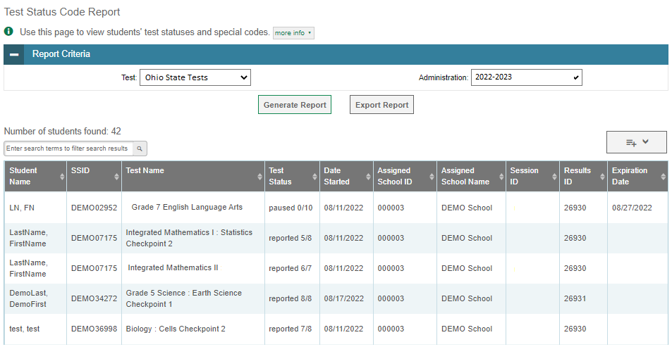
Test Status Code Report
Notes:
The Test Status Code Report is a tool districts use to get the statuses of all students in their district. This report displays all the statuses of all tests for which a student is eligible.
To download this report, go to the Test Status Code Report page and select a test and an administration from the dropdowns available. Then click Generate Report. For a description of the columns in this report, see the tale “Columns in the Test Status Code Report” in the appendix of the TIDE User Guide on the test portal.

Slide 57
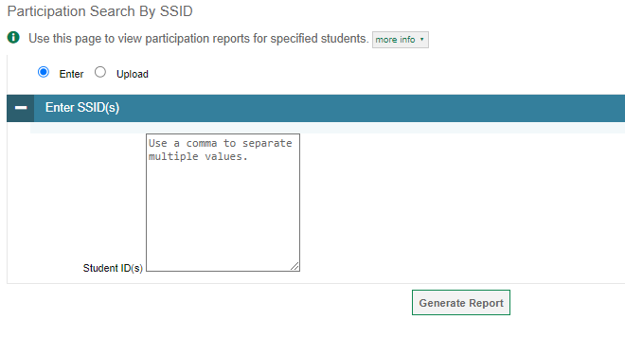
Participation Search By SSID
Notes:
The Participation Search By SSID page allows you to generate participation reports for specified students. Enter a single SSID or multiple SSIDs separated by commas in the Student ID(s) box. You can also upload a single-row Excel file containing student ID numbers. Click Generate Report to view the results.

Slide 58
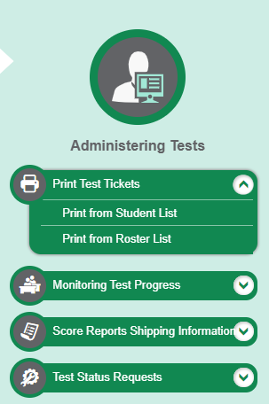
Print Test Tickets
Notes:
A test ticket is a printed form that includes a student’s login information to start taking a test. You can print test tickets from a student list or from a previously uploaded roster.

Slide 59
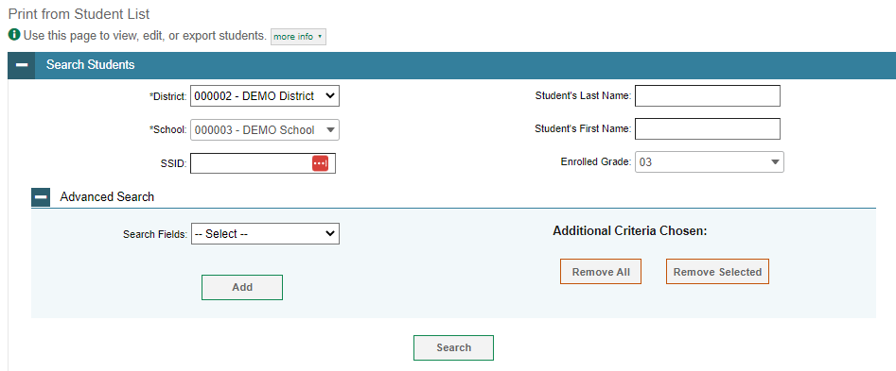
Print Test Tickets from a Student List
Notes:
To print test tickets from a student list, select Print from Student List from the Print Test Tickets task menu. Complete the fields under the Search Students panel. The fields marked with an asterisk are mandatory. To further refine your search results, select additional search fields in the Advanced Search panel. Click Search to view your results.

Slide 60
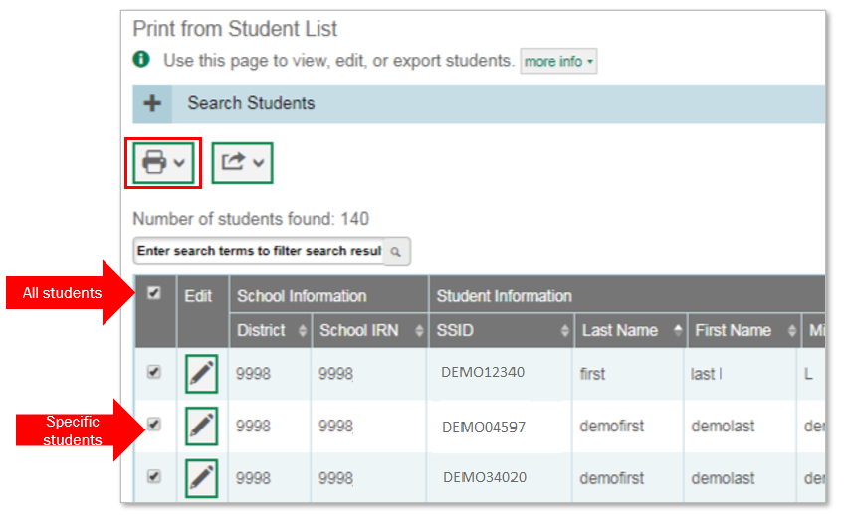
Print Test Tickets from a Student List, continued
Notes:
Next, select the students for whom you want to print test tickets. To print test tickets for specific students, mark the checkboxes for the students you want to print. To print for all students on the page, mark the checkbox at the top of the table. To print for all retrieved students, no additional action is necessary. This option is available by default.
Click the printer icon and select an option from the drop-down menu. A test-ticket layout screen will appear. Choose a test-ticket layout and the test tickets print option. When you click Print, a PDF file of the test tickets will be downloaded.

Slide 61
Print Test Tickets from a Roster List
Notes:
To print test tickets from a roster list, select Print from Roster List from the Print Test Tickets task menu. Complete the fields under the Search for Rosters to Edit panel. The fields marked with an asterisk are mandatory. Click Search to display your results.

Slide 62
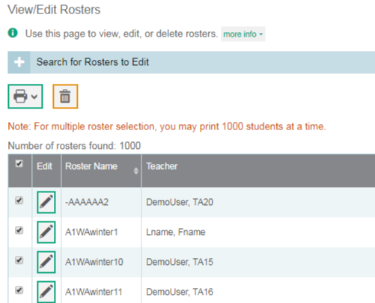
Print Test Tickets from a Roster List, continued
All rosters
Specific rosters
Notes:
Next, select the roster for which you want to print test tickets. To print test tickets for specific rosters, mark the checkboxes for the rosters you want to print. To print for all rosters on the page, mark the checkbox at the top of the table.
Click the printer icon and select the Test Tickets option from the drop-down menu. A test-ticket layout screen will appear. Choose a test-ticket layout and print option and click Print. A PDF file of the test tickets will be downloaded.

Slide 63
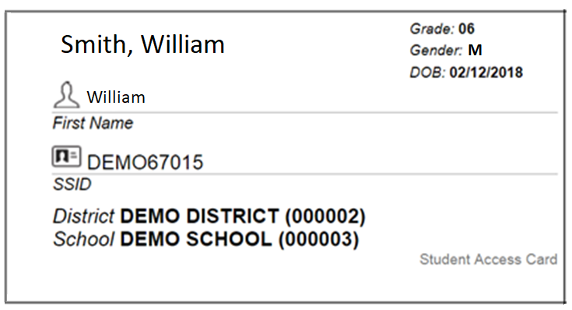
Sample Student Test Ticket
Notes:
Here’s a sample image of what a student test ticket looks like.

Slide 64
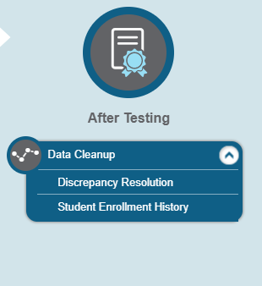
Data Cleanup
Notes:
In the After Testing section of the TIDE dashboard, the Data Cleanup task menu lets users resolve test discrepancies and correct student enrollment information.

Slide 65
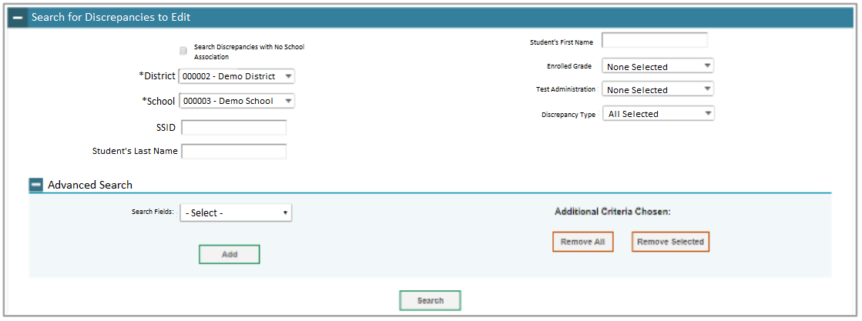
Discrepancy Resolution
Notes:
Complete the fields under the Search for Rosters to Edit panel. The fields marked with an asterisk are mandatory. Click Search to display your results.

Slide 66
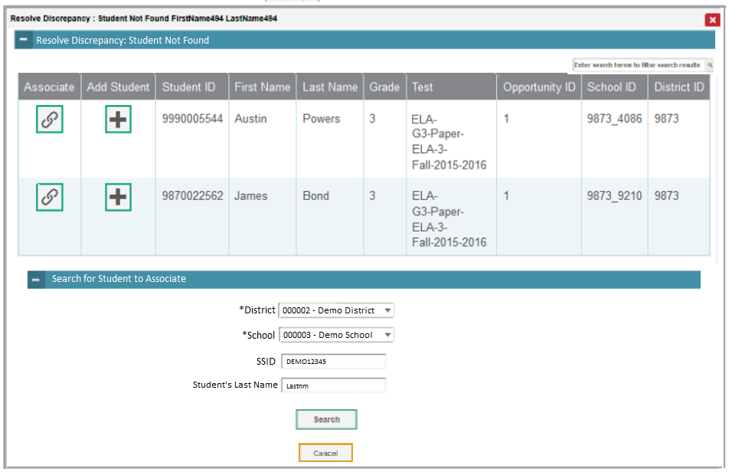
Discrepancy Resolution
Notes:
You can resolve a student-not-found discrepancy in two ways:
Associate – enables you to associate the test with an existing student
Add Student – enables you to add or edit information for the student with whom the test should be associated in TIDE
If the student with whom you want to associate the test exists in TIDE, select in the Associate column. The Search for Students to Associate panel appears. Select the District and School and enter search criteria for the other optional fields, if desired, to retrieve an existing student.

Slide 67
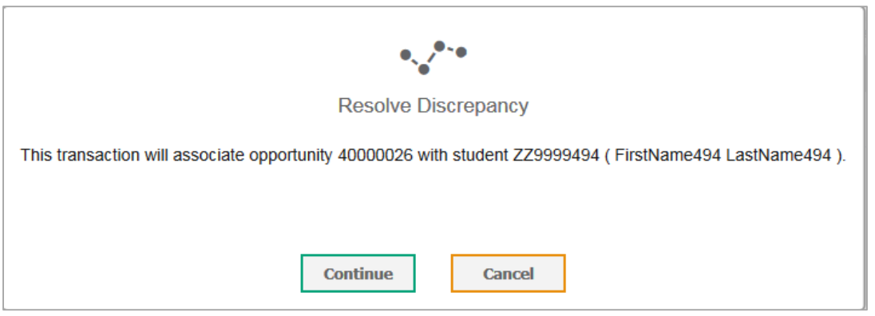
Discrepancy Resolution
Notes:
In the list of retrieved students, select the link symbol for the student with whom you want to associate the test. To continue with the association, select Continue in the Confirmation pop-up window. An affirmation message appears to inform you that the test has been associated with the student and the discrepancy has been successfully resolved.

Slide 68
Contact the Ohio Help Desk
You can contact the Ohio Help Desk for assistance with any technical issues you encounter.
When contacting the Ohio Help Desk, please be ready to provide the following information:
Any error messages that are appearing (including codes)
Your operating system and browser information
Your network configuration information
Your contact information for follow-up by telephone or email
Any other relevant information, such as test names or content areas, SSIDs, session IDs, and search criteria
For test administration or policy issues, please contact your District Test Coordinator.
Notes:
You can find the TIDE User Guide and other helpful resources on the Ohio test portal. However, if you still require assistance with troubleshooting a technical issue, you may also contact the Ohio Help Desk. When contacting the Ohio Help Desk, please be ready to provide the following information:
Any error messages that are appearing (including codes)
Your operating system and browser information
Your network configuration information
Your contact information for follow-up by telephone or email
Any other relevant information, such as test names or content areas, student IDs, session IDs, and search criteria
For questions about test administration or policy issues, please contact your District Test Coordinator.

Slide 69
Thank You!
Further Information
Ohio Portal:
https://oh.portal.cambiumast.com/
Ohio Help Desk
1-877-231-7809
ohhelpdesk@cambiumassessment.com
Notes:
Thank you for taking the time to view this training module. For additional information, refer to your TIDE User Guide located on your portal or contact the Help Desk.

