Slide 1
How to handscore unscored items and modify machine scores
reporting system series #12
Copyright © 2021 Cambium Assessment, Inc. All rights reserved.
Notes:
Welcome to training module #12 in the Reporting System series, How to Handscore Unscored Items and Modify Machine Scores. Some items, such as writing responses, require handscoring for data to appear.
You can also modify scored items that arrive in the Reporting System with machine-generated scores. This training shows you how to complete both tasks.

Slide 2
Objectives
How to Access Tests that Need Handscoring
How to Use the Scoring Mode Window and Item View Window
Review Rubric and Resources for an Item
How to Assign Points Earned and Condition Codes
How to Modify Scores
Notes:
First, we show you the notification you receive when you have tests awaiting handscoring. Then we take you through the process of using the item-view window to review the rubric and resources for an item and assign points and condition codes to it. Finally, we show you how to modify machine-scored items, especially those with a low-confidence warning.

Slide 3
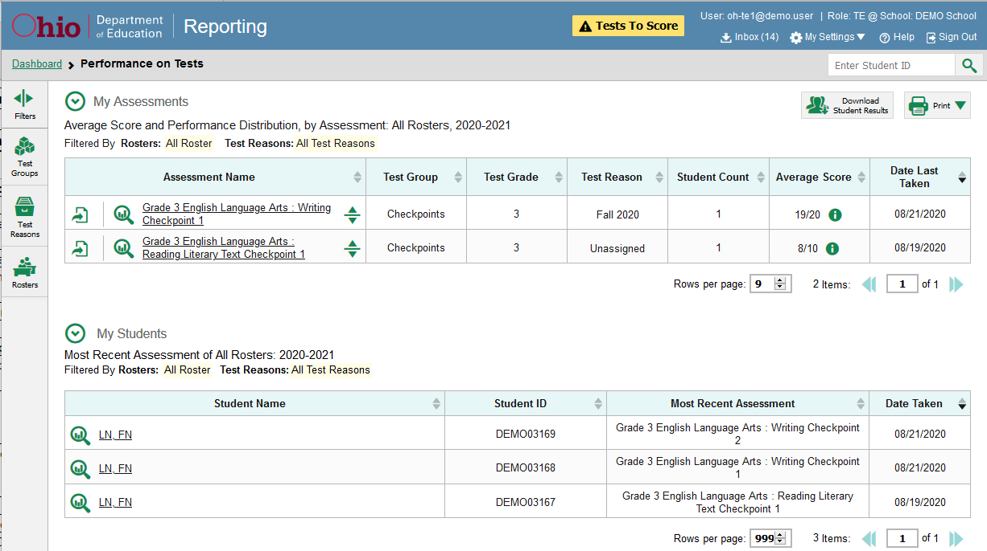
How to Access Tests that Need Handscoring
3
Notes:
The Centralized Reporting System allows authorized users to score certain items on benchmark, checkpoint and released item tests.
Some items that require hand scoring arrive in the Reporting System without any scores. For example, some writing essay items on the checkpoint tests require hand scoring. If a test contains unscored items, its performance data is excluded from your reports until an authorized user scores all the unscored items of that test.
Other items arrive in the system with automated scores generated by the machine scoring system, which authorized users can override if necessary. For example, all writing items on benchmark test have machine-generated scores that can be overridden.
When you have tests awaiting item scoring, a Tests to Score notification appears in the banner.
To enter scores for unscored items, click the Tests to Score notification. The Scoring Mode window opens and displays a list of tests with unscored items. Click the magnifying glass icon next to the name of the test you wish to score.

Slide 4
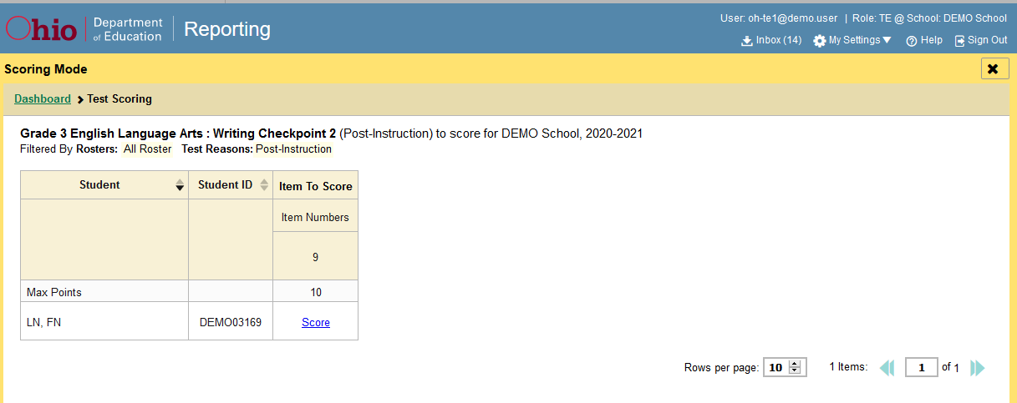
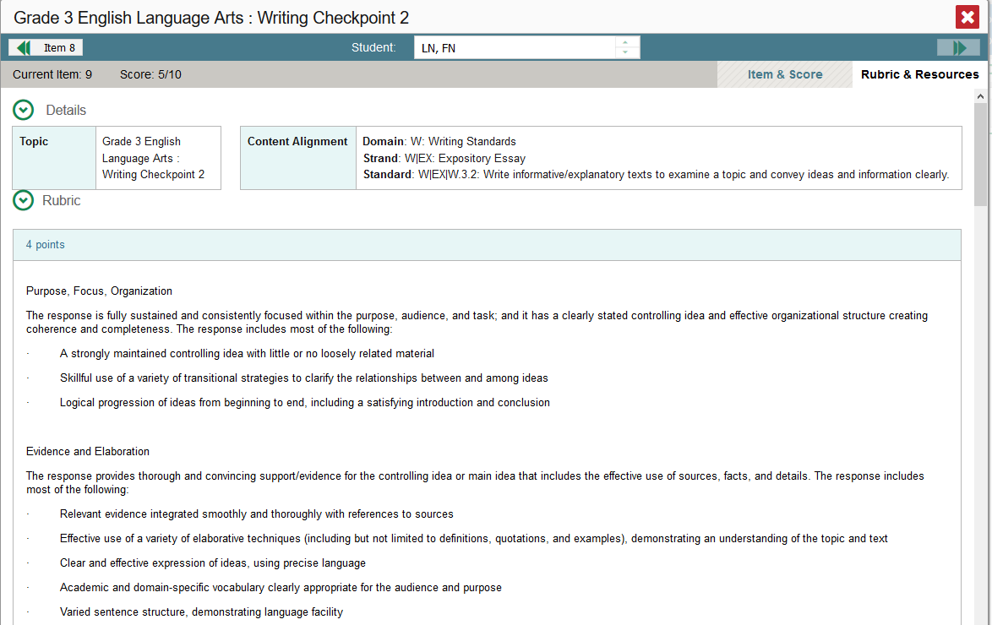
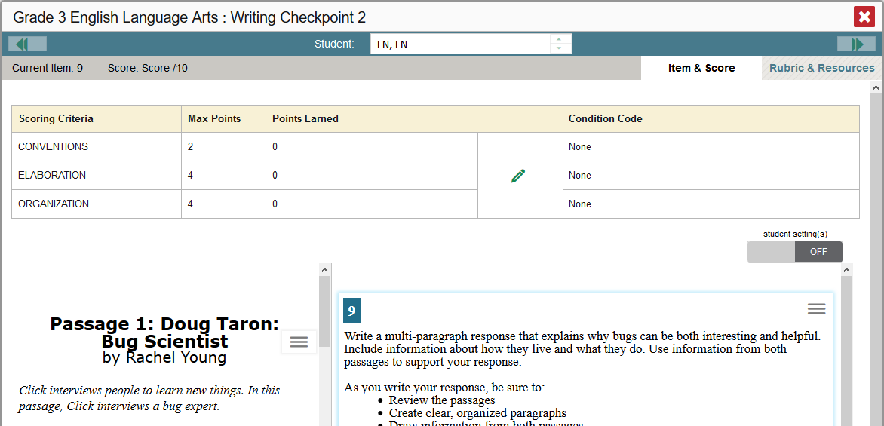
Scoring Mode Window and Item-View Window
4
Notes:
The Scoring Mode window now displays a list of students and items awaiting scoring for the selected test. To enter scores for an item, click the score link for the item in the student’s row. The Item View window opens.
You can review the item rubric and available resources on the Rubric & Resources tab. On the Item & Score tab, review the student’s entered response for scoring. Click the pencil icon to display the points earned options and condition codes.

Slide 5
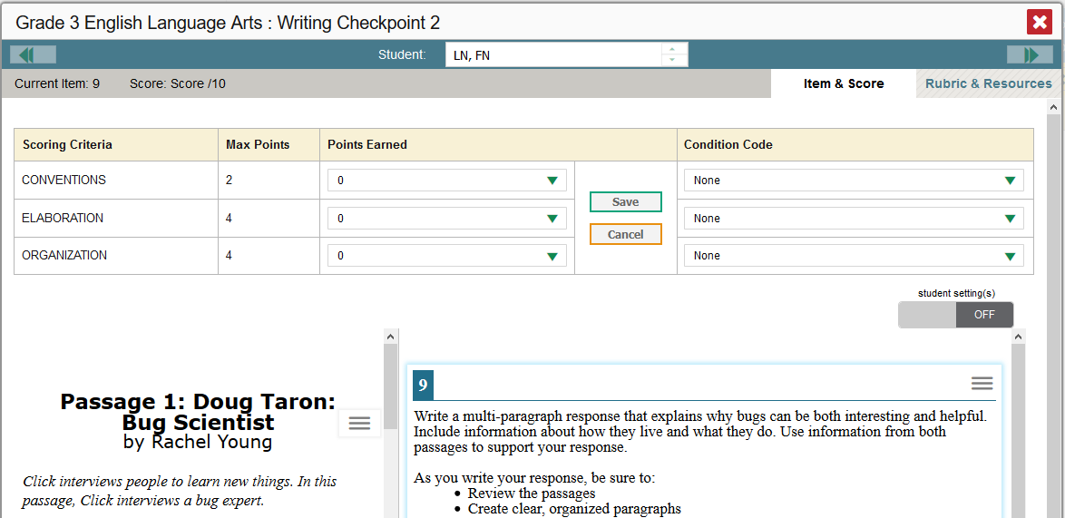
Assign Points Earned and Condition Codes
5
Notes:
In the Item & Score tab, click the pencil icon in the table at the top of the window.
The item view window updates with drop-down menus for Points Earned and for Condition Codes. Review the student’s entered response for scoring.
To enter a score for the response, select or type a numerical score in the Points Earned drop-down menu and click Save.
If you need to assign a condition code to the response, select the appropriate option from the Condition Code drop-down list. Condition codes include instances such as blank, off topic, foreign language or unreadable.
You can continue scoring unscored items in the Item Preview Window.
To view another unscored item for the same student, use the previous/next arrows on the left and right sides of the Item View banner.
To view the same unscored item for another student, use the up/down arrows in the Student field box in the center of the banner to switch between students.
After you enter scores for all the unscored opportunities of a test, that test is removed from the Scoring Mode window. However, you can still modify the item scores on that test directly from the reports by following the procedure for modifying scores. We explain this process on the next several slides.

Slide 6
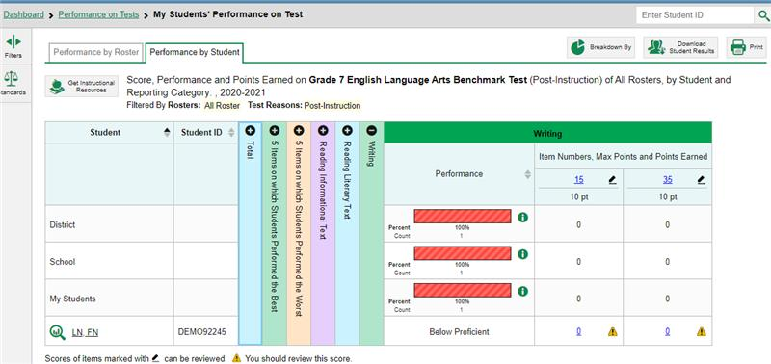
Modify Scores
6
Notes:
Users can modify scores for the writing essay items. Reports display a pencil icon in the column headers for each item with editable scores. When a machine-generated score has a low confidence level, or when a condition code of Non-Specific or Uninterpretable Language has been assigned by machine, a warning sign displays next to the score. It is highly recommended that you review items flagged with this icon.
Click the item score link in the student’s row of the report. The Item View window opens.

Slide 7
Modify Scores in Item & Score Tab
Notes:
Click the pencil icon in the Scoring Criteria table.
To enter a score for the response, select a numerical score from the Points Earned drop-down list. If the item consists of multiple scoring criteria, select a numerical score from the score drop-down list for all scoring criteria. To save the score, click Save. When you close the item view window, any average scores or performance distributions on the assessment report update automatically.
Users can choose to assign a Condition Code in lieu of selecting the number of points earned.

Slide 8
Condition Codes
Condition Code | Source of Code | Description
Insufficient Text (Repetitive Text) | Machine | The response is substantially comprised of repeated text copied over and over.
Blank | Machine | The student did not enter a response.
Non Specific* | Machine | This condition code is assigned to machine-scored responses when TDS identifies that the response requires a condition code but cannot determine which specific condition code it requires. Resolution is required.
Insufficient Text (Too Few Words) | Machine | The response contains too few words to be deemed adequate to be scored.
Non-Scorable Language (Uninterpretable Language)* | Machine | This condition code is assigned to machine-scored responses when TDS identifies that the response contains primarily atypical or unusual words and is unable to assign a score. Resolution is required.
Insufficient Text (Insufficient Original Text) | Machine | The response is composed of a significant amount of text copied directly from the prompt and/or reading passage, with little to no original writing from the student.
Off Topic | Human | Student writes to a subject that is unrelated to the prompt.
Foreign Language | Human | The response is written in a language other than English.
Unreadable | Human | The response is unreadable. For example, an online response is unreadable if it only contains repeated/random keystrokes (e.g., “yyyyyyyyyyy”; “av:aeoiahvb;e”; “hhrrttuuvv”).
Blank | Human | The student did not enter a response.
Notes:
Here is a list of condition codes that are available for the Benchmark and checkpoints tests. As you can see from the table, some of the condition codes are assigned by machine and other condition codes are assigned by human. As mentioned before, when a condition code of Non-Specific or Uninterpretable Language has been assigned by machine, it is highly recommended that you review items flagged with this icon.

Slide 9
The Reporting System Series
1. How to Navigate the Dashboard and Access Your Summative Results
2. How to Understand Measures for Writing Dimensions
3. How to Understand a Demographic Breakdown Report and a Student Portfolio Report
4. How to Drill Down into Your Results by Selecting Specific Tests & Classes
5. How to Drill Down into Your Results by Selecting Previous School Years & Previous Students
6. How to Track Student Performance Over Time Using the Longitudinal Report
7. How to Generate Individual Student Reports (ISR) and Student Data Files
8. How to Print and Export Data You Can See in Your Reports
9. How to Use the Roster Manager to Add, Modify and Upload Rosters
10. How to Analyze a Basic Non-summative Test Report
11. How to Use the Advanced Features of Reporting to View Non-summative Data
12. How to Hand-Score Unscored Items and Modify Machine Scores
Non-summative Assessments Only
Notes:
Thank you for viewing this module on how to handscore unscored items and modify machine scores. More modules are posted on the test portal.

Slide 10
More Help
Further Information: Reporting System User Guide, 2021-2022
https://oh.portal.cambiumast.com/
Email OHHelpdesk@cambiumassessment.com or call 1-877-231-7809
Notes:
For detailed information, consult the Reporting System User Guide, 2021-2022, located on the test portal, or contact the Ohio Help Desk.

