Slide 1
How to Use the Advanced Features of the Reporting System to View your non-summative Data
Reporting system series #11
Copyright © 2021 Cambium Assessment, Inc. All rights reserved.
Notes:
Welcome to training module #11 in the Reporting System series, How to Use the Advanced Features of the Reporting System to View Your Non-Summative Data. In this module we show you some advanced features of non-summative assessment reports.

Slide 2
Objectives
Filter Item-Level Reports by Standard
Assign Test Reasons (Categories) to Interim Test Opportunities
Filter the Dashboard or the Performance on Tests Report by Test Reason
2
Notes:
Our objectives in the training are as follows:
Explain how to filter item-level reports by standards (You can filter either by a group of standards or by a single standard.)
Teach you how to use test reasons to make sense of your data (You can assign a test reason to an interim or benchmark test opportunity, and you can then filter to show only test opportunities with a particular test reason.)

Slide 3
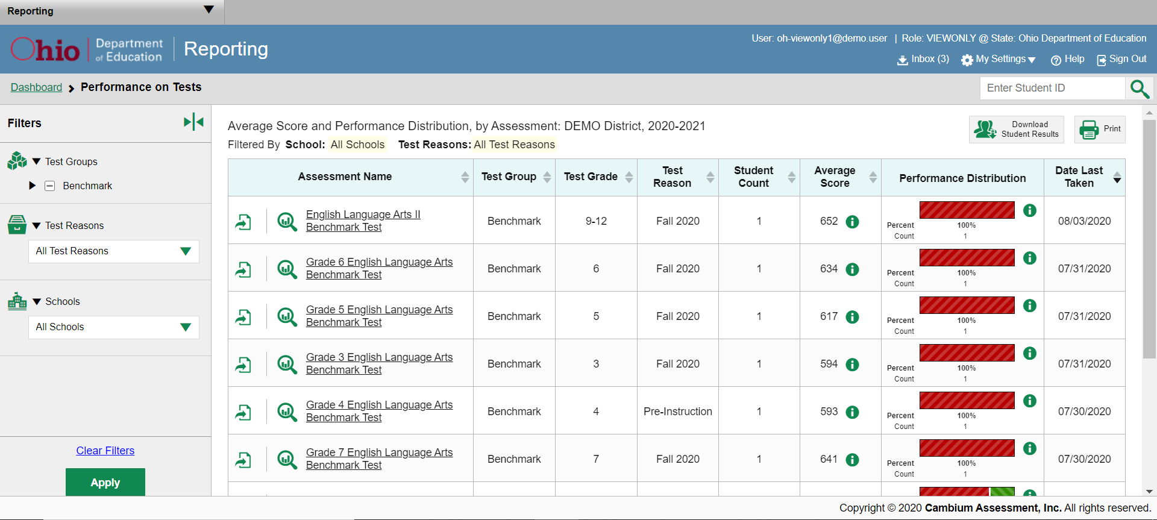
Test Reasons
3
Notes:
Test reasons are categories used to classify test opportunities for reporting purposes. They commonly indicate the timeframe in which a test was taken, like “2021-2022” or “Pre-Instruction” or “Post-Instruction”, and they’re a good way to organize benchmark, checkpoint and released item tests into groups. For example, you might want to categorize students’ assessments into “Pre-Instruction” to use as a baseline the class’s strengths and weaknesses at the beginning of the year. For those same students, you might want to categorize their tests as “Post-Instruction” to see whether students understand the concepts that are being taught right after receiving the relevant instruction.
Test reasons should ideally be assigned in the Test Administration Site at the time of testing. However, you can use the Test Reason Manager in the Reporting System to assign a different test reason to a benchmark or checkpoints test opportunity after the test is completed.
On the next slide we show you the first step to assigning a new test reason.

Slide 4
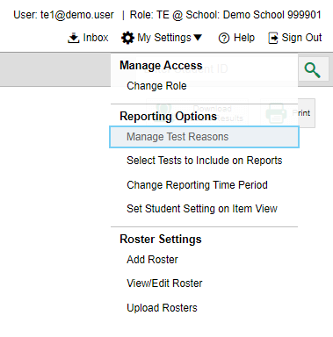
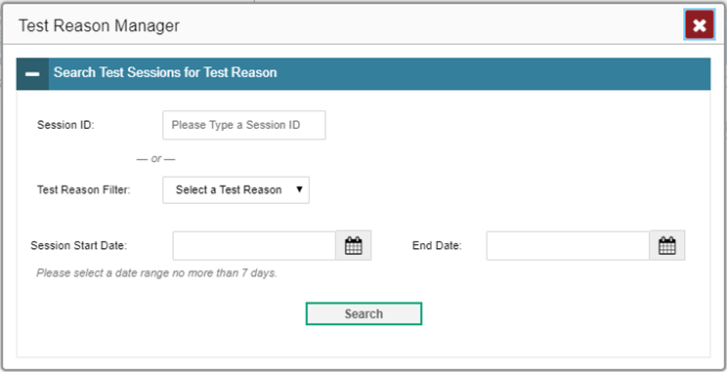
Assign Test Reasons
4
Notes:
From the My Settings drop-down menu in the banner, select Manage Test Reasons. The Test Reason Manager window opens.
To search for test opportunities to categorize, do either of the following:
In the Session ID field, enter the session ID in which the opportunities were completed in the Test Delivery System (TDS).
Or select a test reason associated with the opportunities you want to edit.
Then select a range of dates during which the test session was administered. The range cannot exceed seven days. Finally, click Search.

Slide 5
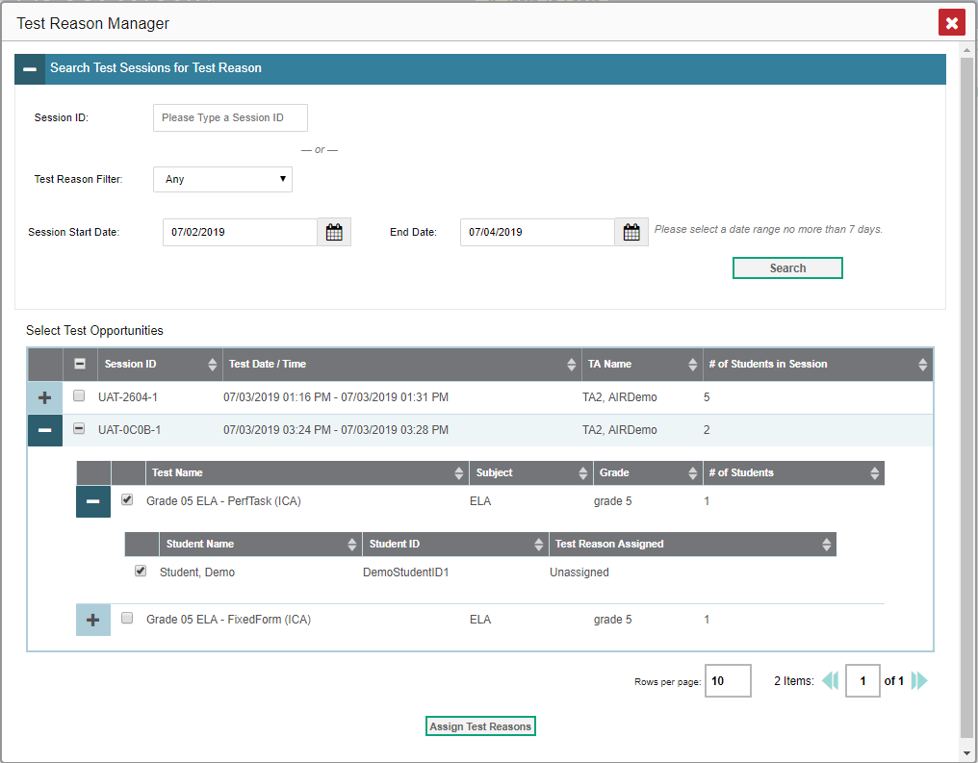
Assign Test Reasons (continued)
5
Notes:
A list of retrieved test sessions appears in the section Select Test Opportunities.
Click the plus sign buttons to expand the list of tests in each session and, under a test, the list of students who took that test in that session. Mark the checkboxes for each session, test, or opportunity that requires a test reason.
Click Assign Test Reasons.
In the confirmation window, select a new test reason to assign to the selected opportunities and click Confirm.
Assigning or reassigning test reasons will make the filter by test reason option more useful. We explain why on the next slide.

Slide 6
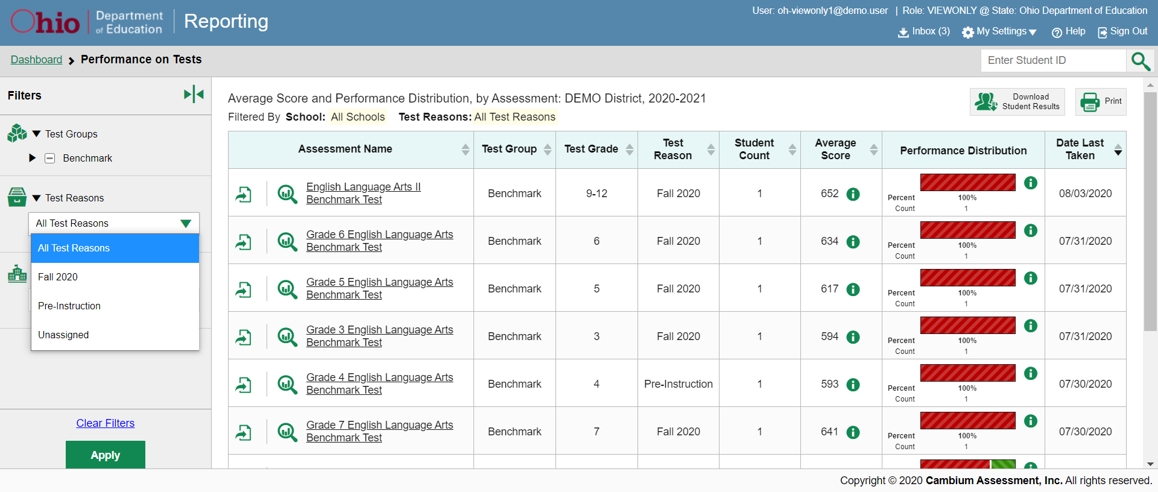
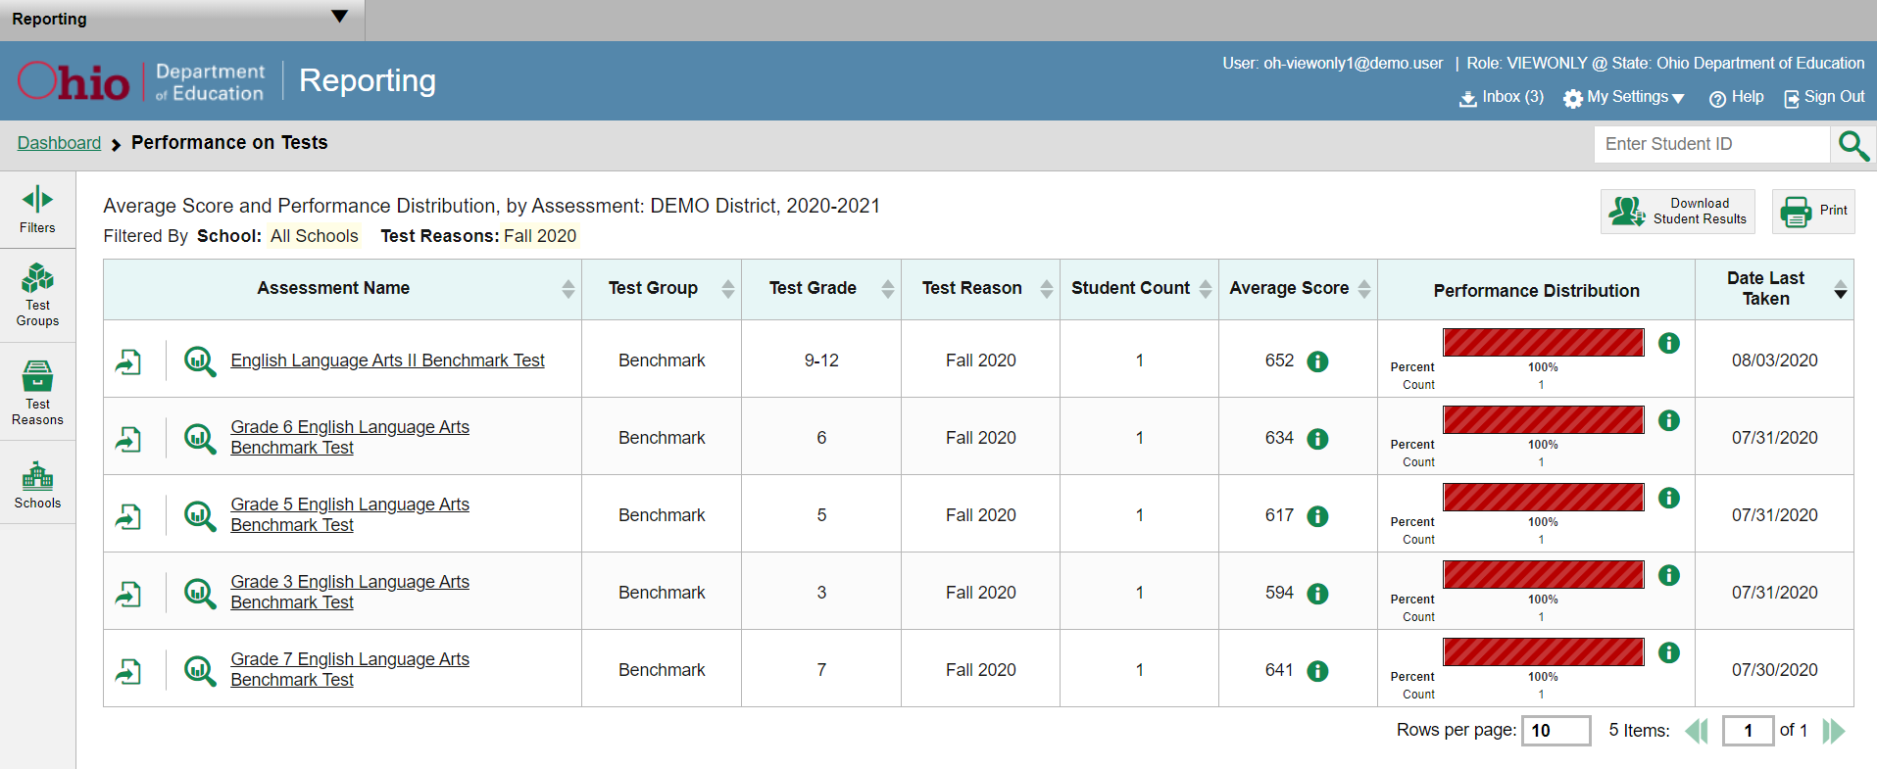
Filter by Test Reason
6
Notes:
When your test opportunities have test reasons, you can filter reports by a single test reason.
For example, you may want to filter by Pre-instruction and look at ELA performance, then filter by Post-instruction and see if students have improved on ELA material. If you don’t filter, you’ll see data for all different test reasons. Filtering allows you to view a single test reason instead of multiple test reasons side by side. You may find reports easier to understand when you’re viewing only a single test reason.
The test reasons filter is available on the dashboards, and in the Performance on Tests report. Here we show the Performance on Tests report. On the left side of the page, click the Test Reason button to display the drop-down list of test reasons. Make a selection from the drop-down list and click Apply. For our example we selected Fall 2020.
The filtered report displays with an updated table header. You see only the tests identified with that reason in your results. You can return to the Filters drop-down menu and select another reason to make comparisons.

Slide 7
The Reporting System Series
1. How to Navigate the Dashboard and Access Your Summative Results
2. How to Understand Measures for Writing Dimensions
3. How to Understand a Demographic Breakdown Report and a Student Portfolio Report
4. How to Drill Down into Your Results by Selecting Specific Tests & Classes
5. How to Drill Down into Your Results by Selecting Previous School Years & Previous Students
6. How to Track Student Performance Over Time Using the Longitudinal Report
7. How to Generate Individual Student Reports (ISR) and Student Data Files
8. How to Print and Export Data You Can See in Your Reports
9. How to Use the Roster Manager to Add, Modify and Upload Rosters
10. How to Analyze a Basic Non-summative Test Report
11. How to Use the Advanced Features of Reporting to View Non-summative Data
12. How to Hand-Score Unscored Items and Modify Machine Scores
Non-summative Assessments Only
Notes:
Thank you for viewing this module on how to use the advanced features of the reporting system to view your non-summative data. More modules are posted on the test portal.

Slide 8
More Help
Further Information: Reporting System User Guide, 2021-2022
https://oh.portal.cambiumast.com/
Email OHHelpdesk@cambiumassessment.com or call 1-877-231-7809
Notes:
For detailed information, consult the Reporting System User Guide, 2021-2022, located on the test portal, or contact the Ohio Help Desk.

