Slide 1
How to analyze Basic non-summativr Reports
Reporting system series #10
Copyright © 2021 Cambium Assessment, Inc. All rights reserved.
Notes:
Welcome to training module #10 in the Reporting System series, How to Analyze Basic Non-Summative Reports. In this module we show you some of the unique reporting characteristics of non-summative tests that include item-level data.

Slide 2
Objectives
Understand the types of tests that report item-level data in Reporting
Navigate from the dashboard to non-summative assessment data
Interpret simple non-summative reports
View and understand items on tests
2
Notes:
The objectives of this module are to first introduce the types of non-summative tests that are reported in the Reporting System.
Next, we show you how to navigate from the dashboard to your non-summative data.
We then help you interpret simple non-summative reports.
Finally, we show you how to view and understand items on your tests.

Slide 3
All Tests
Non-Summative Tests
Benchmarks:
—fixed-form tests following Ohio’s State Tests blueprints
—users can compare item-level scores across all students
—reported with familiar scale scores and performance levels
Checkpoints:
—fixed-form tests that cover a single reporting category
—users can see item-level scores for individual students —reported with raw scores
Summative Tests
Released Items:
—Collections of items released from prior operational forms —users can see item-level scores for individual students —reported with raw scores
Types of Non-Summative Tests that Report Item-Level Data
Our Focus:
Item-Level Data Included on Benchmark, Checkpoint and Released Item Reports
3
Notes:
The focus of this training module is on non-summative data in the Reporting System.. For these kinds of low-stakes tests, Reporting provides item-level data, access to the items themselves and access to student responses to the items. This chart shows how tests in Reporting are categorized.
Summative tests are end-of-year or end-of-course comprehensive tests that assess the grade-level standards for an entire subject. Non-summative tests can be divided into benchmark, checkpoint and released item tests.
Benchmark tests are full length tests and follow the Ohio’s State Tests blueprints. Users can compare item-level scores and the items themselves, for all their students.
Checkpoint tests are short tests in a single reporting category with non-secure items. Users can compare item-level scores and the items themselves, for all their students.
Released item tests are collections of items released from prior operational forms. Users can compare item-level scores and the items themselves, for all their students.
In the next slides, we show you how to navigate to these test results for your students.

Slide 4
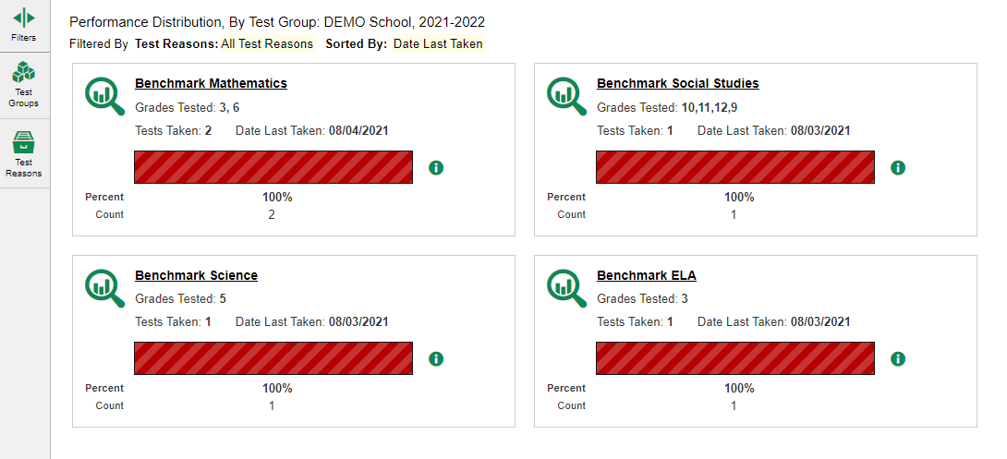
Dashboard View
4
Notes:
Here is a teacher dashboard. It displays all the tests your students have completed.
To navigate from the dashboard to other test data, click the Filters button at the top of the panel on the left. The Filters panel opens.

Slide 5
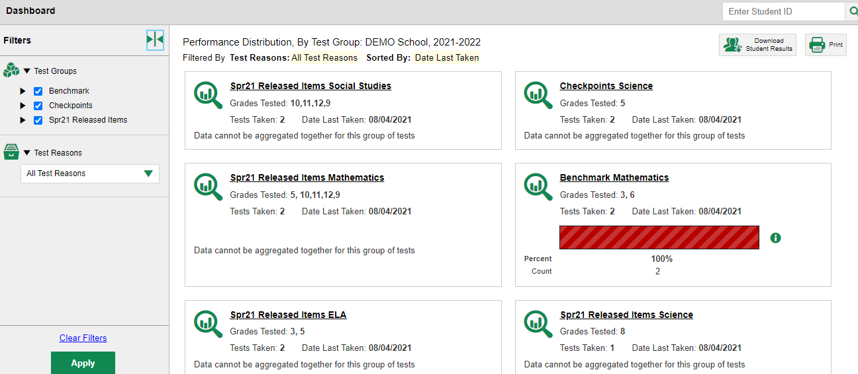
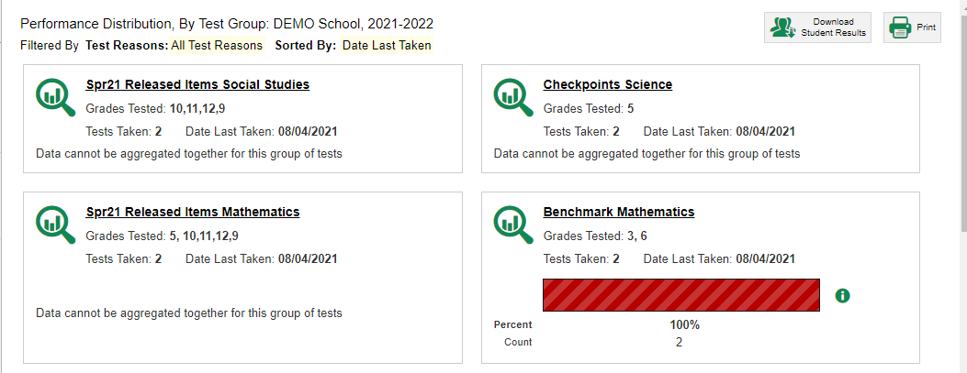
Dashboard View: Filtering
5
Notes:
Click on Test Group and select the benchmark, checkpoint or released item tests that you would like to view.
Click the Apply button at the bottom of the Filters panel.
The dashboard updates to display the aggregate test results for the tests you have selected. Click a test name or the magnifying glass beside it. This takes you to the Performance on Tests page displaying aggregate data for that group.

Slide 6
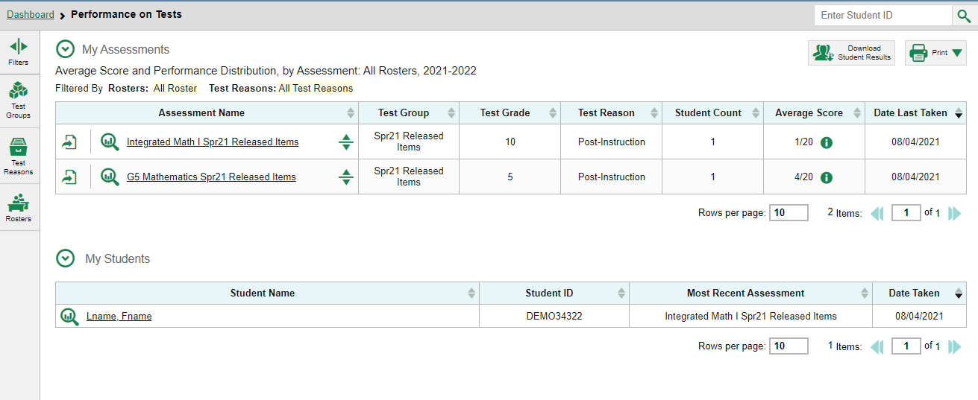
Performance on Tests Report View
6
Notes:
Here is the Performance on Tests page. It is filtered to display only tests that fall within the single test group you clicked on. You can use the table to quickly compare how your students have performed across tests.
From here, you can click on any one of the tests in order to view the data for the specific test. You can navigate from there to the Performance by Student tab, or to the Roster Performance on Test page.
The first page we show you is a Roster Performance on Test page for a benchmark assessment.

Slide 7
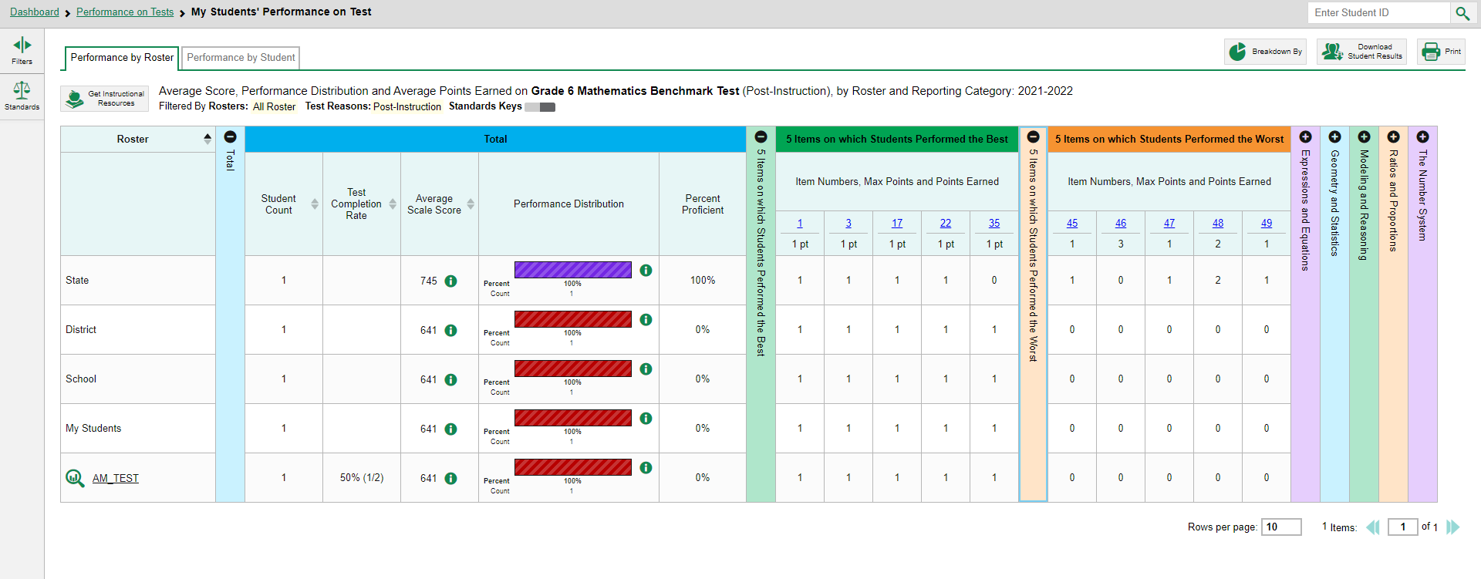
Test Report View: Single Reporting Category
7
Notes:
Here is the Roster Performance on Test page for a class roster that took the Grade 6 Math Benchmark test.
The colored sections in the table include a Total performance section in blue, a green section for 5 Items on which Students Performed the Best and an orange section for 5 Items on which Students Performed the Worst. You can expand or collapse the sections by clicking the vertical section bars, which display plus and minus signs.
To show you how to analyze your results, first focus on the green section, showing the five items on which students performed the best.

Slide 8
Test Report View: Single Reporting Category (continued)
8
Notes:
The rows under the section header, 5 Items on which Students Performed the Best, list the item number, the points possible, and the average number of points earned for the item. This roster’s students performed the best on items #1, #3, #17, #22, and #35.
In reports with item-level data, you may occasionally see “n/a” instead of a score for an item. It means that the student did not respond to the item, or the item was not included in that form of the test.
Note that the average point values for the state, district, school, and teacher’s total students display at the top of the table, so you can compare your roster’s performance to that of those larger groups.
Next, we show you a similar report with fewer than ten items on the test.

Slide 9
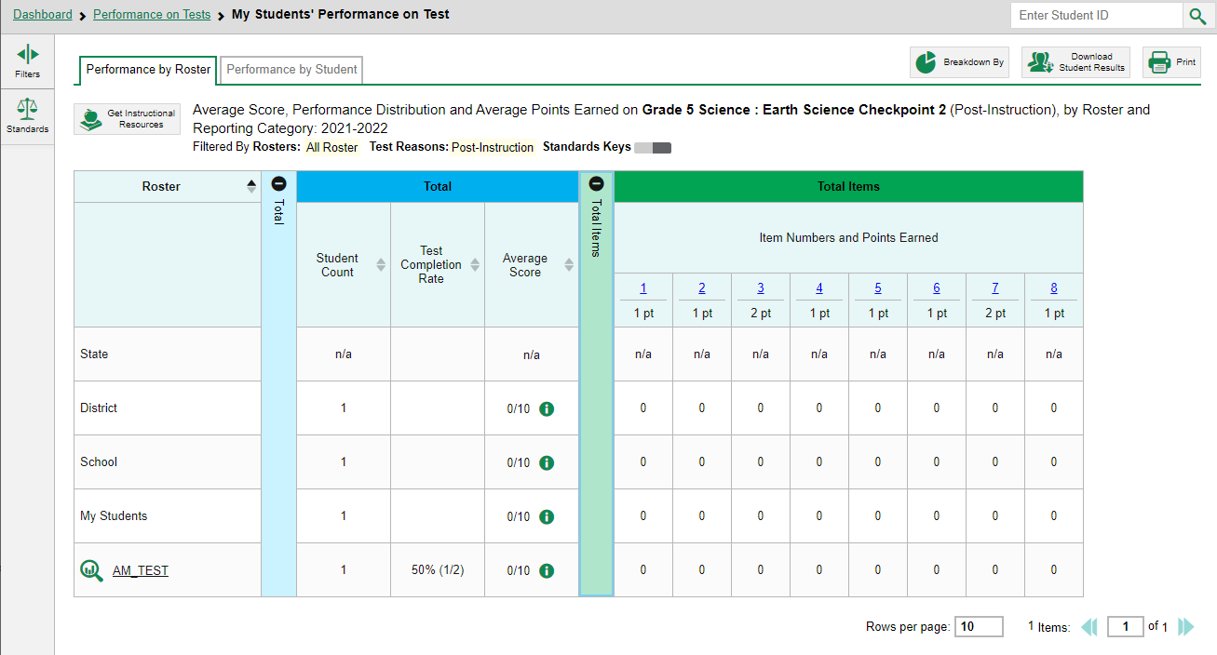
Test Report View: Single Reporting Category (<10 items)
9
Notes:
This is a Roster Performance on Test report on a checkpoint test. Because this test has fewer than 10 items, it does not display the 5 Best and 5 Worst sections. Instead, item-level data are shown only in the Total Items section.
Next, we show you a similar test with multiple reporting categories.

Slide 10
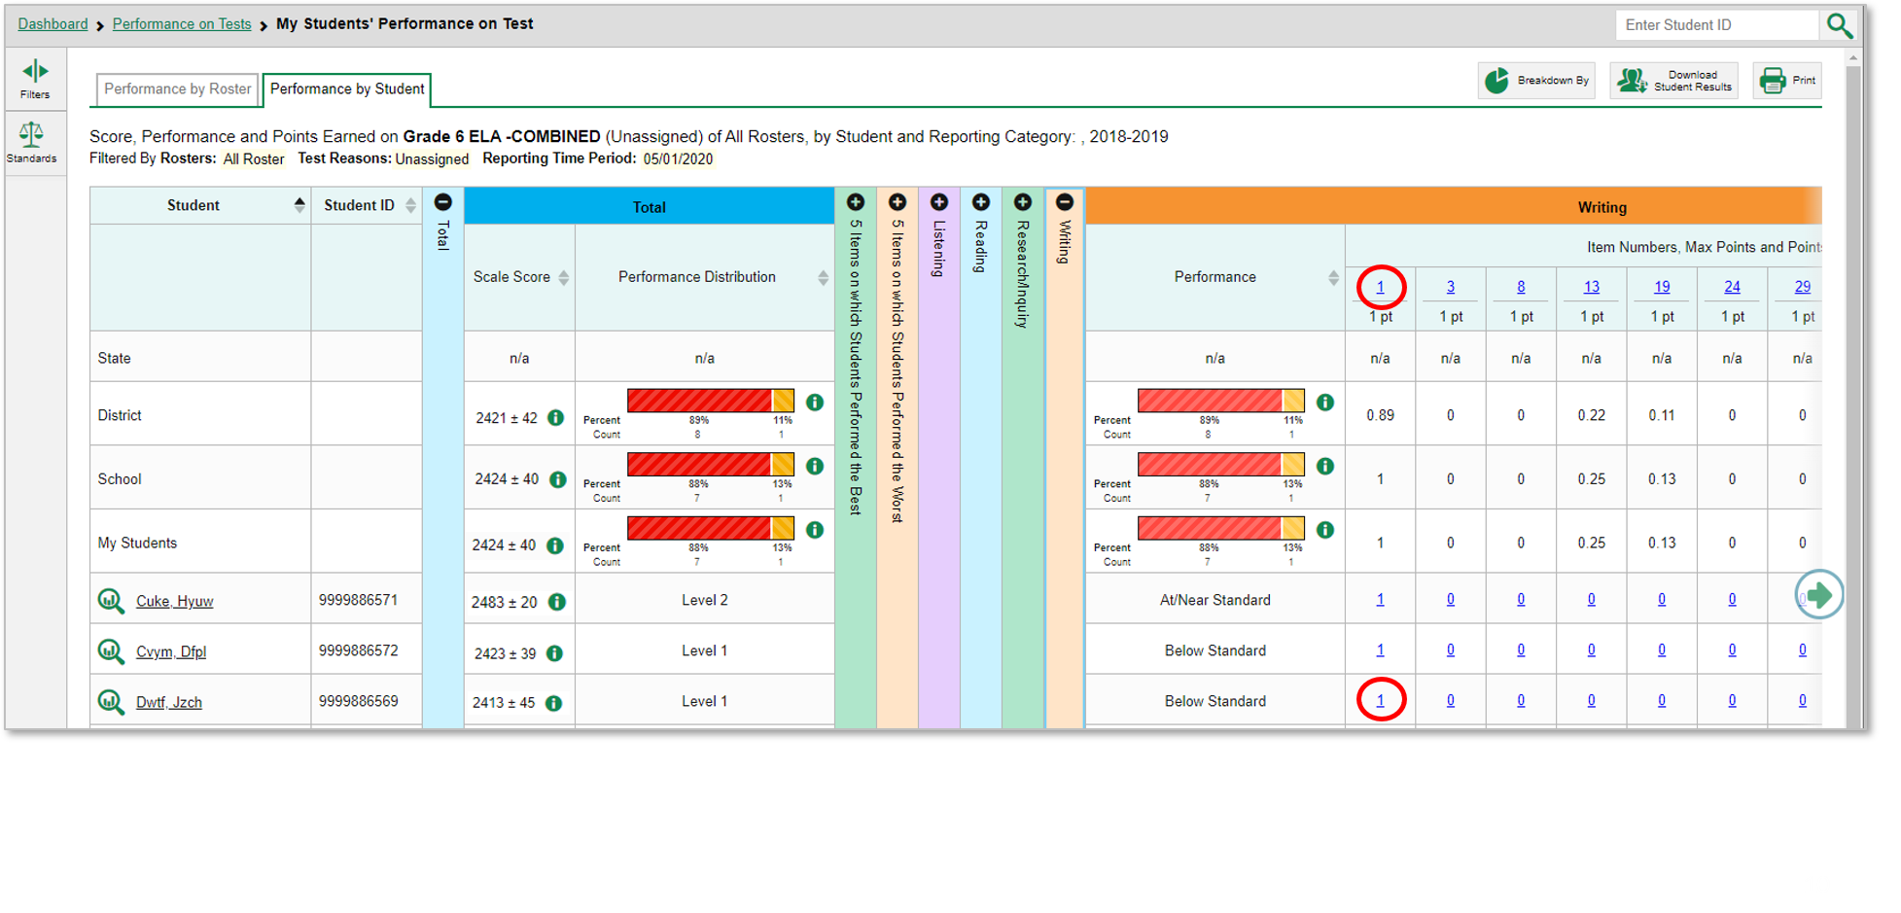
Reports with Multiple Reporting Categories
Notes:
Here is the Performance by Student tab of the My Students’ Performance on Test report for the Grade 3 ELA Benchmark Tests.
The table includes several reporting categories. The items included in each reporting category are the ones that assess that skill area. Clicking the green arrow button on the right allows you to scroll right.
Under each reporting category you can see the item number (blue item link) and the maximum points for the item. For example, you can see that item #1 under Writing is worth 1 point. The last student listed on this page earned 1 point for their answer to that item.
Every reporting category section in this report includes a performance column that can be sorted. Click the up or down arrow next to the column header to sort in ascending or descending order. When you sort your students this way you can quickly see who needs more support in each reporting category.
Next, we show you how to access an actual item and a student’s response to it.

Slide 11
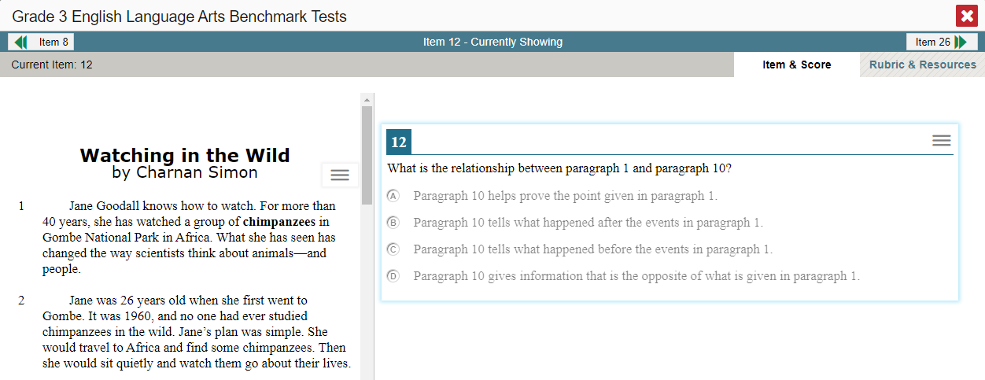
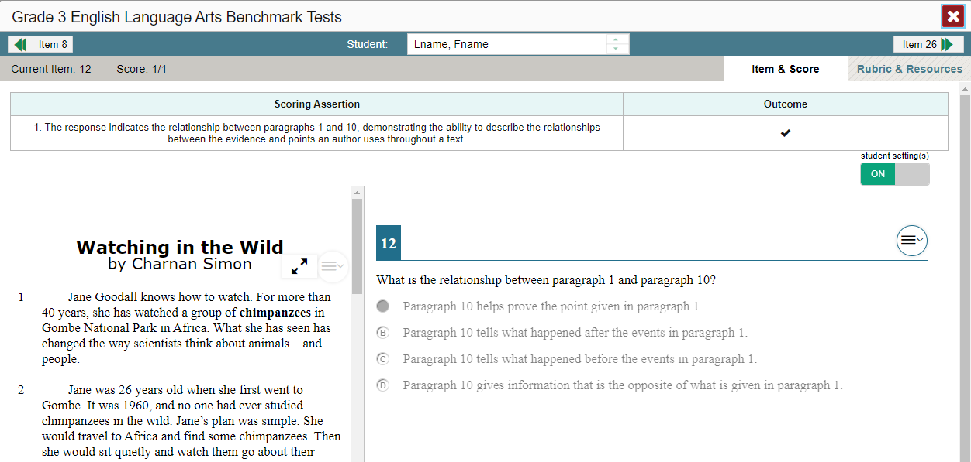
Viewing an Item and Student Response
11
Notes:
To view a test item, click the item number link in the first row of a report table. The item view window displays the test question as it appeared during the test for the student.
To view the student’s actual response to an item, find that student’s name in the Student column on the left. Then click the blue score link under the numbered item. In this example we look at item #12 for the next-to-last student listed.
You can see the item along with the actual answer provided by that student.
On the next slide, we explain the additional item information you can access in the reporting system.

Slide 12
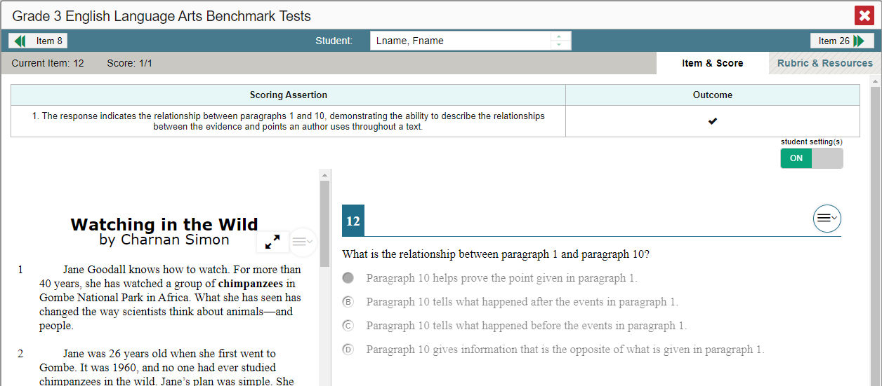
Item & Score Tab
12
Notes:
You can see the current item number and the score for that item at the top-left of your screen in the gray bar. The student in our example answered the item correctly for a score of 1 out of 1 point on item #12.
In the top right gray bar, you will see two tabs, Item & Score and Rubric & Resources.
The Item & Score tab (open in the upper left of your screen) shows the score a particular student obtained for that item.
To make it easier for you to access your student level item results, you can move between students and items without returning to the report by using the fields in the teal bar.
You can view different students’ scores on the same item by clicking the down arrow beside the student bar. This will take you to the next student listed in the report table so you can see how the next student performed on the same item.
You can also view the next item in the test by clicking on the arrow button at the top right of the screen. You can view the previous item by clicking on the arrow button at the top left of the screen. Because we opened item #12 from the 5 Best section on the report, item #8 displays as the previous item listed under the 5 Best column.
Below the item scores, you see the Scoring Assertion. Each scoring assertion contains both a statement that provides information about what the student did in their response, and the content knowledge, skill or ability that is evidenced by their response. For example, an assertion for a mathematics graphing item might be: The student correctly graphed the correct function, showing evidence of the ability to model relationships between two quantities. Some items may have multiple scoring assertions.
The Outcome column shows a checkmark for a correct answer, or an X for each incorrect answer. This item has a single scoring assertion.
At the bottom of the screen, you can see the test item along with the student’s response to it.
We explain the Rubric & Resources tab on the next slide.

Slide 13
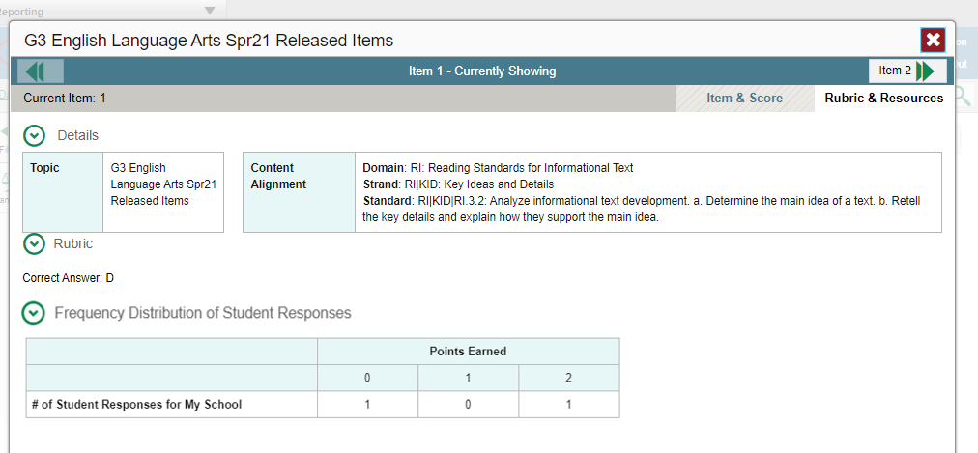
Rubric & Resources Tab
13
Notes:
On the Rubric & Resources tab you can see additional item information including the standard to which the item is aligned, the Scoring Rubric, and Frequency Distribution of Student Responses. The sections are expanded and collapsed using the circled arrows to the left.
The Rubric displays the criteria used to score the item. A simple correct answer may be listed, or this section may include a score breakdown or a human-readable rubric.
The Frequency Distribution of Student Responses provides a breakdown of how many students earned each possible point value available for the item. In this example, 2 students in the school responded to item #1 on this Grade 3 English language arts Item Release test. 1 of them answered correctly and earned 2 points for the item while the other student did not answer correctly and earned 0 points.

Slide 14
The Reporting System Series
1. How to Navigate the Dashboard and Access Your Summative Results
2. How to Understand Measures for Writing Dimensions
3. How to Understand a Demographic Breakdown Report and a Student Portfolio Report
4. How to Drill Down into Your Results by Selecting Specific Tests & Classes
5. How to Drill Down into Your Results by Selecting Previous School Years & Previous Students
6. How to Track Student Performance Over Time Using the Longitudinal Report
7. How to Generate Individual Student Reports (ISR) and Student Data Files
8. How to Print and Export Data You Can See in Your Reports
9. How to Use the Roster Manager to Add, Modify and Upload Rosters
10. How to Analyze a Basic Non-summative Test Report
11. How to Use the Advanced Features of Reporting to View Non-summative Data
12. How to Hand-Score Unscored Items and Modify Machine Scores
Non-summative Assessments Only
Notes:
Thank you for viewing this module on how to analyze basic non-summative reports. More modules are posted on the test portal.

Slide 15
More Help
Further Information: Reporting System User Guide, 2021-2022
https://oh.portal.cambiumast.com/
Email OHHelpdesk@cambiumassessment.com or call 1-877-231-7809
Notes:
For detailed information, consult the Reporting System User Guide, 2021-2022, located the test portal, or contact the Ohio Help Desk.

