Slide 1
The Centralized Reporting System—
Working with Item-Level Data for Ohio Assessments:
- Ohio’s State Tests (OST)
- Readiness Assessments
- Ohio’s Alternate Assessments for Students with the Most Significant Cognitive Disabilities (AASCD)
2022–2023
Copyright © 2022 Cambium Assessment, Inc. All rights reserved.
The data is this training is for training purposes only and do not
represent actual results. All names and ID numbers are fictitious.
Notes:
Welcome to the training module on working with item-level data in the Centralized Reporting System for Ohio’s Assessments: Ohio’s State Tests, or OST, the Readiness Assessments, and Ohio’s Alternate Assessments for Students with the Most Significant Cognitive Disabilities, or AASCD. A variety of sample tests are used in this module and the data reflected inf or training purposes only.
This training is based on the Centralized Reporting System User Guide, 2022–2023, which is available on the Ohio Assessment System test portal. There is a list of the full CRS Training Module Series on the last slide of this presentation.

Slide 2
Topics
Topics | Slides
Understand the Differences between Summative & Non-Summative Tests | 3
How to View Items and Student Responses | 4–10
3. How to Modify Machine Scores | 11–12
4. How to Score Unscored Items | 13–17
5. Contact Information & The CRS Series | 18–19
Notes:
There are five topics covered in this training module. You can jump to the section slides if you need information on a single topic. The topics are:
1. Understand the Differences between Summative & Non-Summative Tests
2. How to View Items and Student Responses
3. How to Modify Machine Scores
4. How to Score Unscored Items
5. Contact Information & The CRS Series

Slide 3
Types of Non-Summative Tests that Report Item-Level Data
All Tests
Non-Summative Readiness Tests:
Benchmarks & Checkpoints
Benchmarks:
—Tests with items reported in 3–5 reporting categories
—Users can compare item-level scores across all students
—Benchmarks model the OST and are given up to twice per school year
Checkpoints:
—Short tests with up to 10 items in a single reporting category
—Users can compare item-level scores across all students
—Checkpoints are administered throughout the school year as Pre-Instruction and Post-Instruction tests
Summative Tests:
OST & AASCD
Our Focus:
Item-Level Data Included on Benchmark and Checkpoint Test Reports
Notes:
The focus of this section will be on non-summative test reports that contain item-level data, access to the items themselves, and access to student responses to the items. This chart shows how tests in Reporting can be categorized.
All tests are either summative or non-summative assessments. Summative tests are end-of-year or end-of-course comprehensive tests that assess the student’s command of an entire subject. Non-summative tests include the Readiness Assessments’ Benchmark and Checkpoint tests.
Benchmark tests are similar to summative tests and report item-level data.
Checkpoints are small tests that assess a single reporting category. Users can compare item-level scores and the items themselves for all their students.

Slide 4
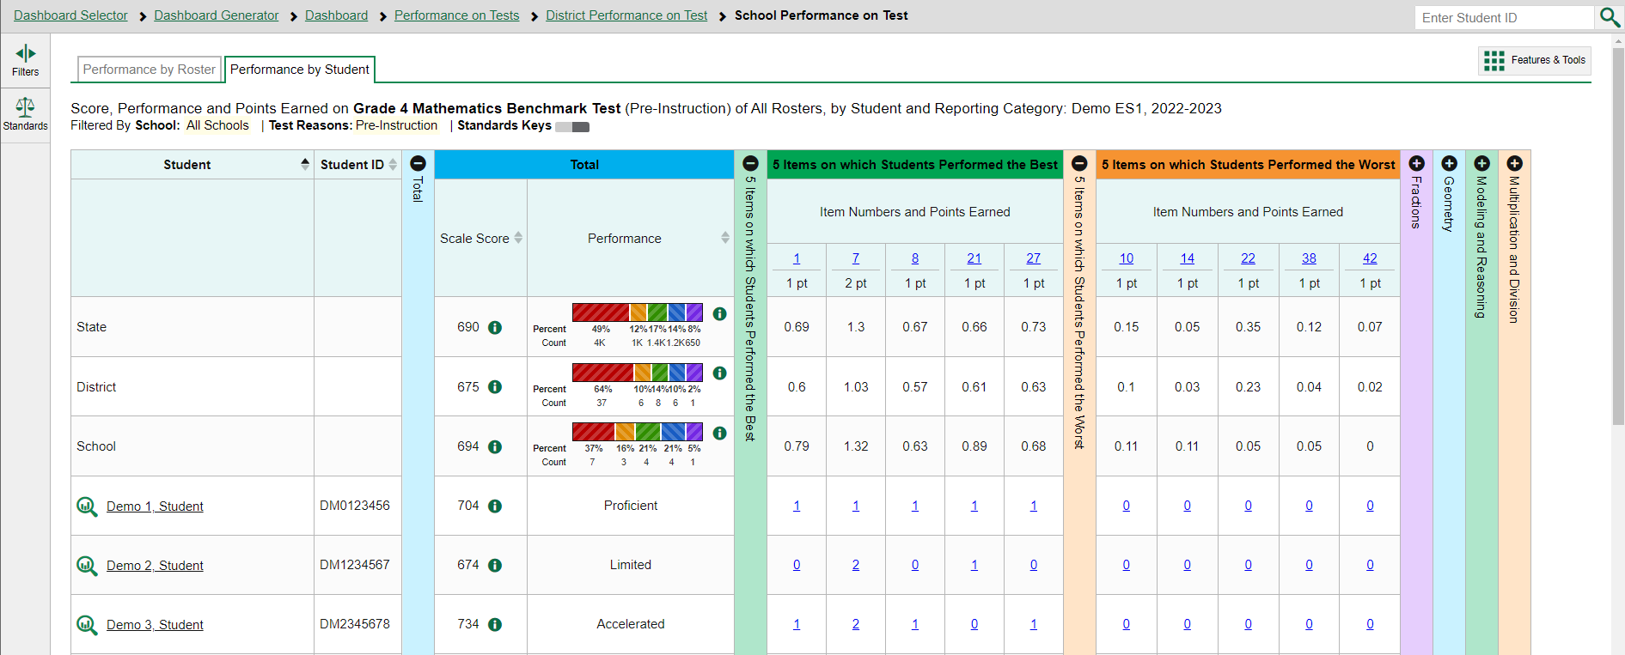
Reports with Item-Level Data
Notes:
Here is a School Performance on Test report, by student, for the Grade 4 Mathematics Benchmark Test. You can access the items themselves and the student responses to the items.
The colored sections in the table include a blue Total performance section, a green section for 5 Items on which Students Performed the Best, an orange section for 5 Items on which Students Performed the Worst, and four reporting categories. You can expand or collapse the sections by clicking the vertical section bars, which display plus and minus signs.
To show you how to analyze your results, we focus first on the green section, showing the five items on which students performed the best.
The first two rows under the section header, 5 Items on which Students Performed the Best, list the item number and the maximum number of points for the item. The students on this roster performed the best on items 1, 7, 8, 21, and 27.
For example, Demo Student 1 earned 1 out of 1 points on four items and 1 out of 2 points on item #7. This student earned 0 points on all the items in 5 Items on Which Students Performed the Worst.
You can sort these results by clicking the expansion arrows in the Scale Score and Performance columns.
In reports with item-level data, you may occasionally see “n/a” instead of a score for an item. It means that the student did not respond to the item, or the item was not included in that form of the test.

Slide 5
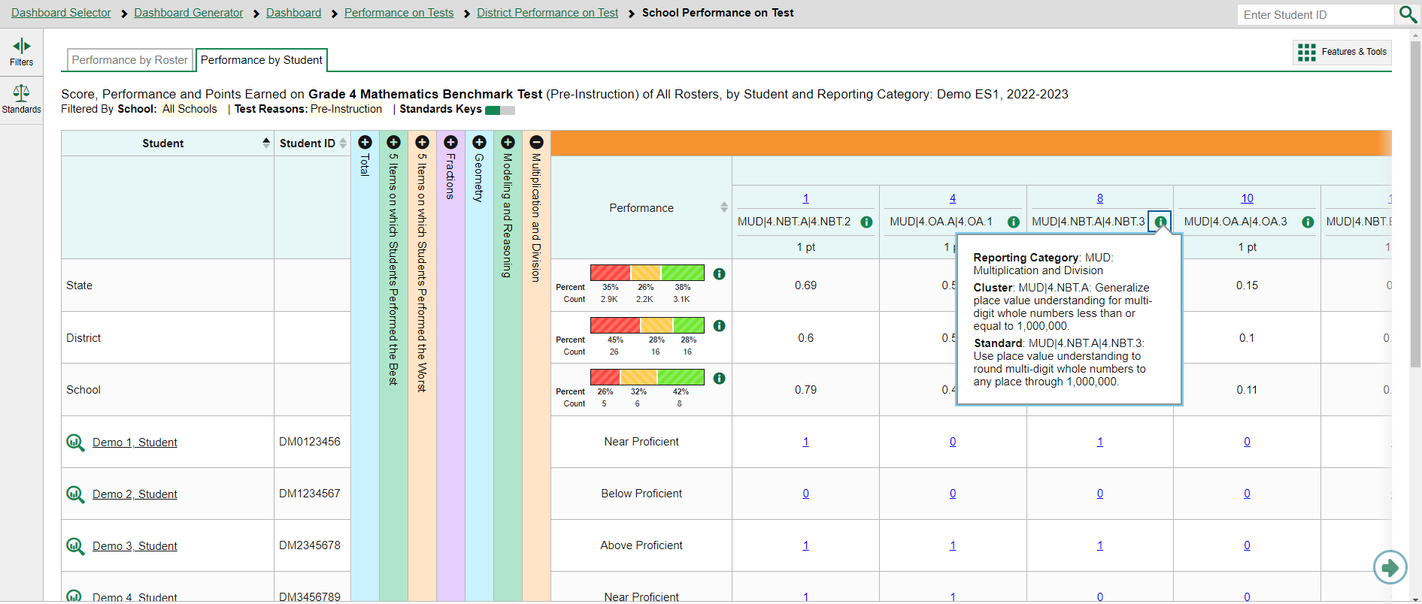
How to View Standards for Each Item
Notes:
In a report displaying item-level data, you can view the standard to which each item is aligned. This allows you to determine at a glance what the item measures. To show or hide item standards, click the Standards Keys toggle in the table header. The standards display beneath the blue item numbers. Click the more information buttons beside the standard keys to view the legend for each standard.

Slide 6
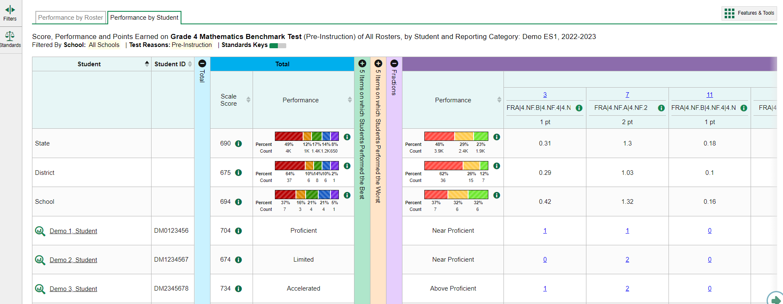
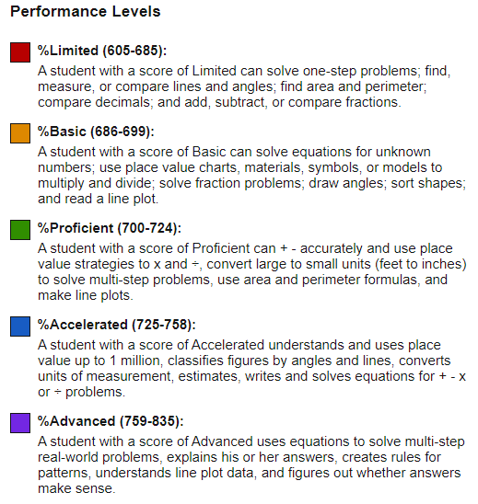
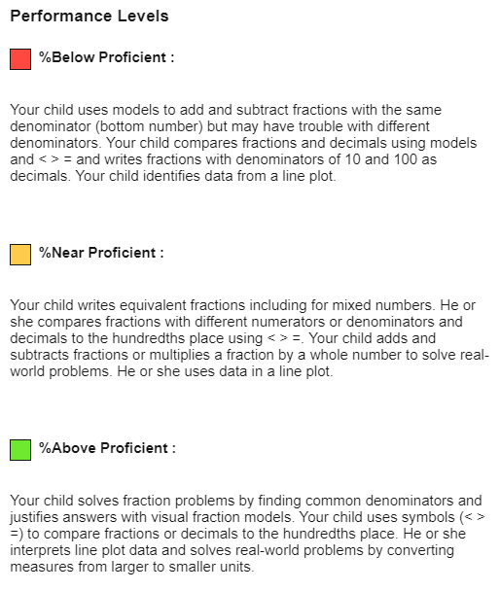
Reports with Multiple Reporting Categories
Notes:
You may also sort the results in the Reporting Categories by Performance level. It may be helpful to sort in ascending order so that you see the students who are struggling in that domain display at the top of the results table. You can also compare a student’s overall performance on the test to their performance in each reporting category. For example, Demo Student 1 performed at the Proficient level overall, but at the Near Proficient level in the Fractions domain. Legends for the overall Performance Levels and the category Performance Levels are shown here.

Slide 7
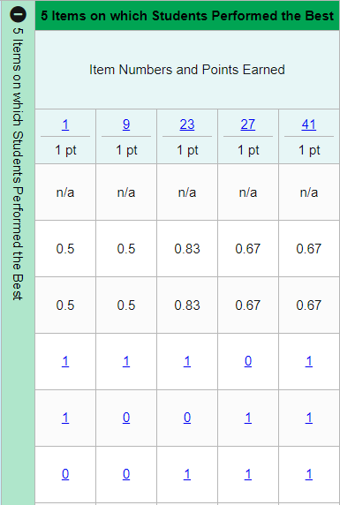
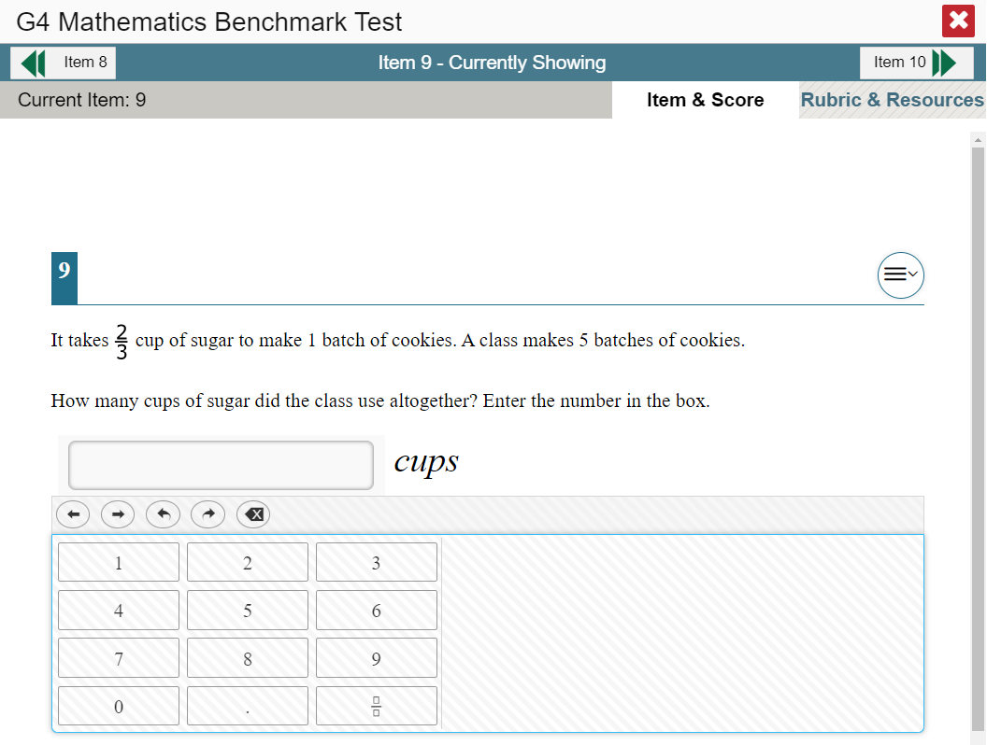
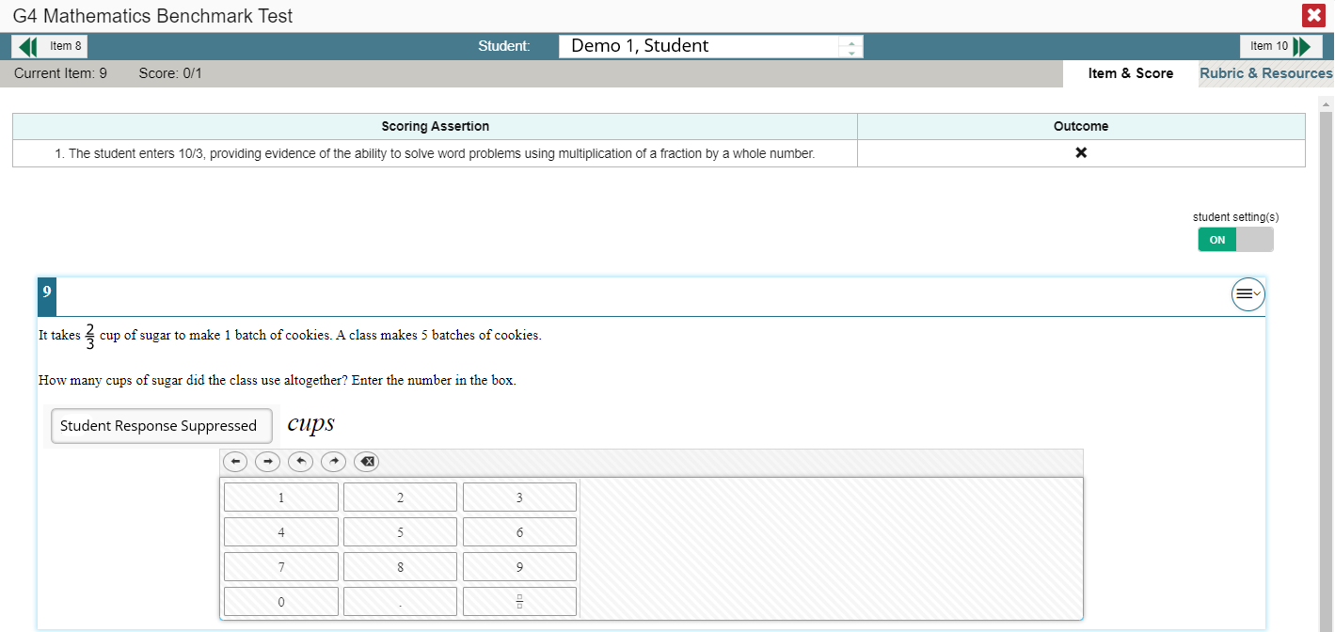
Viewing an Item and Student Response
Notes:
To view a test item in a blank, unanswered state, click the item number link in the first row of a report table. The item view window displays the test question as it appeared on the assessment on the Student Testing Site.
To view an item with a student’s response, find that student’s name in the Student column on the left. Then click the blue score link under the numbered item. In this example, we look at item 9 for the last student listed.
The item view window displays the item along with the answer provided by that student.
On the next slide, we will explain the features of an item view window that includes the student’s response.

Slide 8
Item & Score Tab
Notes:
You can see the current item number and the score for that item in the gray bar in the banner. The student answered incorrectly for a score of 0 out of 1 point on item 9.
Moving to the right in the gray bar, you see two tabs, Item & Score and Rubric & Resources. You can toggle between these tabs to display associated content. The Item & Score tab is open in this slide, and the Rubric & Resources tab is open in the next slide.
Underneath the teal and gray banners, the scoring assertions are displayed with their outcomes.
In the Scoring Assertion column, each assertion states exactly what the student must do to earn points. The Outcome column shows a checkmark for a correct answer, or an X for each incorrect answer. This item has a single scoring assertion.
Below, the test item is displayed along with the student’s response. Reviewing a student’s response may provide clues to the student’s thinking.
You can show or hide a student’s visual settings, like large fonts, different color contrasts, or Spanish language, on a per-item basis. To do so, click the toggle above the item on the right side.

Slide 9
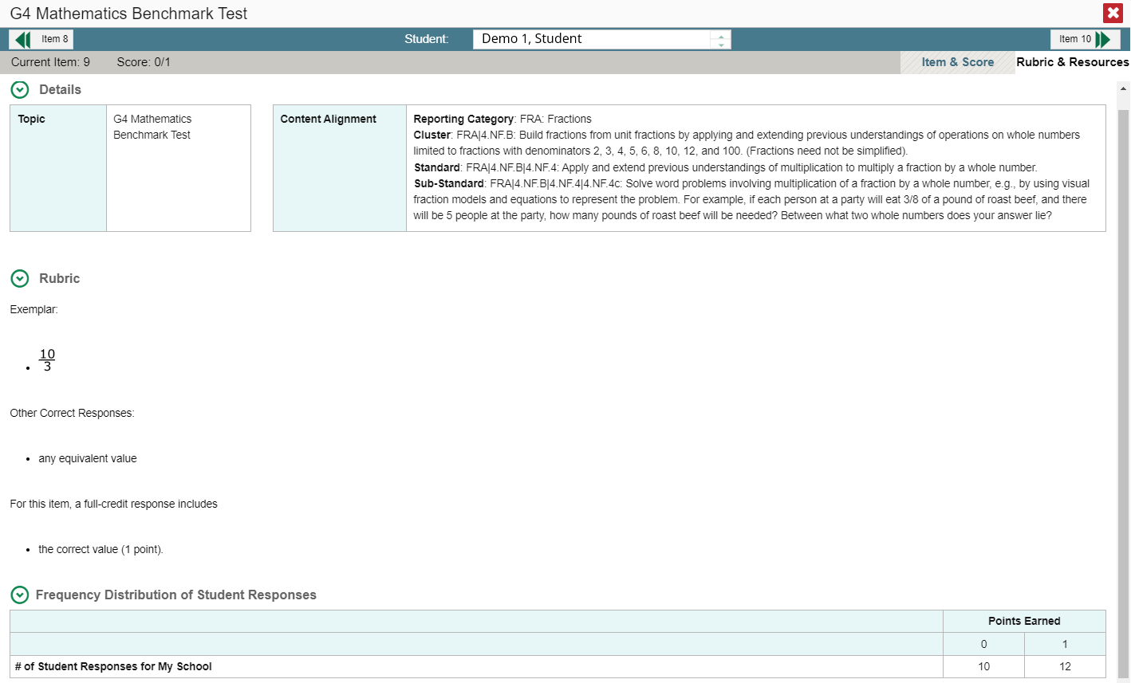
Rubric & Resources Tab
Notes:
The Rubric & Resources tab has the same teal and gray banner features and is divided into multiple sections, which may include Details, Rubric, and Frequency Distribution of Student Responses. The sections are expanded and collapsed using the circled arrows to the left. The information included in each section varies, depending on the test item.
The Topic lists the skill area to which the item belongs. The Content Alignment section describes, in detail, the learning standard to which the item is aligned.
The Rubric displays the criteria used to score the item. A simple correct answer may be listed, or this section may include a score breakdown, a human-readable rubric, or an exemplar, which provides an example of a response for each point value.
Frequency Distribution of Student Responses provides a breakdown of how many students earned each possible point value available for the item. In this example, 22 students in the school responded to item 9 on this mathematics test. 12 of them earned one point for the item and 10 of them earned 0 points.

Slide 10
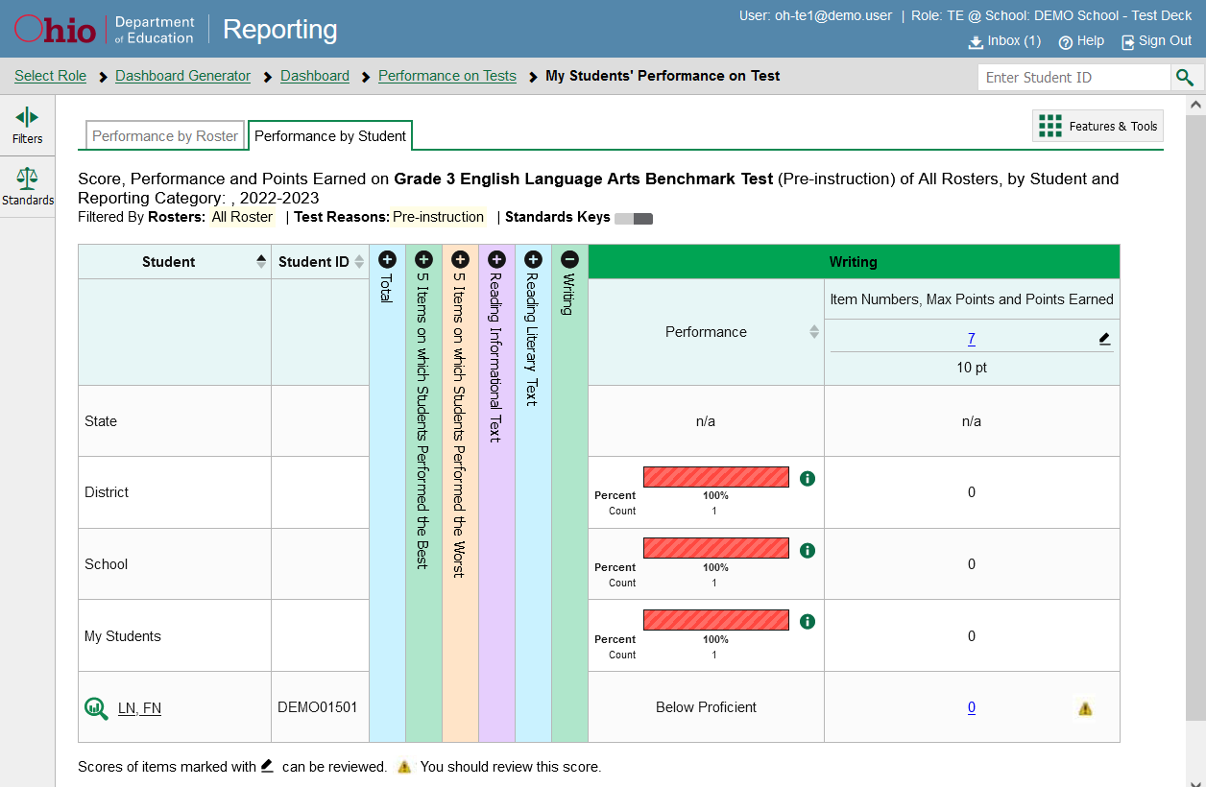
Modify Scores from CRS
Notes:
The Centralized Reporting System (CRS) allows authorized users to score certain items on benchmark and checkpoint tests.
Some items arrive in the CRS with automated scores generated by the machine scoring system, which authorized users can override if necessary. For example, all writing items on benchmark tests have machine-generated scores that can be overridden.
Other items that require hand scoring arrive in the CRS without any scores. For example, some writing essay items on the checkpoint tests require hand scoring. If a test contains unscored items, its performance data are excluded from your reports until an authorized user scores all the unscored items of that test.
Users can modify scores for the writing essay items directly from reports in the Centralized Reporting System. Reports display a pencil icon in the column headers for each item with editable scores, as shown in this My Students’ Performance on Test report for the Grade 3 ELA Benchmark test. When a machine-generated score has a low confidence level, or when a condition code of Non-Specific or Non-Scorable Language (Uninterpretable Language) has been assigned by machine, a warning icon displays next to the score. It is highly recommended that you review items flagged with this icon.
Click the item score number link in the student’s row of the report. The Item View window opens.

Slide 11
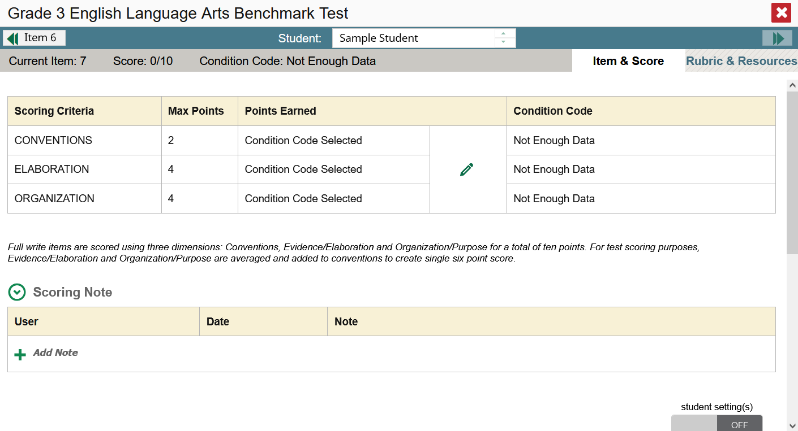
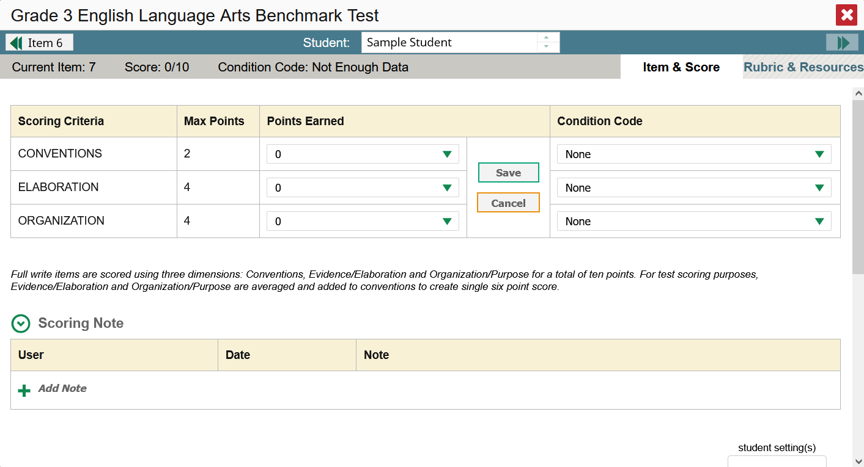
Modify Scores in Item & Score Tab
Notes:
Click the pencil edit button in the Scoring Criteria table.
To change the score for the response, select a numerical score from the Points Earned drop-down list. If the item consists of multiple scoring criteria, enter a score for each criterion. To save the score, click Save. When you close the Item View window, any average scores or performance distributions in the assessment report will update automatically.
You can assign condition codes in lieu of selecting the number of points earned.

Slide 12
Condition Codes
Condition Code | Source of Code | Description
Insufficient Text (Repetitive Text) | Machine | The response is substantially comprised of repeated text copied over and over.
Blank | Machine | The student did not enter a response.
Non Specific* | Machine | This condition code is assigned to machine-scored responses when TDS identifies that the response requires a condition code but cannot determine which specific condition code it requires. Resolution is required.
Insufficient Text (Too Few Words) | Machine | The response contains too few words to be deemed adequate to be scored.
Non-Scorable Language (Uninterpretable Language)* | Machine | This condition code is assigned to machine-scored responses when TDS identifies that the response contains primarily atypical or unusual words and is unable to assign a score. Resolution is required.
Insufficient Text (Insufficient Original Text) | Machine | The response is composed of a significant amount of text copied directly from the prompt and/or reading passage, with little to no original writing from the student.
Off Topic | Human | Student writes to a subject that is unrelated to the prompt.
Foreign Language | Human | The response is written in a language other than English.
Unreadable | Human | The response is unreadable. For example, an online response is unreadable if it only contains repeated/random keystrokes (e.g., “yyyyyyyyyyy”; “av:aeoiahvb;e”; “hhrrttuuvv”).
Blank | Human | The student did not enter a response.
Notes:
Here is a list of condition codes that are available for the benchmark and checkpoint tests. As you can see from the table, some of the condition codes are assigned by machine and others are assigned by humans. As mentioned before, when a condition code of Non-Specific or Non-Scorable Language (Uninterpretable Language) has been assigned by machine, it is highly recommended that you review items flagged with this icon.

Slide 13
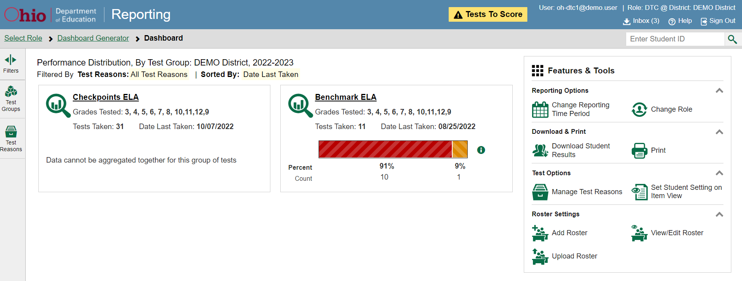
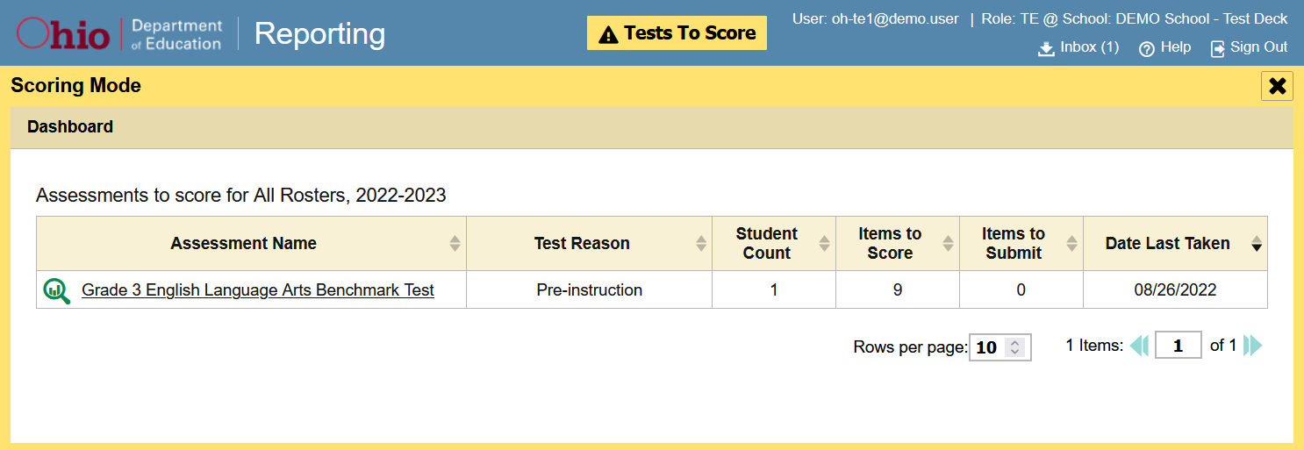
Enter Scores for Unscored Items
Notes:
When you have tests awaiting item scoring, a Tests To Score notification appears in the banner.
To enter scores for unscored items, click the Tests To Score notification. The Scoring Mode window opens and displays a list of tests with unscored items. Click the magnifying glass view button next to the name of the test you wish to score.

Slide 14
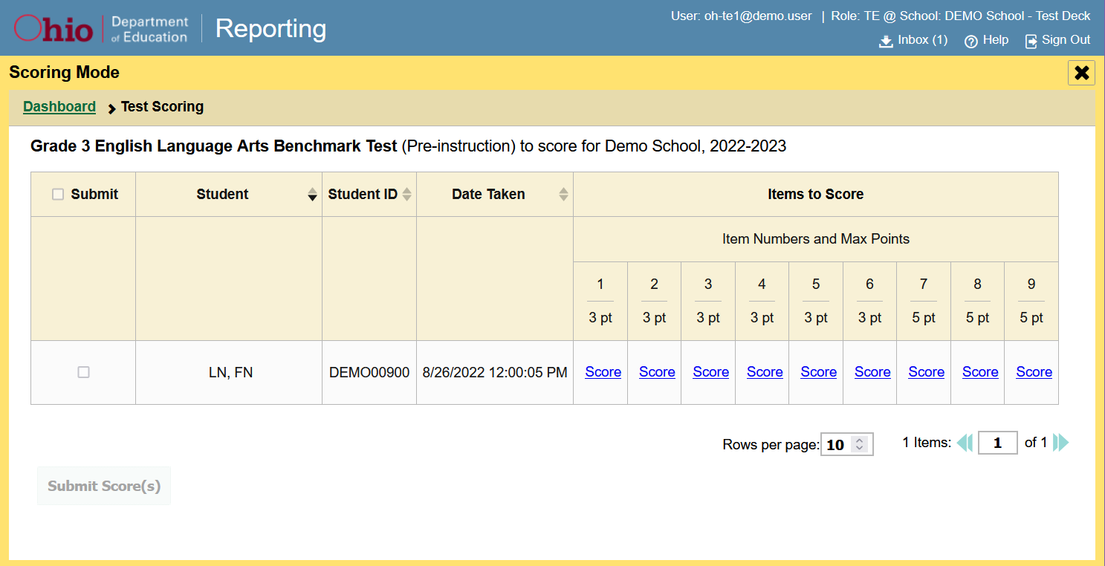
Enter Scores for Unscored Items—Scoring Mode Window
Sample Student
Notes:
The Scoring Mode window now displays a list of students and items awaiting scoring for the selected test. To enter scores for an item, click the Score link for the item in the student’s row. The Item View window opens.

Slide 15
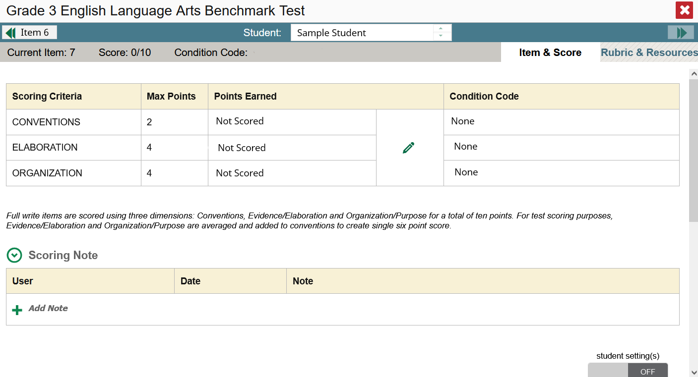
Enter Scores for Unscored Item—Item View Window—Item & Score Tab
Student Response Area
Notes:
The Item View window displays with two tabs below the banner. The open tab, Item & Score, consists of the Scoring Criteria table, the Scoring Note section, and below that, the student response. The second tab is the Rubric & Resources tab, shown on the next slide.

Slide 16
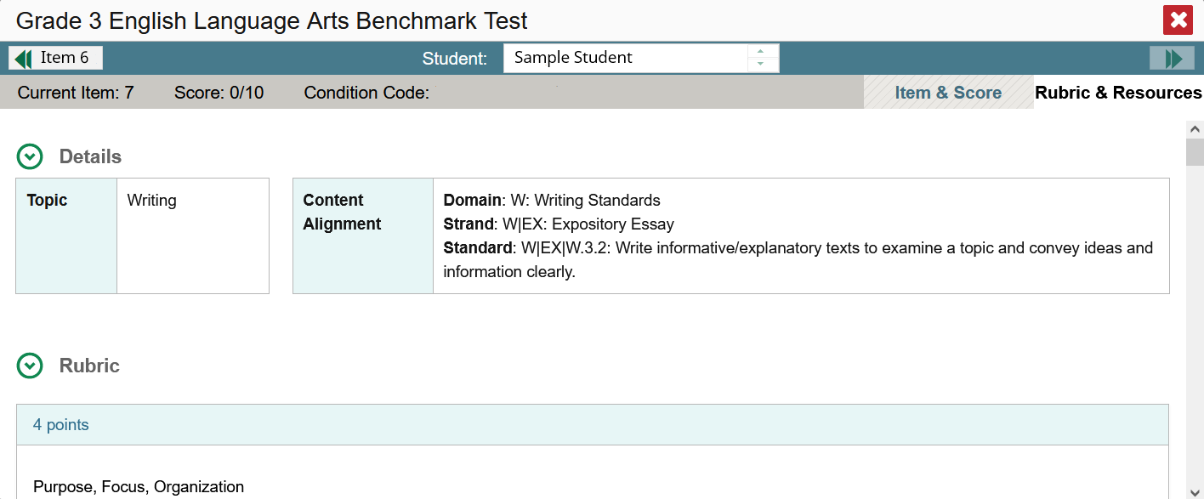
Enter Scores for Unscored Item—Rubric & Resources Tab
Notes:
You can review the item rubric and available resources in the Rubric & Resources tab. This will help you determine an appropriate score for the student’s response.

Slide 17
Enter Scores for Unscored Item—Item & Score Tab in Edit Mode
Student Response Area
Notes:
As previously mentioned, in the Item & Score tab, the student’s response displays below the scoring note section. Review the response for scoring. When you are ready to enter a score click the pencil edit button to display the points earned options and condition codes, as shown in the image on the right.
To enter a score for the response, select or type a numerical score in the Points Earned drop-down menu and click Save.
If you need to assign a condition code to the response, select the appropriate option from the Condition Code drop-down list. Condition codes include Blank Response, Off Topic Response, Foreign Language, and Unreadable Response.
You can continue scoring unscored items in the Item View window.
To view another unscored item for the same student, use the previous and next buttons on the left and right sides of the Item View banner.
To view the same unscored item for another student, use the up and down arrows in the Student field box in the center of the banner.

Slide 18
Thank You!
Further Information: Centralized Reporting System User Guide, 2022-2023
https://oh.portal.cambiumast.com/
Email OHHelpdesk@cambiumassessment.com
or
Call 1-877-231-7809
Notes:
Thank you for taking the time to view this training module. For detailed information, consult your Centralized Reporting System User Guide, 2022–2023, located on the Ohio Assessments test portal, or contact the Ohio Help Desk.

Slide 19
The CRS Series
The Centralized Reporting System: The Basics for Ohio Assessments
The Centralized Reporting System: Generating ISRs and Student Data Files for Ohio Assessments
The Centralized Reporting System: Viewing Results within Reporting Categories for Ohio Assessments
The Centralized Reporting System: Working with Item-Level Data
The CRS Series, specifically created for Ohio Readiness Assessments:
How to Access Your Readiness Assessments Data in the Centralized Reporting System
How to Use the Advanced Features of the Centralized Reporting System to View Your Benchmark and Checkpoint Data
How to Modify Machine Scores and Hand-Score Unscored Items
Notes:
There is a 4-part series of CRS trainings for the Ohio Assessments: OST, Readiness Assessments, and AASCD. They are:
The Centralized Reporting System: The Basics for Ohio Assessments
The Centralized Reporting System: Generating Individual Student Reports and Student Data Files for Ohio Assessments
The Centralized Reporting System: Viewing Results within Reporting Categories for Ohio Assessments
The Centralized Reporting System: Working with Item-Level Data
In addition to this series, there is a 3-part series of training modules that focus specifically on the Readiness Benchmark and Checkpoint tests. They are:
How to Access Your Readiness Assessments Data in the Centralized Reporting System
How to Use the Advanced Features of the Centralized Reporting System to View Your Benchmark and Checkpoint Data
How to Modify Machine Scores and Hand-Score Unscored Items
These modules can be found on the Ohio Assessments Portal.

