Slide 1
The Centralized Reporting System—
Viewing Results within Reporting Categories for Ohio Assessments:
- Ohio’s State Tests (OST)
- Readiness Assessments
- Ohio’s Alternate Assessments for Students with the Most Significant Cognitive Disabilities (AASCD)
2022–2023
Copyright © 2022 Cambium Assessment, Inc. All rights reserved.
The data is this training is for training purposes only and do not
represent actual results. All names and ID numbers are fictitious.
Notes:
Welcome to the training module on viewing results within reporting categories in the Centralized Reporting System for Ohio’s Assessments: Ohio’s State Tests, or OST, the Readiness Assessments, and Ohio’s Alternate Assessments for Students with the Most Significant Cognitive Disabilities, or AASCD. A variety of sample tests are used in this module and the data reflected is for training purposes only.
This training is based on the Centralized Reporting System User Guide, 2022–2023, which is available on the Ohio Assessment System test portal. There is a list of the full CRS Training Module Series on the last slide of this presentation.

Slide 2
Topics
Topics | Slides
Analyze Data in the Reporting Categories | 3–8
Analyze Data in the Writing & Writing Dimensions Categories | 9–12
3. More Information & The CRS Series | 13–14
Notes:
There are three topics covered in this training module. You can jump to the section slides if you need information on a single topic. The topics are:
1. Analyze Data in the Reporting Categories
2. Analyze Data in the Writing & Writing Dimensions Categories
3. Contact Information & The CRS Series

Slide 3
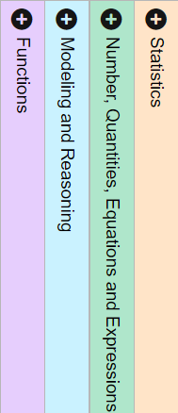
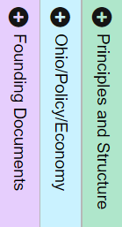
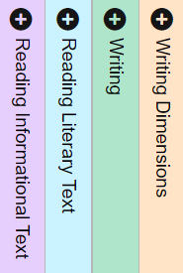
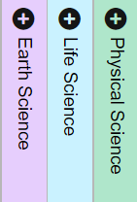
Reporting Categories Used in Some Sample Tests
Uncover Your Students’ Strengths and Weaknesses by Analyzing
Item-Level Data in the Reporting Categories
ELA Benchmark
& OST
Algebra Benchmark
& OST
Grade 5 Science Benchmark & OST
American Government Benchmark & OST
Test | Reporting Categories | Item Data Available? | View the item content and the student response?
OST | Yes, 3–5 | Yes | No
Benchmarks | Yes, 3–5 | Yes | Yes
Checkpoints | None, a single category is assessed | Yes | Yes
AASCD | Yes, 3–4 | No | No
Notes:
The OST, the Readiness Benchmark tests, and the AASCD assessments place learning standards into reporting categories that define how test data is reported for a test. On this slide you see a sample of Ohio assessments and the reporting categories used for each test. The best way for a teacher to know a student’s strengths and weaknesses in a subject is to analyze the item-level data contained within these categories. Each OST, and Benchmark test has three to five reporting categories. AASCD tests have three to four reporting categories. Reporting categories represent groups of similar skills or learning standards assessed within each grade and subject.
Analyzing data within the reporting categories is the focus of this training module. The chart summarizes the display of reporting categories for the Ohio assessments and indicates if items and student responses are viewable on the report. Notice that the most significant difference between OST and Benchmark tests is that test items and student responses are viewable in the Benchmark data, but not in the OST reports. The Readiness Checkpoints assess skills in a single reporting category, so those reports do not display categories, but the 6–10 items on the test are viewable, along with student responses.

Slide 4
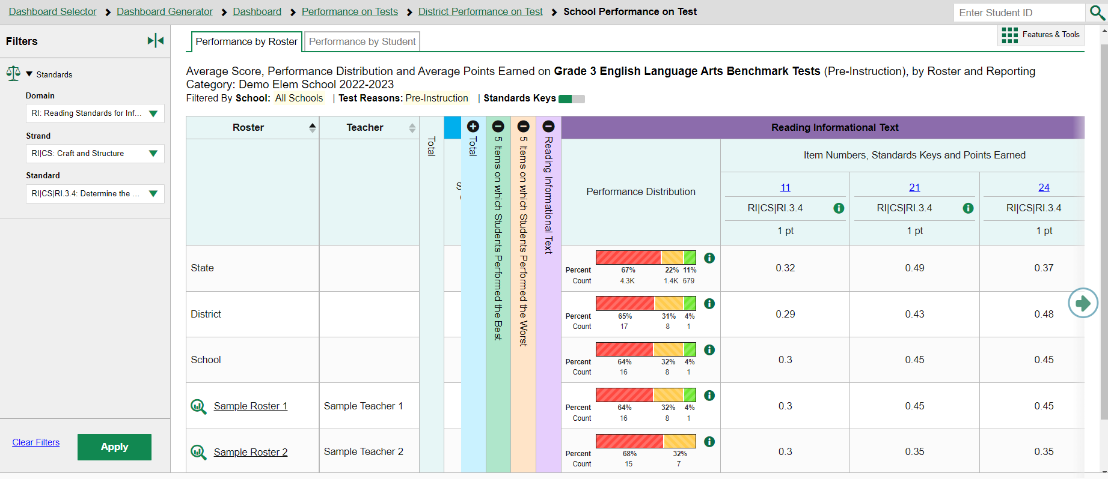
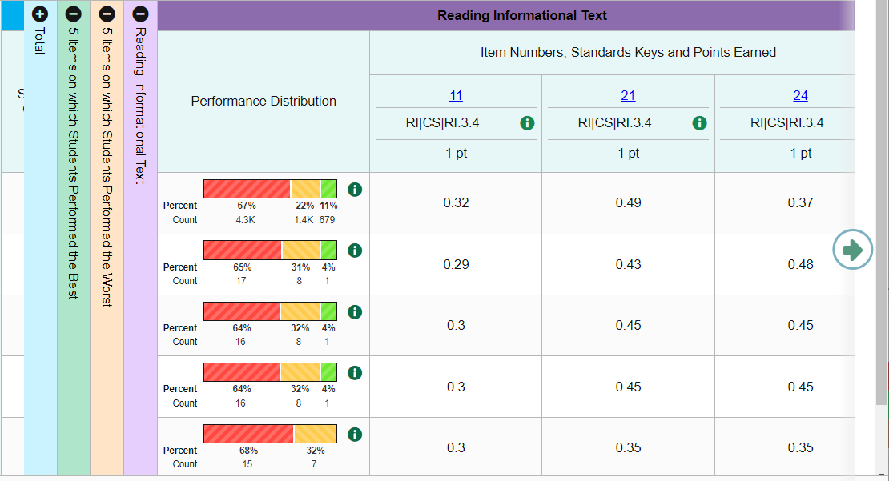
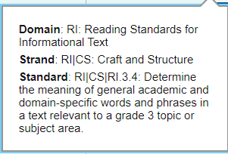
Lay-Out of a Sample Test with Reporting Categories
Notes:
Here is a Grade 3 ELA Benchmark Test with the Reading Informational Text category expanded and the Filters panel open. The Standards Keys button in the header is toggled to the ON position. Because of this the standard assessed by the item displays below the blue item number. Click the green information button to display a legend listing the domain, strand, and standard for each item.
There are typically 5 to 15 items grouped in a reporting category. Here you can see items #11, #21, and #24. Use the green arrow button or the green scroll bar to move to the right to see more items. The item numbers display as a blue link under the header, “Item Numbers, Standards Keys and Points Earned,” because when you click them, the item view pop-up window will display, showing the item, the rubric and resources associated with it.

Slide 5
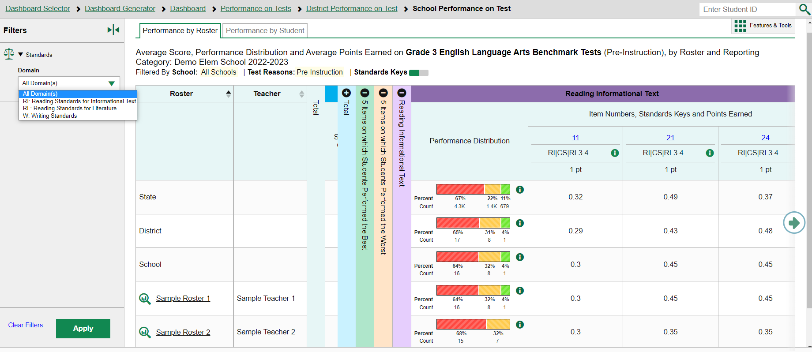
Reporting Categories and the Standards Filter
Notes:
It is important to use the Filters panel to reduce the size of the report, so that you can deeply analyze your students’ results at the standard level. The first option in the Filters panel is the Domain drop-down, which lists the reporting categories used on the test. You can see that the first domain listed in the menu, “RI: Reading Standards for Informational Text” matches the purple Reporting category header: “Reading Informational Text.”

Slide 6
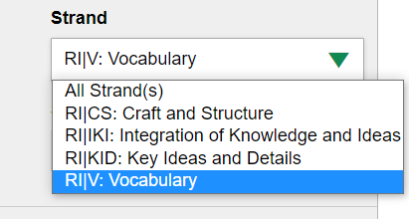
Filter by Domain, Strand, and Standard
Notes:
When a Domain is selected, a Strand drop-down menu displays. When a Strand is selected, a Standard menu displays. Shown here are the four strands listed under the Strand drop-down menu and the 2 standards on the Standard menu.
Note that for other subjects, the terms “Domain,” “Strand” and “Standard” may be different.
To review, this Grade 3 ELA Benchmark test can be filtered by:
3 Reporting Categories, also called Domains
RI: Reading Standards for Informational Text, the one selected in this image
RL: Reading Standards for Literature
W: Writing Standards
If you select to view the Reading Standards for Informational Text domain, 4 Strands display. They are:
RI/CS: Craft and Structure
RI/KI: Integration of Knowledge and Ideas
RI/KD: Key Ideas and Details
RI/V: Vocabulary, the one selected in this image
If you select to view the Vocabulary strand, 2 Standards display. They are:
RI/V/L.3.4: Determine or clarify the meaning of unknown and multiple-meaning word and phrases based on Grade 3 reading and content, choosing flexibly from a range of strategies.
RI/V/L.3.5: Demonstrate understanding of word relationships and nuances in word meanings.
Make your selections and click the green Apply button. The report will update, eliminating all items that do not match the selections made in the Filters panel.

Slide 7
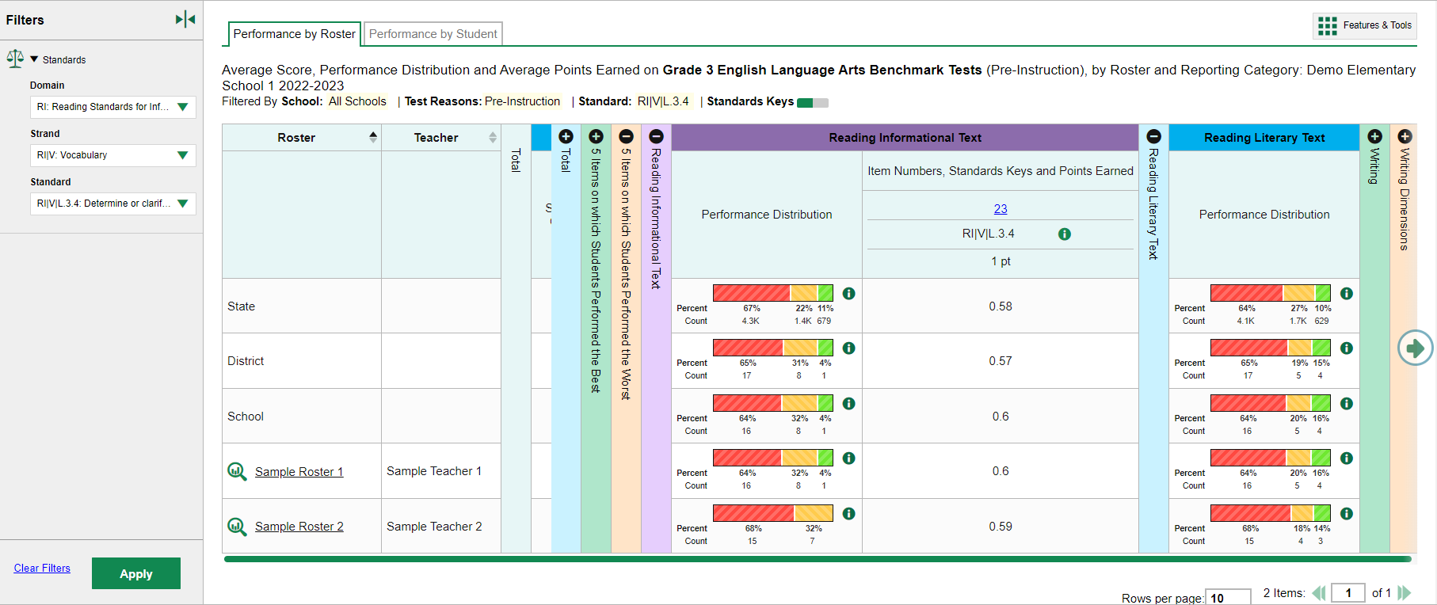
Understand a Filtered Report
Notes:
Here you see the filtered report. It shows that one item, #23, displays in the Reading Informational Text category. The cell under the item number displays the domain, RI, the Strand, V, the Standard, L 3.4. The other reporting categories display on the report, but no items appear in them because the items in those categories do not match the filter selections.
Item #23 is worth one point. The average score of the students on both sample rosters is about .6. You can see that there are 25 students on Sample Roster 1, and 64% of them performed at the Below Proficient level, 32% of them at Near Proficient, and 4% of them at Above Proficient level in the Reading Informational Text category. You need to drill deeper into the individual student results to find out how to improve the performance in that domain. The students on Roster 2 have similar results.
To see a list of all the students on all the rosters in this report, toggle to the Performance by Student tab at the top of the report. To view just the students on one roster, click the underlined name of a roster or click the green magnifying glass button beside it.

Slide 8
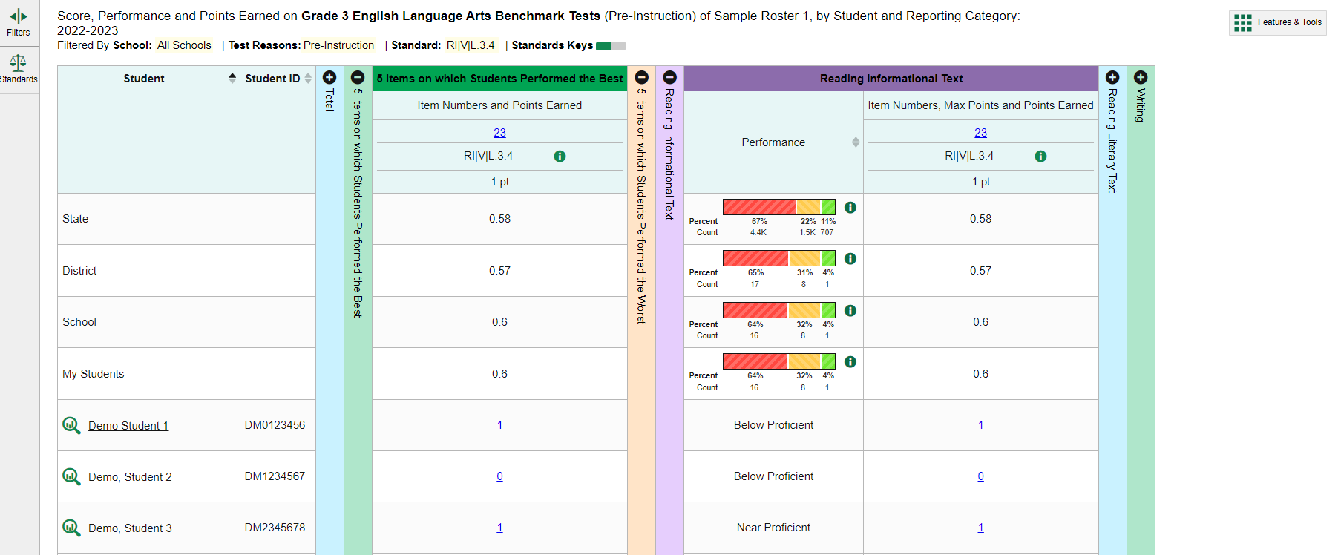
Comparing Student Scores on a Filtered Report
Notes:
Here are the results of the students on Sample Roster 1. Each student score displays as a blue link that can be opened to display item #23 and the student’s response to it. As an example of another possible comparison, the 5 Items on which Students Performed the Best section is open, showing that Item #23 was one that the students collectively performed well on. You can see that their scores were in line with the State, District, School, and other students’ scores.
There are many ways you can filter your data to get the results you need to see. For more information about working with item-level data, please view the training module: The Centralized Reporting System—Working with Item-Level Data for Ohio Assessments. It is located on the Ohio Assessment Test Portal.
The filter selections persist until you log out of the system, or you apply the Clear Filters button in the Filters panel.

Slide 9
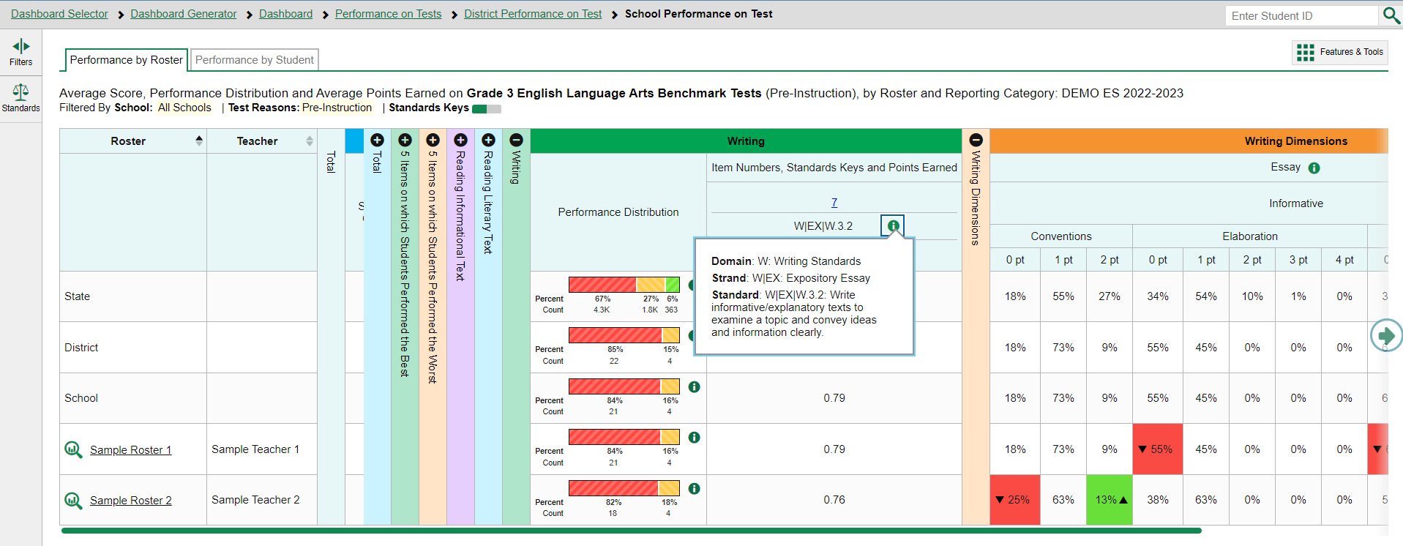
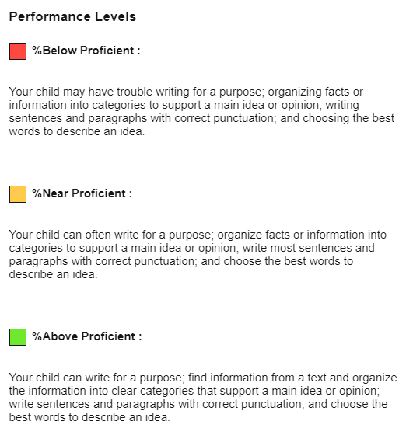
The Writing Reporting Category—Performance by Roster
Notes:
Here you see the Grade 3 ELA Benchmark Test with a writing item worth 10 points. The Writing category shows the average points earned for two sample rosters and those can be compared to State, District, and School averages. The Performance Distribution bar shows the distribution of scores by percent and count in this category. The legend for the Performance Levels is shown here. The information button next to the standard displays the domain, strand, and standard assessed by the Writing item. The item number displays as a blue link, meaning that the item view window can be opened.
A Writing Dimensions category appears on this report of aggregate results. This category is only available on aggregate reports (district, school, roster). When you drill down into individual student results this category does not apply.

Slide 10
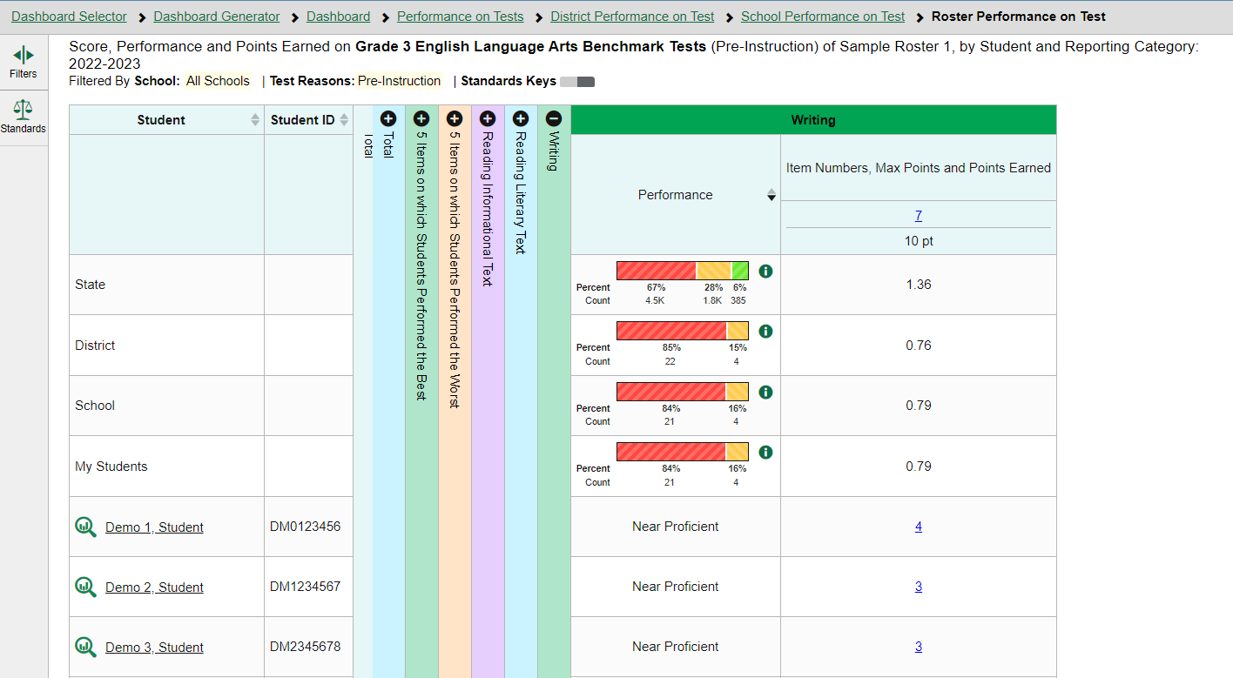
The Writing Reporting Category—Performance by Student
Notes:
Here is the student performance report for the same test showing the point values earned for each individual student. The blue item score links are clickable, allowing you to view the student’s response to the essay prompt. The Writing Dimensions category no longer displays.

Slide 11
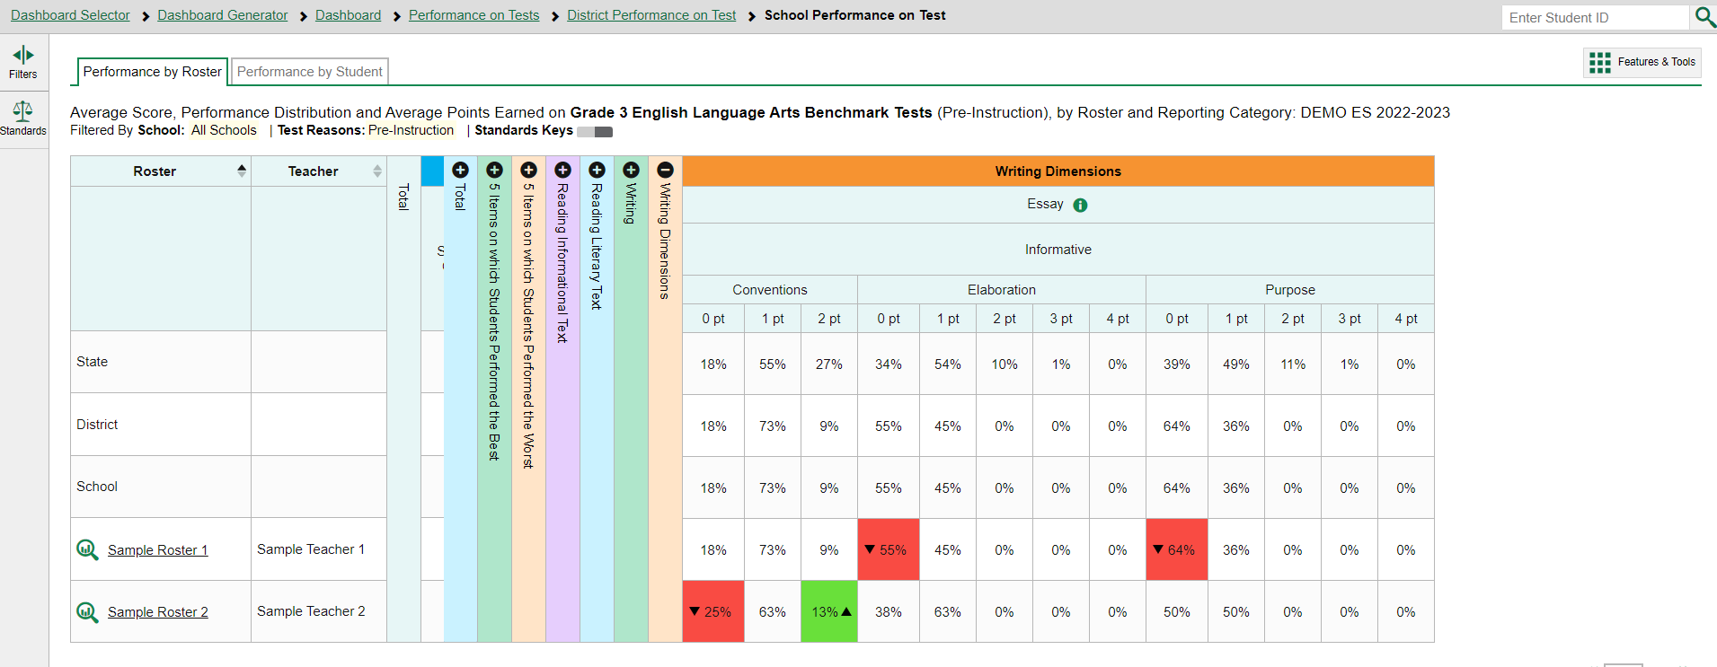
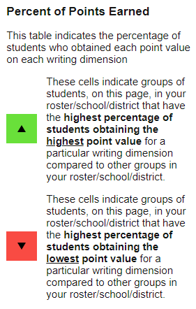
The Writing Dimensions Reporting Category
Notes:
The Writing Dimensions reporting category appears after the Writing reporting categories on aggregate reports of assessments that include a writing item.
The columns within the Writing Dimensions category are nested below the Essay header. In this example, the essay is Informative. Below are three columns for the dimensions: Conventions, Elaboration, and Purpose. Below that are sub-columns for the possible points students can earn in the three dimensions: 0 points, 1 point, 2 points, 3 points, or 4 points. The cells below show the percentage of students in a roster who earned each point value in each dimension. For example, of the students in Sample Roster 1, 9% earned 2 points or full value in Conventions, 73% of them earned 1 point, and 18% of them earned 0 points.
To help you analyze your students’ performance in the different dimensions, certain cells are highlighted green or red. The cell with the highest percentage of students earning the highest point value for a dimension is shaded green and displays an up arrow in the cell. These students performed well in that dimension as compared with other students. The cell with the highest percentage of students earning the lowest point value for a dimension is shaded red and displays a down arrow. These students performed comparatively poorly. You can see this in Sample Roster 1 where 55% of the students earned 0 points in Elaboration, and 64% of the students earned 0 points in Purpose.
Currently writing dimensions data is available on most OST and Readiness Assessments ELA tests.

Slide 12
Writing Dimensions—High and Low Point Values
Notes:
The shading serves as a visual flag. The goal is to help users identify patterns where groups of students are doing consistently well or consistently poorly. And even if there is no pattern, it allows the user to focus on areas that need remediation and to figure out what is working well and can be shared across classes.

Slide 13
More Help
Further Information: Centralized Reporting System User Guide, 2022-2023
https://oh.portal.cambiumast.com/
Email OHHelpdesk@cambiumassessment.com
or
Call 1-877-231-7809
Notes:
Thank you for taking the time to view this training module. For detailed information, consult the Centralized Reporting System User Guide, 2022-2023, located on the test portal or contact the Ohio Help Desk.

Slide 14
The CRS Series
The Centralized Reporting System: The Basics for Ohio Assessments
The Centralized Reporting System: Generating ISRs and Student Data Files for Ohio Assessments
The Centralized Reporting System: Viewing Results within Reporting Categories for Ohio Assessments
The Centralized Reporting System: Working with Item-Level Data
The CRS Series, specifically created for Ohio Readiness Assessments:
How to Access Your Readiness Assessments Data in the Centralized Reporting System
How to Use the Advanced Features of the Centralized Reporting System to View Your Benchmark and Checkpoint Data
How to Modify Machine Scores and Hand-Score Unscored Items
Notes:
There is a 4-part series of CRS trainings for the Ohio Assessments: OST, Readiness Assessments, and AASCD. They are:
The Centralized Reporting System: The Basics for Ohio Assessments
The Centralized Reporting System: Generating Individual Student Reports and Student Data Files for Ohio Assessments
The Centralized Reporting System: Viewing Results within Reporting Categories for Ohio Assessments
The Centralized Reporting System: Working with Item-Level Data
In addition to this series, there is a 3-part series of training modules that focus specifically on the Readiness Benchmark and Checkpoint tests. They are:
How to Access Your Readiness Assessments Data in the Centralized Reporting System
How to Use the Advanced Features of the Centralized Reporting System to View Your Benchmark and Checkpoint Data
How to Modify Machine Scores and Hand-Score Unscored Items
These modules can be found on the Ohio Assessments Portal.

