Slide 1
The Centralized Reporting System—Generating ISRs & Student Data Files for Ohio Assessments:
- Ohio’s State Tests (OST)
- Readiness Assessments
- Ohio’s Alternate Assessments for Students with the Most Significant Cognitive Disabilities (AASCD)
2022–2023
Copyright © 2022 Cambium Assessment, Inc. All rights reserved.
The data is this training is for training purposes only and do not
represent actual results. All names and ID numbers are fictitious.
Notes:
Welcome to the training module on generating Individual Student Reports, or ISRs, and Student Data Files in the Centralized Reporting System for Ohio’s Assessments: Ohio’s State Tests, or OST, the Readiness Assessments, and Ohio’s Alternate Assessments for Students with the Most Significant Cognitive Disabilities, or AASCD. A variety of sample tests are used in this module and the data reflected is for training purposes only. The examples are drawn from the listed assessments. Information about generating Individual Student Reports and Data files in CRS is also applicable to Ohio’s English Language Proficiency Assessments.
This training is based on the Centralized Reporting System User Guide, 2022–2023, which is available on the Ohio Assessment System test portal. There is a list of the full CRS Training Module Series on the last slide of this presentation.

Slide 2
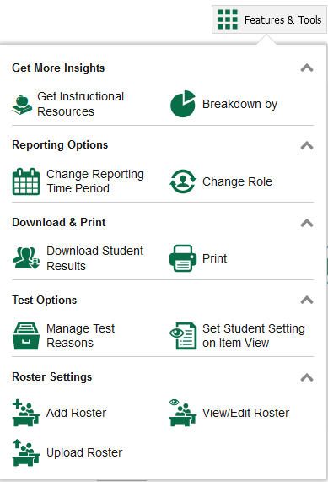
Download Student Results
Two Types of Results
Individual Student Reports (ISRs)
The Student Data File
Notes:
This training module covers the two options available under the Download Student Results button in Features & Tools. You can generate an Individual Student Report, or ISR, and generate a Student Data File. ISRs are covered first. The two processes are very similar in nature.
An ISR is a PDF that displays test results for a single test opportunity taken by a student. It may consist of a single page or multiple pages. ISRs are useful for sharing performance information with students and their parents and guardians. A Student Data File is an Excel, CSV, or text file of the information used for analysis.
The Student Results Generator button is the “head and shoulders” icon located in the Features & Tools menu, under the Download & Print options. It is labelled Download Student Results. When you click it, the Student Results Generator pop-up window displays.

Slide 3
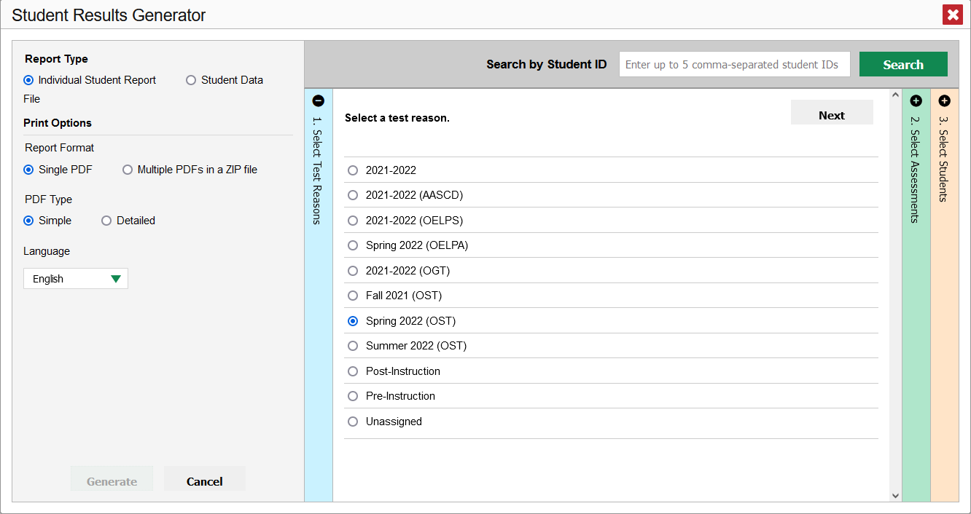
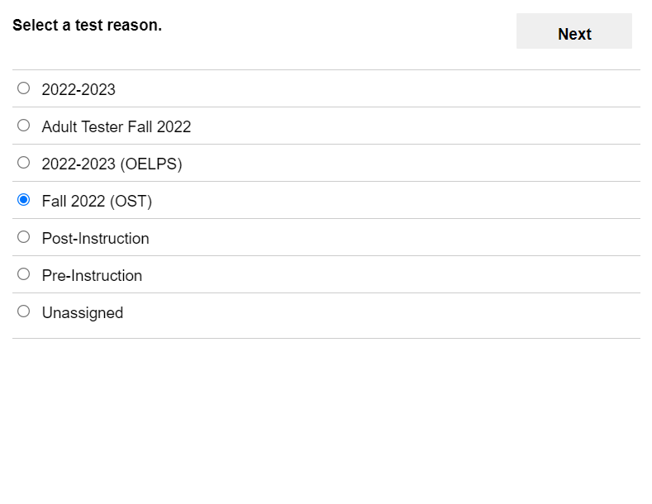
Build Individual Student Reports
Start with Selecting a Report Type
Notes:
The Student Results Generator button is the “head and shoulders” icon located in the Features & Tools menu, under the Download & Print options. It is labelled Download Student Results. When you click it, the Student Results Generator pop-up window displays. Both reports, the ISR and the Student Data File, are typically built by completing three numbered and colored sections:
#1 Select Test Reasons
#2 Select Assessments
#3 Select Students.
On the next few slides are the steps of generating an ISR. You construct the Student Data File in the same way, with different Print Options.
Before going through the numbered sections, note that there are several selections available under Print Options for an ISR.
You can choose a single PDF or multiple PDFs in a zip file.
You can select a simple or detailed ISR. Simple ISRs are generally one page. Detailed ISRs are multiple pages and contain more details about the student’s performance.
If you select tests in section 2 with translated ISRs available, the language drop down will appear. The specific languages offered (if available) vary by assessment program.
You move between sections by using the Previous and Next buttons or by clicking the plus and minus symbols at the top of a section. The Student Results Generator opens in default mode with the Select Test Reasons page expanded and Student Data selected.

Slide 4
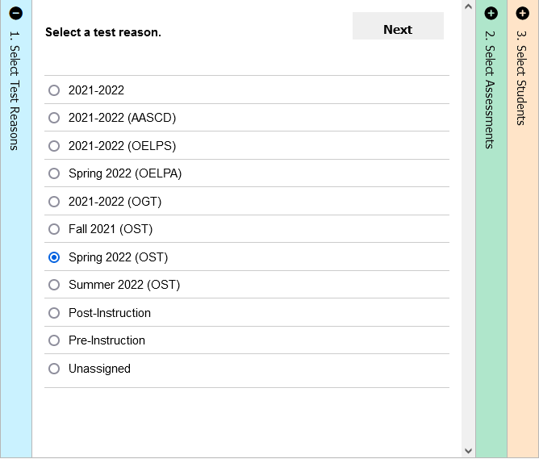
Select a Test Reason
Notes:
Section #1 is Test Reasons. Test reasons for summative tests represent the test administration windows. Test reasons for non-summative tests can be categories, like pre-instruction or post-instruction. After making a selection, move to section two: Select Assessments.

Slide 5
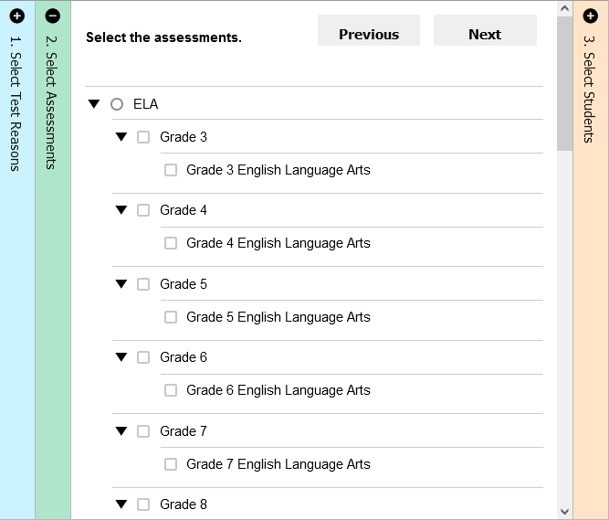
Select Assessments
Notes:
Column 2 lists assessments by subject and grade. Select individual assessments or subjects. When you are generating ISRs you can select multiple grades under ONE subject, but not multiple subjects. Move to section three: Select Students.

Slide 6
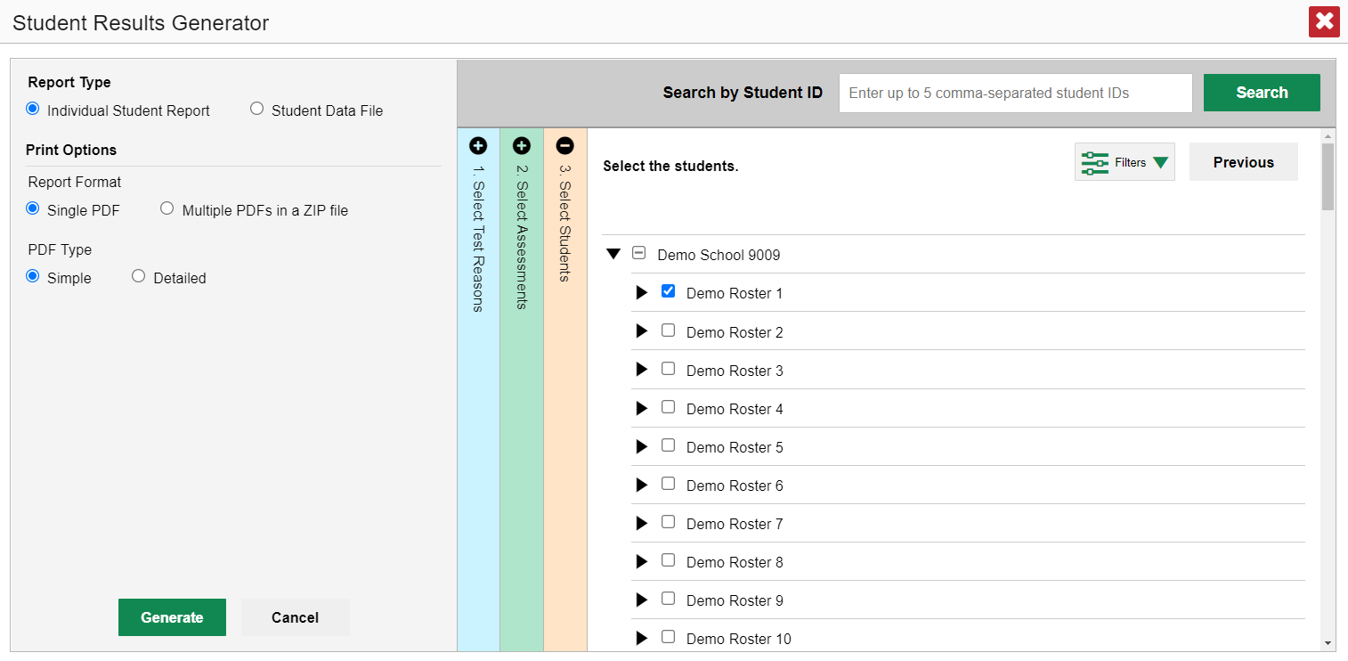
Select the Students
Notes:
Column 3 is labeled Select Students. The Select Students column displays the rosters in the Demo School. This section will load results depending on the user’s role. Teachers and school-level users will see a list of rosters with student names below. Each roster can be expanded to show the students on that roster by clicking on the arrow next to the roster name. District users will see a list of schools. Make your selections and click Generate. The file will post to your Secure Inbox.
District test coordinators are limited to selecting students from up to THREE schools only.

Slide 7
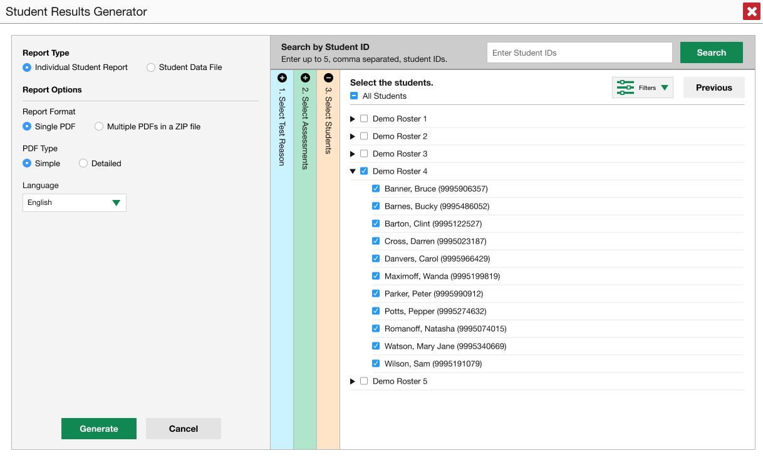
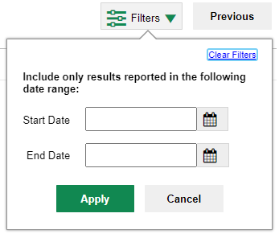
Another Customizing Option
Notes:
Another customizing option is accessed via the Filters button which is in the Select Students section to the left of the Previous button. You can select a range of dates to be included in the ISR by using the calendar to enter a start date and an end date. Click Apply. After making your customizations, click the green Generate button and the ISR(s) will post to your Inbox.

Slide 8
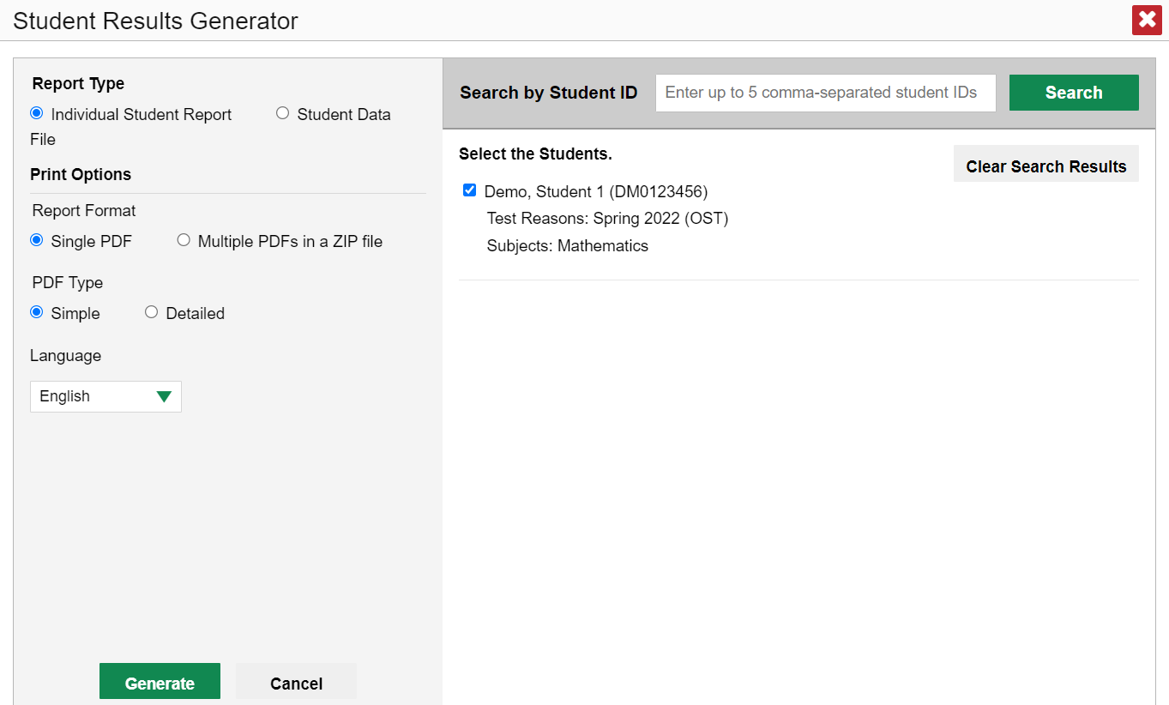
ISR from the Student Portfolio Report
Notes:
If you click the Download Student Results button from the Student Portfolio Report, the data will load pre-populated, as shown here, without the three colored panels. You see the student’s name and SSID, the test reason, and the subject. You can clear the Student Portfolio selection by clicking Clear Search Results. That removes the selected student and takes you to the three panels you can select from, with nothing pre-selected.
When you click the green Generate button, the report will be available in your Inbox.
If you need to print just a few more student’s ISRs, you can enter up to five, comma-separated SSIDs in the Search by Student ID box, and the same pre-populated template will display, allowing you to generate the ISRs for all those students’ tests.

Slide 9
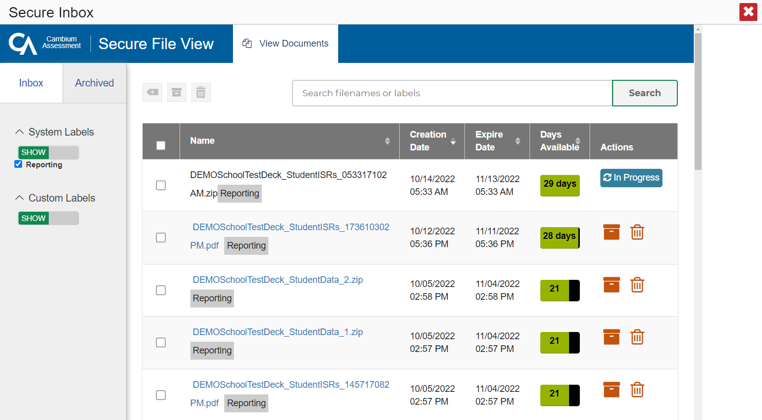
Secure Inbox
Notes:
Here is a sample Secure Inbox showing multiple ISR postings. You can archive or delete a file at any time by using the buttons under the Actions column in the results table. Click on the name of a file to download it to your computer.
Files are automatically deleted after 29 days in both the Inbox and the Archived boxes.

Slide 10
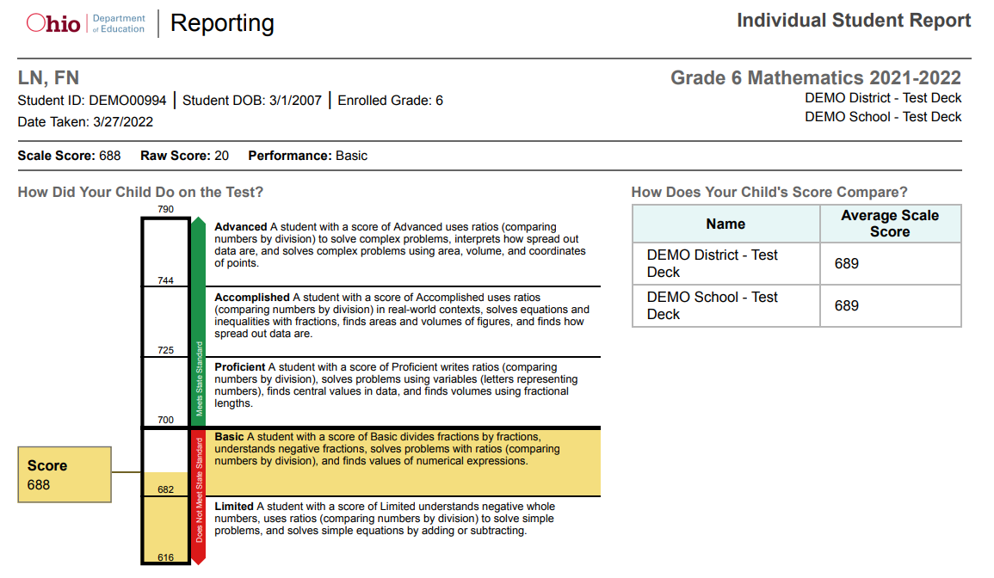
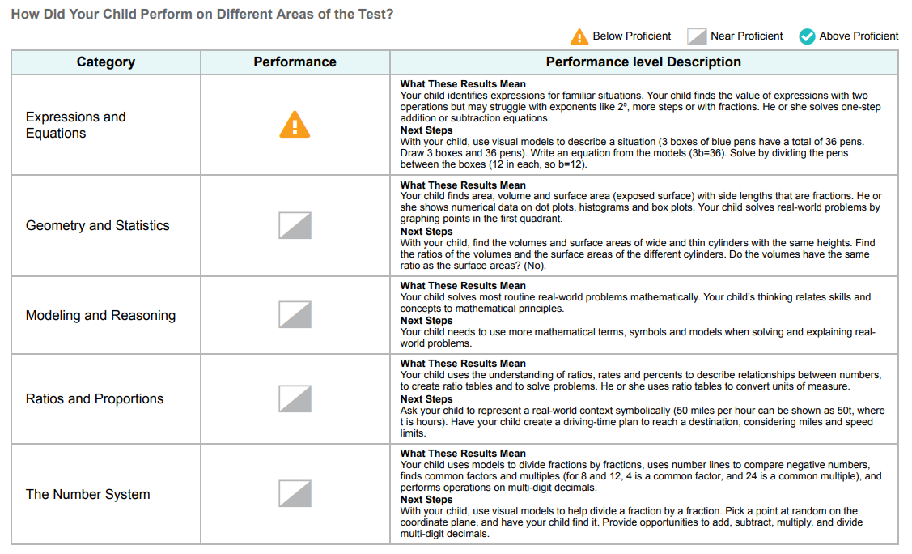
Sample Individual Student Report
Simple ISR
Notes:
Here is a sample ISR. You can order a simple report or the more detailed report. The simple ISR includes the student, school and test information at the top followed by the student’s scores. Next is the barrel chart, providing a visual depiction of the scores, performance level descriptions, and comparison scores. Finally, a chart with reporting category performance and information. Some ISRs may contain additional elements.

Slide 11
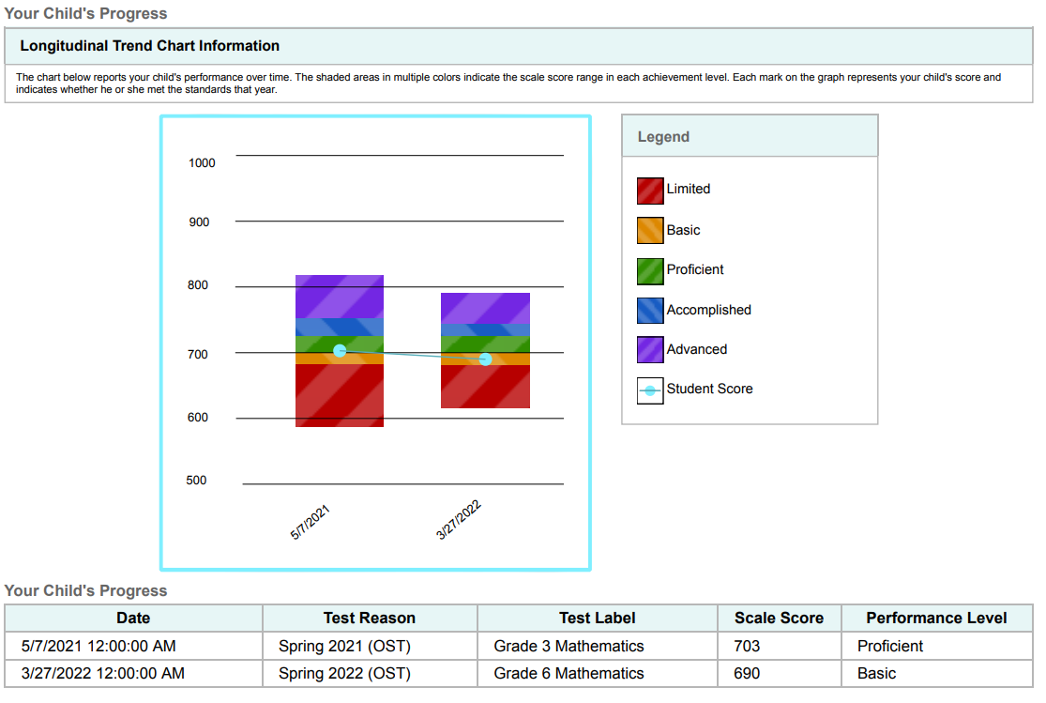
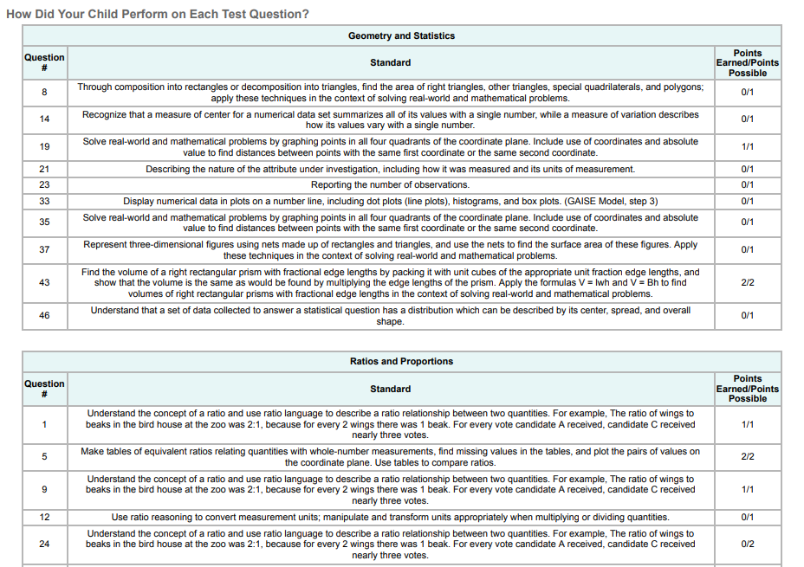
Sample Individual Student Report
Detailed ISR
Notes:
The detailed report may include a longitudinal trend chart section, like the one shown here. You can see the student’s progress over time as the results of the two tests display as performance level and scale score. The shaded areas in multiple colors indicate the scale score range in each achievement level. Each mark on the graph represents the student’s score and indicates whether he or she met the standards that year. Item-level data is included in the detailed ISR for some assessments. Here you see the points earned out of possible points for each standard in the reporting categories of a Mathematics test.

Slide 12
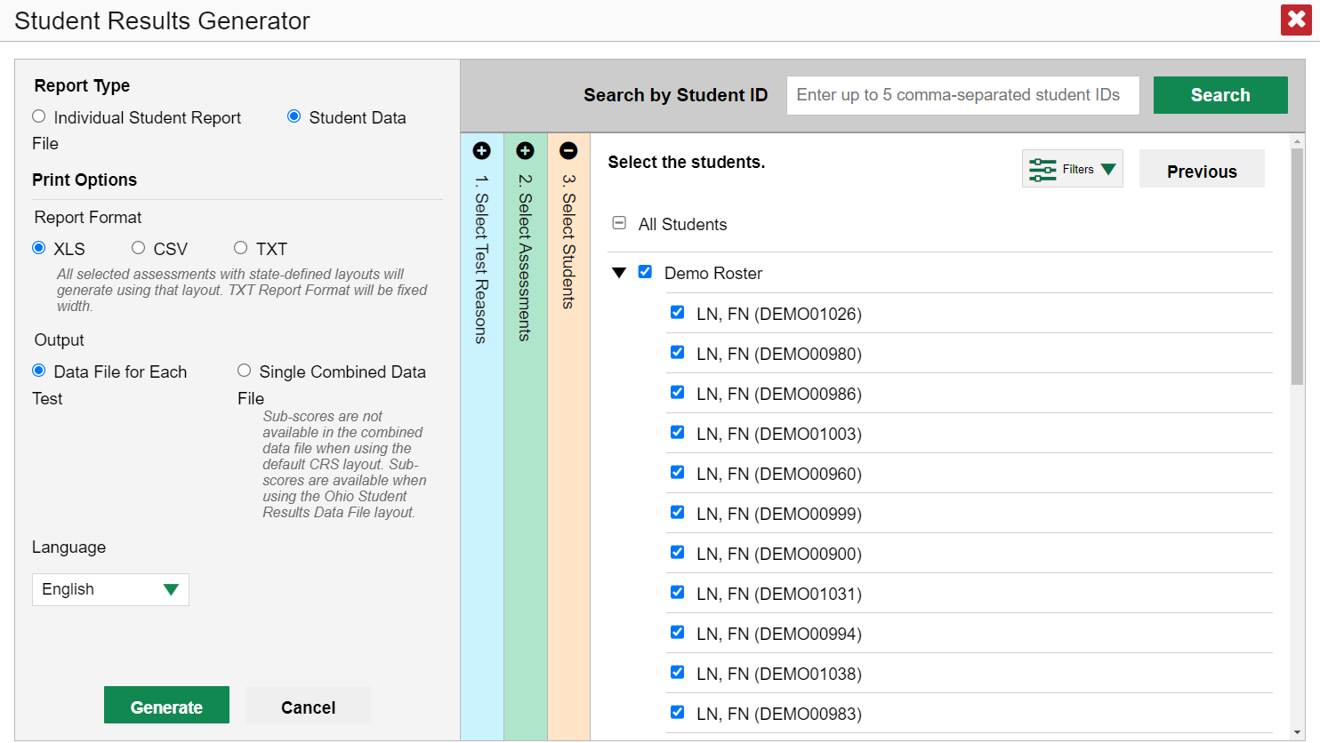
Generate a Student Data File
Notes:
A student data file is a report on performance data delivered in Excel, comma-separated values (CSV), or fixed-width text format. The generated file will use a layout based on the school year for that data and the assessment. These layouts are available on the test portal. Some years and assessments use the default CRS layout instead of an assessment specific layout.
Files of this nature allow the user to employ the workbook features of a spreadsheet application to organize and sort the data or to upload the data into student information systems. The generation process for a student data file is the same one used for the ISR with different print options. Customize the student data file using the same three selection columns. Choose your desired file format and output type, then click the green Generate button. The student data file displays in the user’s Inbox.

Slide 13
Sample Student Data File
Notes:
Here is a sample Student Data File.

Slide 14
Generating ISRs and Student Data Files
ISRs
Student Data Files
One test reason
A single subject; multiple grades
Up to 3 schools for district-level users
Language (if available)
One test reason
Multiple subjects; multiple grades
Multiple schools in a district
Data file for each test or combined data file
Notes:
Here is a review of the options for each type of report: ISRs and Student Data Files.
Options for ISRs include:
One test reason
A single subject: multiple grades
Up to three schools for district-level users
Language (if available)
Options for Student Data Files include:
One test reason
Multiple subjects; multiple grades
Multiple schools in a district
Data file for each test or combined data file

Slide 15
More Help
Further Information: Centralized Reporting System User Guide, 2022-2023
https://oh.portal.cambiumast.com/
Email OHHelpdesk@cambiumassessment.com
or
Call 1-877-231-7809
Notes:
Thank you for taking the time to view this training module. For detailed information, consult the Centralized Reporting System User Guide, 2022-2023, located on the test portal, or contact the Ohio Help Desk.

Slide 16
The CRS Series
The Centralized Reporting System: The Basics for Ohio Assessments
The Centralized Reporting System: Generating ISRs and Student Data Files for Ohio Assessments
The Centralized Reporting System: Viewing Results within Reporting Categories for Ohio Assessments
The Centralized Reporting System: Working with Item-Level Data
The CRS Series, specifically created for Ohio Readiness Assessments:
How to Access Your Readiness Assessments Data in the Centralized Reporting System
How to Use the Advanced Features of the Centralized Reporting System to View Your Benchmark and Checkpoint Data
How to Modify Machine Scores and Hand-Score Unscored Items
Notes:
There is a 4-part series of CRS trainings for the Ohio Assessments: OST, Readiness Assessments, and AASCD. They are:
The Centralized Reporting System: The Basics for Ohio Assessments
The Centralized Reporting System: Generating Individual Student Reports and Student Data Files for Ohio Assessments
The Centralized Reporting System: Viewing Results within Reporting Categories for Ohio Assessments
The Centralized Reporting System: Working with Item-Level Data
In addition to this series, there is a 3-part series of training modules that focus specifically on the Readiness Benchmark and Checkpoint tests. They are:
How to Access Your Readiness Assessments Data in the Centralized Reporting System
How to Use the Advanced Features of the Centralized Reporting System to View Your Benchmark and Checkpoint Data
How to Modify Machine Scores and Hand-Score Unscored Items
These modules can be found on the Ohio Assessments Test Portal.

