Slide 1
The Centralized Reporting System—
The Basics for Ohio Assessments:
- Ohio’s State Tests (OST)
- Readiness Assessments
- Ohio’s Alternate Assessments for Students with the Most Significant Cognitive Disabilities (AASCD)
2022–2023
Copyright © 2022 Cambium Assessment, Inc. All rights reserved.
The data is this training is for training purposes only and do not
represent actual results. All names and ID numbers are fictitious.
Notes:
Welcome to the training module on the basics of the Centralized Reporting System for Ohio’s Assessments: Ohio’s State Tests, or OST, the Readiness Assessments, and Ohio’s Alternate Assessments for Students with the Most Significant Cognitive Disabilities, or AASCD. A variety of sample tests are used in this module and the data reflected is for training purposes only. The examples are drawn from the listed assessments. Basic information about CRS is also applicable to Ohio’s English Language Proficiency Assessments.
This training is based on the Centralized Reporting System User Guide, 2022–2023, which is available on the Ohio Assessment System test portal. There is a list of the full CRS Training Module Series on the last slide of this presentation.

Slide 2
Topics Covered in this Training
Topics | Slides
1. Log in to the Centralized Reporting System (CRS) & Understand User Roles | 3–6
2. Dashboard Generator Page & the Dashboard | 7–10
3. Performance on Tests Report | 11–15
4. Change Reporting Time Period | 16
5. Teacher, School, District and Student Reports | 17–25
6. Tests with Reporting Categories | 26–28
7. Print & Export Data | 29–32
8. Generate ISRs & Student Data Files | 33–35
9. Create Rosters | 36–39
10. Use the Longitudinal Report & the Demographic Breakdown Report | 40–44
11. Contact Information & The CRS Series | 45–46
Notes:
There are eleven topics covered in this training module. You can jump to the section slides if you need information on a single topic. The topics are:
1. Log in to the Centralized Reporting System, or CRS & Understand User Roles
2. Dashboard Generator Page & the Dashboard
3. Performance on Tests Report
4. Change Reporting Time Period
5. District, School, Teacher, and Student Reports
6. Tests with Reporting Categories
7. Print & Export Data
8. Generate ISRs & Student Data files
9. Create Rosters
10. Use the Longitudinal Report & the Demographic Breakdown Report
11. Contact Information & The CRS Series

Slide 3
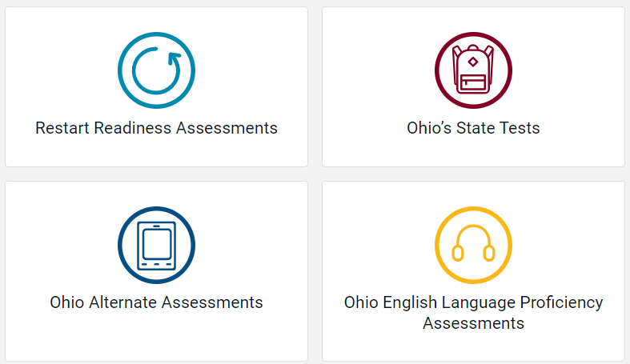
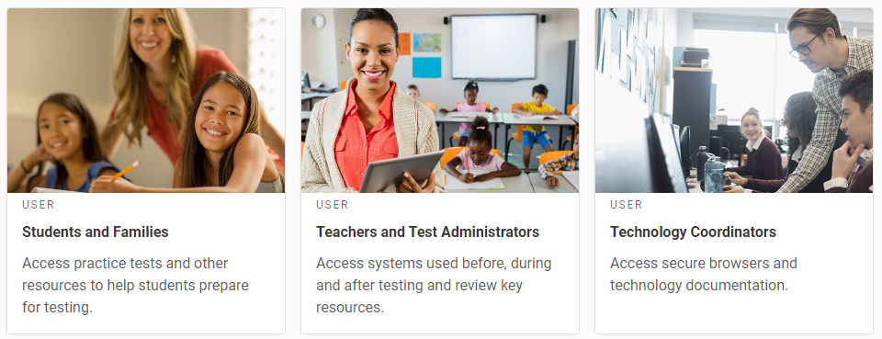
Log In to Centralized Reporting
Notes:
To log in to Centralized Reporting, go to the Ohio Assessment System portal. Select the appropriate assessment card and on the following page, select the Teachers and Test Administrators card.

Slide 4
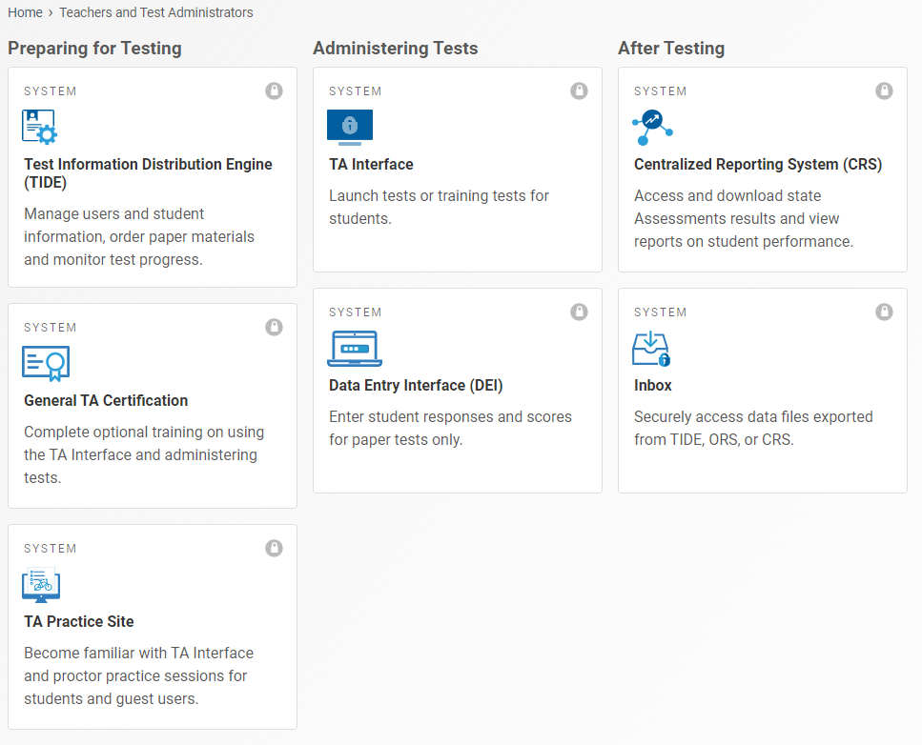
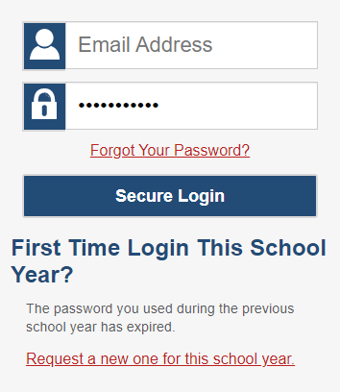
Log In to Centralized Reporting
Notes:
Then select the CRS card in the After Testing column of the Teachers and Test Administrators page. When the log in page appears, enter the email address associated with your Test Information Distribution Engine , or TIDE, account and your unique password. Select Secure Login.

Slide 5
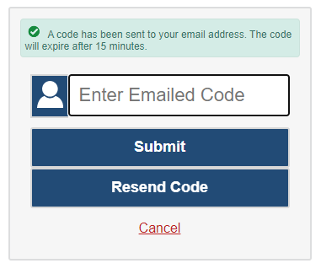
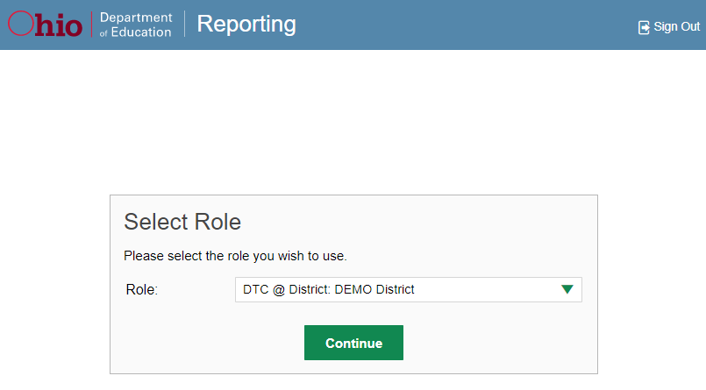
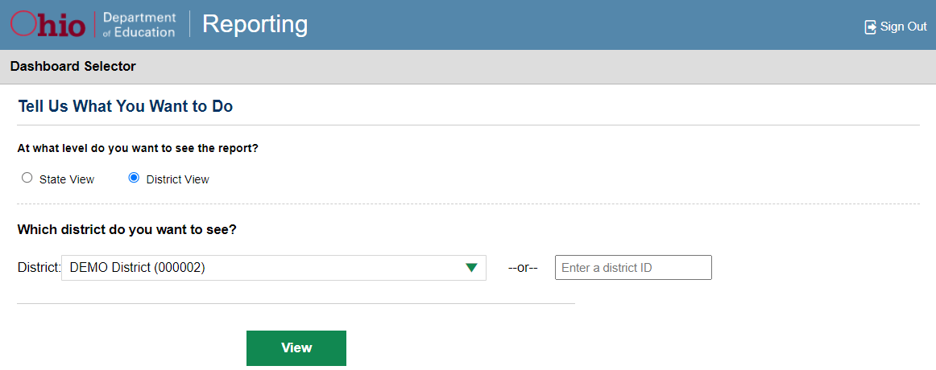
Log In to Centralized Reporting: Additional Screens
Notes:
You may see an Enter Emailed Code page. If so, enter the code sent to your email address and click Submit. Depending on your assigned user role, you may be prompted to make selections from the “Tell Us What You Want to Do” page. Make your selections and click View to display the Dashboard Generator. If you are assigned multiple roles, you may be prompted to select an option on the Select Role page . Click Continue. The Dashboard Generator page displays.
The next slide summarizes user roles.

Slide 6
Understand Different User Roles
User | Which Students Appear in Your Reports | Filter Options | Aggregate Comparisons Available
Teacher (TE) | All students in your classes who have completed assessments | By class roster | Your students School District State
School (BTC, BRU) | All students in your school who have completed assessments | Select a teacher, then by roster | Your school District State
District (DTC, DA, DRU) | All students in your district who have completed assessments | By school | Your district State
Notes:
Teachers, school-level users, and district-level users have access to different features and data in Centralized Reporting. This chart summarizes which students will appear in your reports, the filter options, and the aggregate comparisons available for each of the three roles.

Slide 7
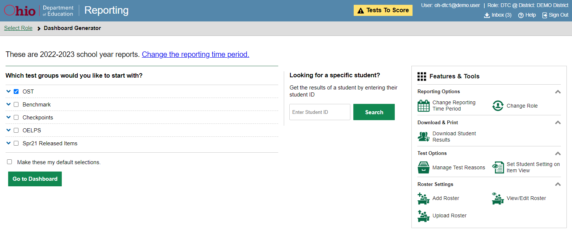
Step 1 in Viewing Reports: Dashboard Generator
1
1
2
3
Notes:
When you log in to CRS, the Dashboard Generator page displays. Viewing reports is a simple three step process. Step 1 is to make selections on the Dashboard Generator. This page displays BEFORE the appearance of the dashboard so you can easily customize your results in order to view only the data that are most helpful to you.
The banner displays your username and your role. Underneath is the secure Inbox, a Help button, and a Sign Out button. If you have test items that need to be scored a yellow alert button appears in the banner.
There are three prominent sections on the page.
In section 1, are the test groups where you can check the tests that apply to your needs and make those your default selections. Here you see drop-down menus for AASCD, Adult testers, Benchmarks, Checkpoints, OELPA, OELPS, OST and Spring 2021 Released Items. If you want to bypass making selections each time you log in to CRS, mark the Make these my default selections box. Your selections will be set in the Dashboard Generator until you change them.
In section 2, you can access an individual Student Portfolio report by entering a student ID number in the search box.
In section 3, is the Features & Tools menu where you can take some actions prior to viewing data on the dashboard. The Features & Tools menu displays on every page in CRS.
Click Go to Dashboard to proceed to the Dashboard.

Slide 8
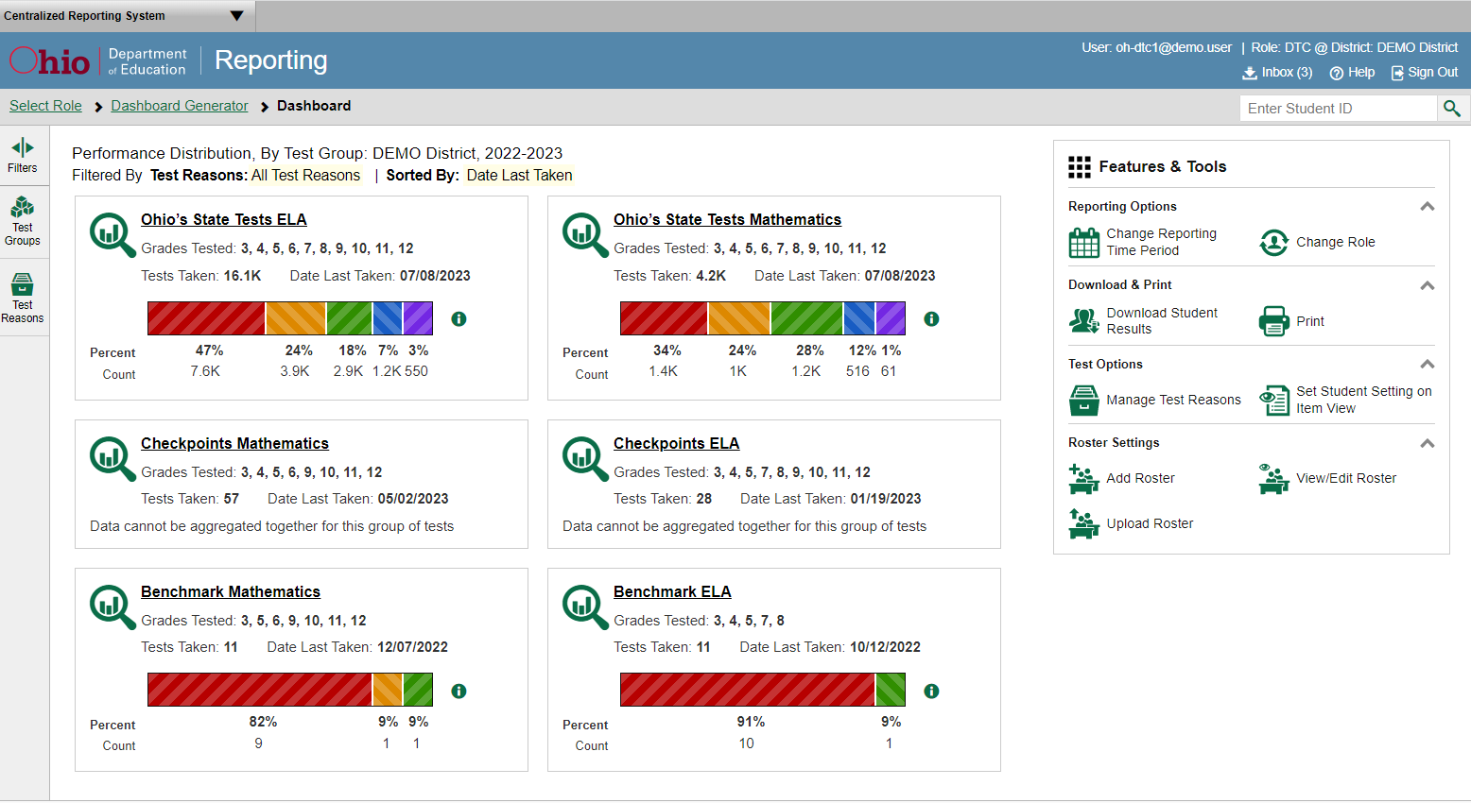
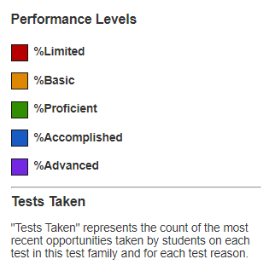
Step 2 in Viewing Reports: Dashboard—Test Group Cards
Notes:
Step 2 is the Dashboard which appears after you select test groups from the Dashboard Generator. Test information and results are displayed for the students who are assigned to you based on your role. Teachers see all the tests their students have taken. School-level users see tests taken by all the students in the school. District-level users see the tests taken by all the students in the district.
A test group card displays for each test, by subject, along with the grades tested and the total number of tests taken. The cards are sorted from left to right, then top to bottom based on the date last taken. The performance distribution results display as a color-coded bar with the percent proficient and student count listed under each colored level. Click the green information button to display the performance levels.
For example, on this district-level Dashboard, 16,100 students took the Ohio English Language Arts test. 47% of them performed at the Limited level, 24% of them at Basic, 18% of them at Proficient, 7% of them at Accomplished, and 3% of them performed at Advanced.
The Checkpoints test group cards do not include a Performance Distribution bar because the data cannot be aggregated for this group of tests. Scores for checkpoint tests display as the number of correct responses over the total numbers of test items, or a raw score.
The data on the dashboard gives teachers, administrators, and principals a high-level way to quickly compare how their students performed across different test groups.

Slide 9
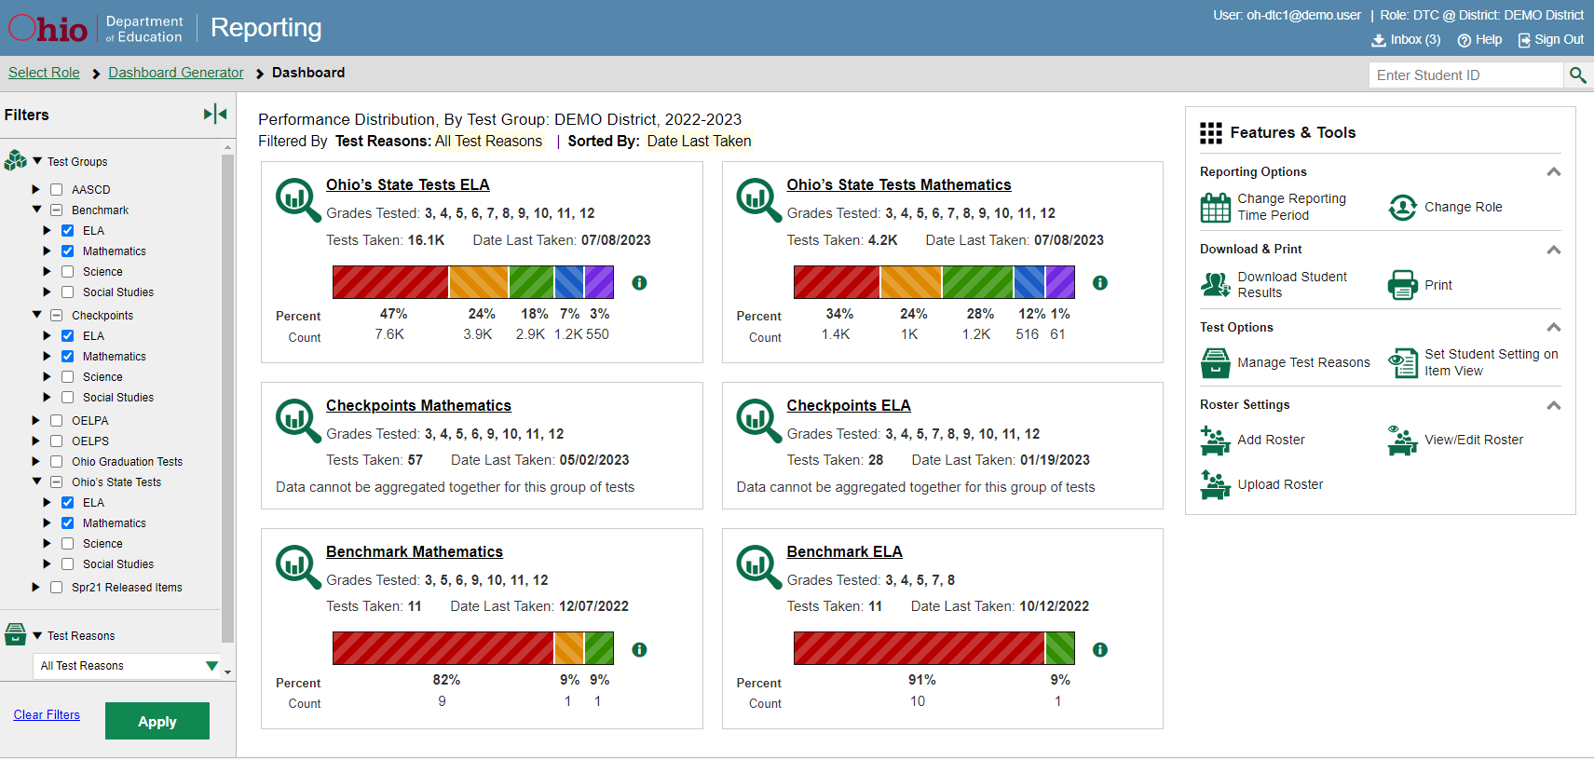
Dashboard—Filters Panel
Notes:
If you want to change the test group cards you see on your dashboard without returning to the Dashboard Generator, use the Filters panel. Make selections from the Test Groups options and/or the Test Reasons options. Test Reasons typically represent test administration seasons or opportunities. Selecting certain test groups and a test reason omits results you do not wish to see.
Click the green Apply button and your dashboard customizes according to your selections. You can see here that the ELA and Mathematics Benchmarks, the ELA and Mathematics Checkpoints, and the OST ELA and Mathematics tests have been applied to this Dashboard. Filter selections are highlighted in yellow in the table of results header. Clear the filters at any time by clicking the Clear Filters button and clicking Apply again.

Slide 10
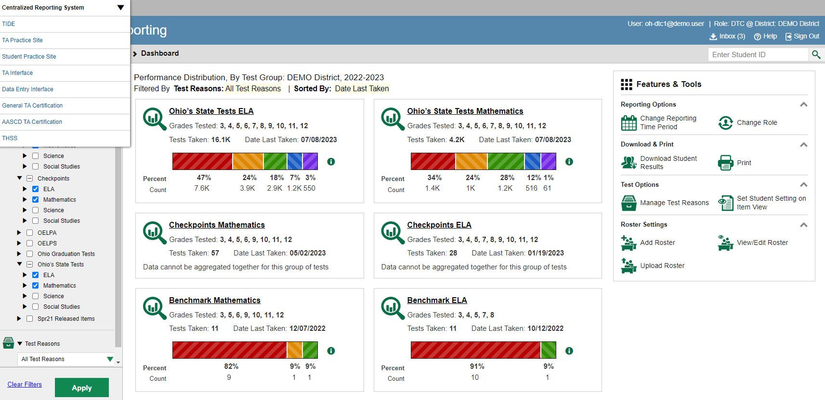
System Switcher
Notes:
In the upper-left corner of each page in Centralized Reporting is the “System Switcher.” You can move from CRS directly into TIDE, the TA Practice Site, the TA Certification course and other systems when you need to perform tasks in those systems. You don’t have to log out and log back in.
To advance to the Performance on Tests report, click the underlined name of a test group card or the green magnifying glass view button.

Slide 11
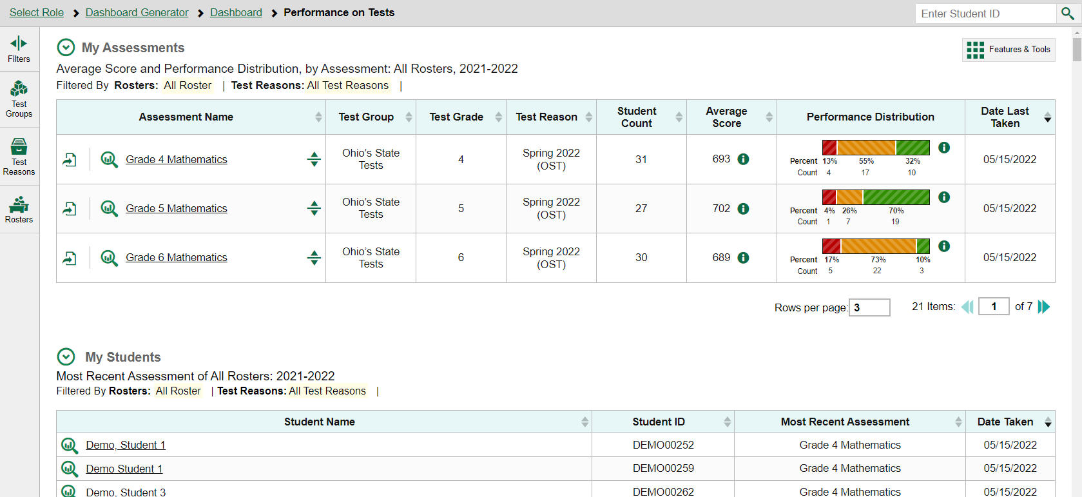
Step 3 in Viewing Reports: Performance on Tests Report—Teacher
Notes:
Step 3 in viewing reports is the Performance on Tests reports. This is where you will select a specific test or student to display. Here is the Performance on Tests report for a teacher who clicked on the OST Mathematics test group card. A teacher’s Performance on Tests reports features TWO tables of results: one for assessments and one for students.
The My Assessments table lists all the tests that the teacher’s students have taken, in order of date last taken.
The My Students table lists all the teacher’s students who took those tests, in order of the most recent test taken and allows quick access to the students’ portfolios.
Teachers have a Rosters option in the Filters panel. They can easily focus on certain groups of students by filtering by rosters. Once a filter is applied, both tables update based on the students in the selected roster.

Slide 12
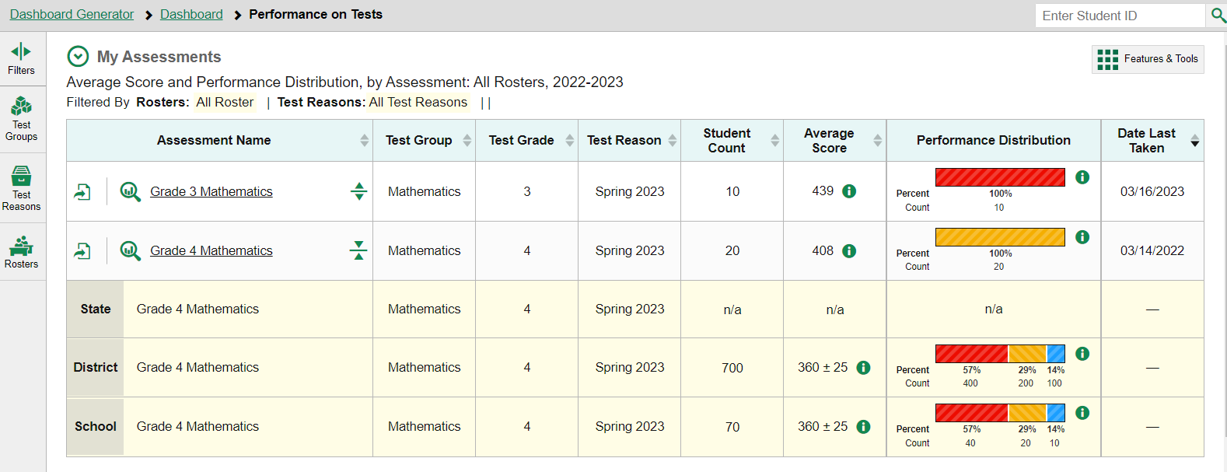
Performance on Tests Report for a Teacher—Aggregate Comparison Rows
1
Grade 3 English Language Arts
Ohio’s State Tests
Grade 3 English Language Arts
Ohio’s State Tests
3
Grade 3 English Language Arts
Ohio’s State Tests
3
Grade 3 English Language Arts
Ohio’s State Tests
3
Grade 3 English Language Arts
Ohio’s State Tests
3
Notes:
Anyone can also compare their students’ results to aggregate state, district, and school data directly from the Performance on Tests page. Simply click the expansion arrows to the right of the assessment name. The aggregates are highlighted in yellow on the report.
Notice that an export button is included for each test in the table. Use it to generate a PDF, Excel, or CSV file of the results for that test. There is more information on this topic in section #7 of this module.
Click on the underlined name of the report or the magnifying glass view button to the left of it to drill down into that test data.

Slide 13
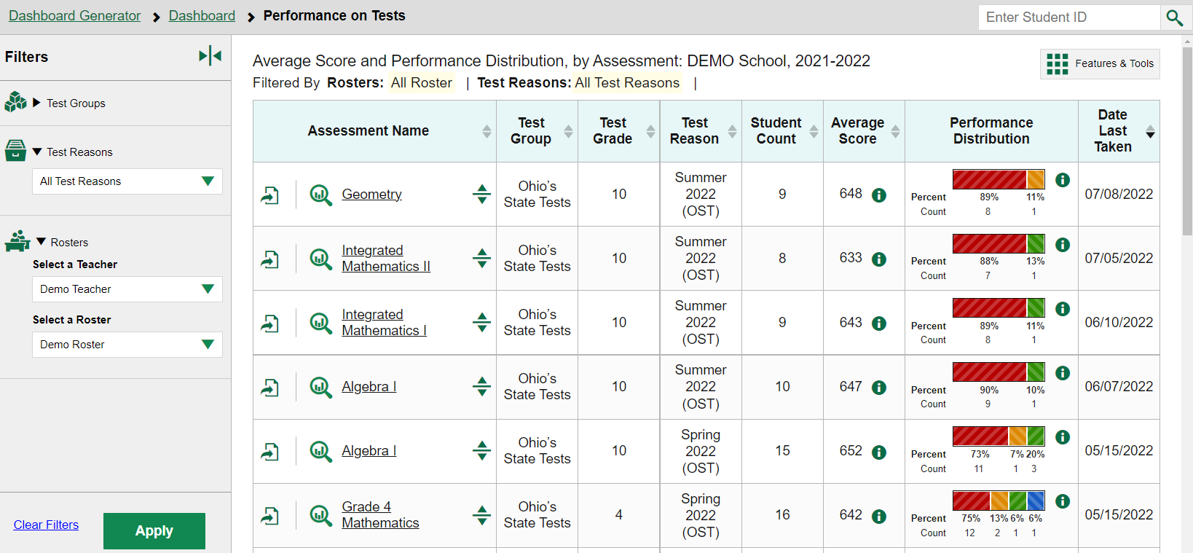
Performance on Tests Report for a School-Level User
Notes:
Here is what a school-level user sees on the Performance on Tests page after clicking the Mathematics OST card on the Dashboard. Each mathematics test is listed in the table. School users can filter their data by Test Groups, by Test Reasons, and Rosters by Teacher and Teacher Roster. Filtering by Teachers and Rosters is a great way for principals and other school level users to focus on specific groups of students. Rosters can be created for any group of students and students can belong to any number of rosters, making them a very flexible way of analyzing results.

Slide 14
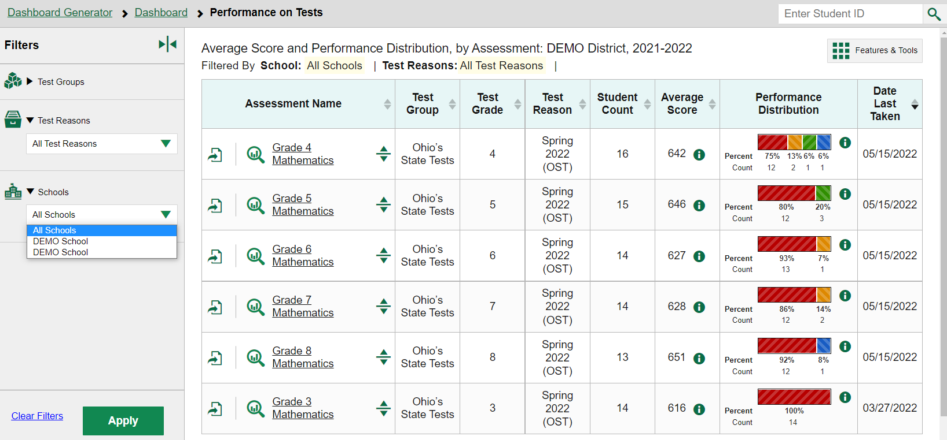
Performance on Tests Report for a District-Level User
Notes:
Here is a Performance on Tests report as it displays for a district-level user who clicked on the Mathematics test group card on the Dashboard. The Filters panel now includes a Schools dropdown menu so that district-level users can filter for one specific school. Select an underlined Assessment Name or click on the magnifying glass view button to see the District Performance on Tests report for that test.

Slide 15
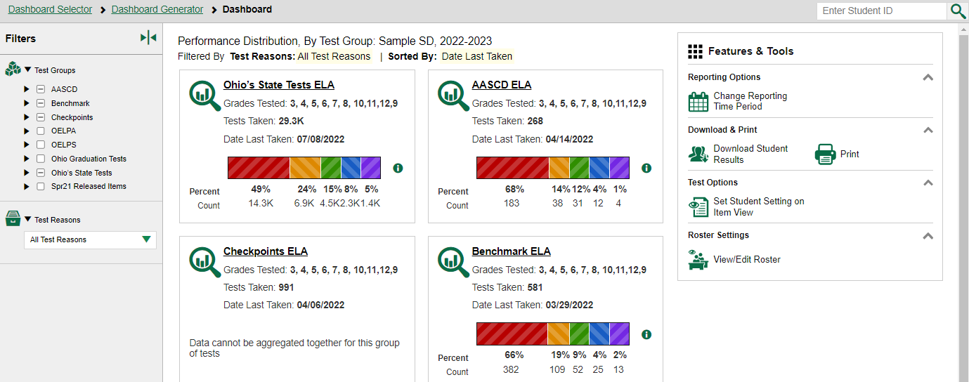
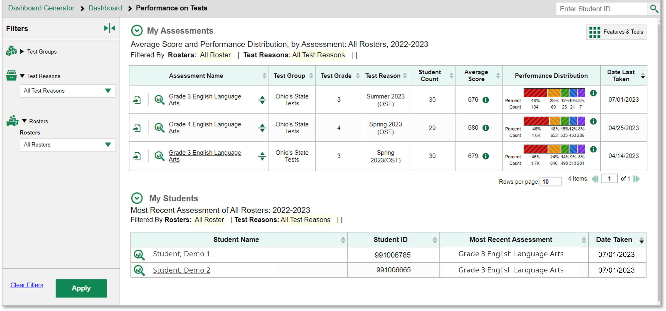
To Review
Step 1
Step 2
Step 3
Notes:
To review the three-step sequence of navigation: CRS opens with the Dashboard Generator, followed by the customized Dashboard, then the Performance on Tests report. From there, you drill down into more specific test data. District users navigate to district reports, school-level users navigate to school reports, and teachers navigate to “My Students’” reports.

Slide 16
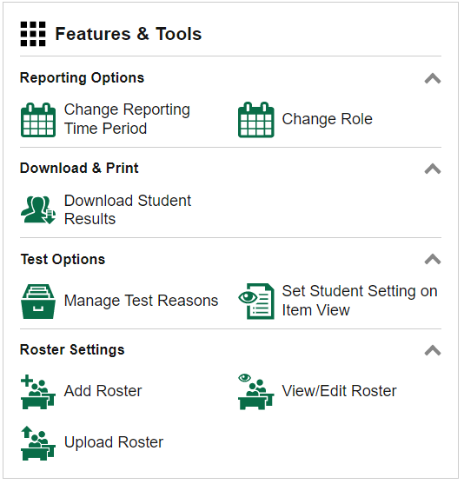
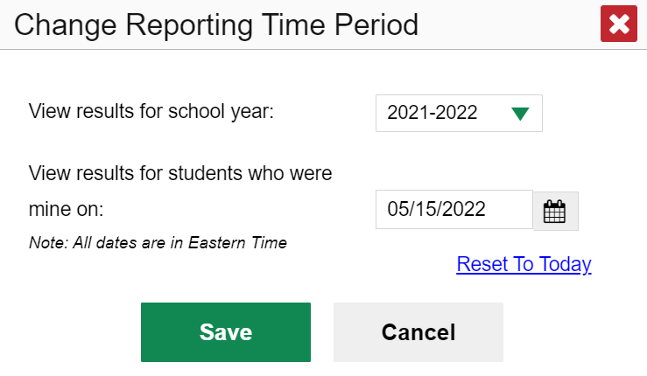
Change Reporting Time Period
Notes:
The Change Reporting Time Period option, available on any page under Features & Tools, allows you to view test results from a previous point in time, for your current students and/or for your former students.
To view previous test results for your current students, select the school year from the drop-down menu. Leave the calendar tool set to the current date.
To view test results for students you had in the past, select a school year from the menu AND use the calendar tool to set a date. The date should be one on which you know these former students were assigned to you. For example, a day in the month of May of that school year, after testing has begun.
Note that for school and district users, your current students is based on students currently active in your school or district in TIDE. For teachers it is active students on your rosters.
When you click Save for either of the two options, your reports will reflect data according to those settings. When you log out of the system, the reporting time period defaults back to the current school year and current date.

Slide 17
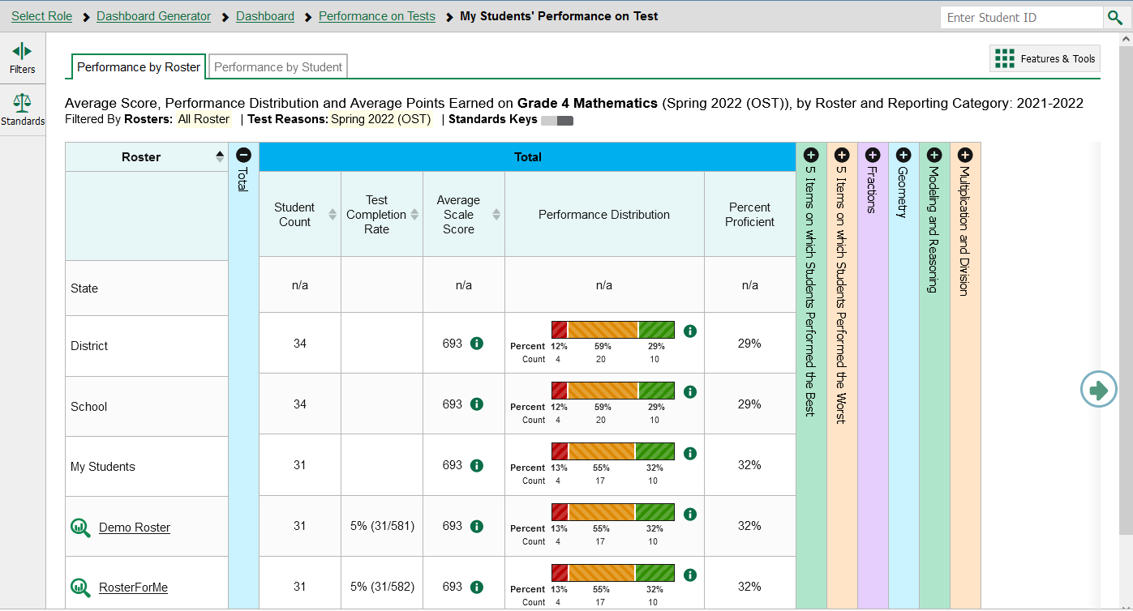
Teachers: My Students’ Performance on Test Report—by Roster
Notes:
When you click on a specific test from the Performance on Tests report, you will arrive at a report for that test. Many of the report elements and features are the same, with some variations based on type of test and user role. To start let’s look at a teacher’s Performance on Test page for the Grade 4 Mathematics test.
School users and teachers see two tabs on the navigation bar: Performance by Roster and Performance by Student. You can toggle between the tabs to change the data from a list of rosters to a list of students.
The report lists the class rosters in the left column along with aggregate comparison rows. Blue columns vary by report type, user role and test and may include the scale score, raw score, average score, student count, performance distribution, test completion rate or other measures. The test completion rate is based on the number of students in the roster that have completed the test. The accordion chart includes expandable sections to dig deeper into the test results.
This Mathematics test includes six expandable categories: Items on which Students Performed the Best; Items on which Students Performed the Worst; and the four reporting categories; Fractions; Geometry; Modeling and Reasoning; and Multiplication and Division.

Slide 18
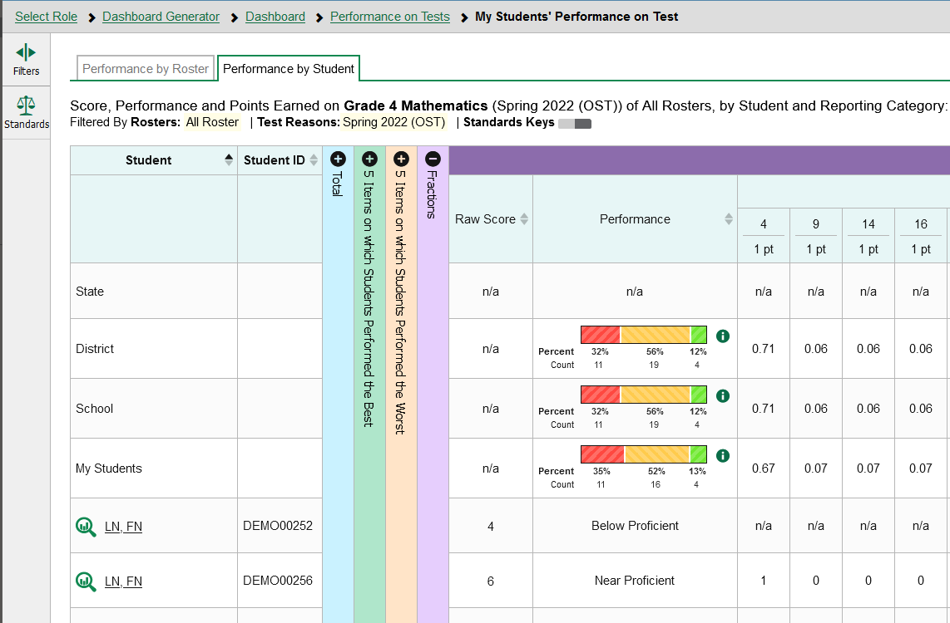
Teachers: My Students’ Performance on Test Report—by Student
Notes:
Here is the same Grade 4 Mathematics test displaying all the teachers’ students who took that test. The Performance measure for each reporting category identifies the level for each individual student. To view the Student Performance on Test report, click the underlined student name or the green magnifying glass view button to the left of the name.

Slide 19
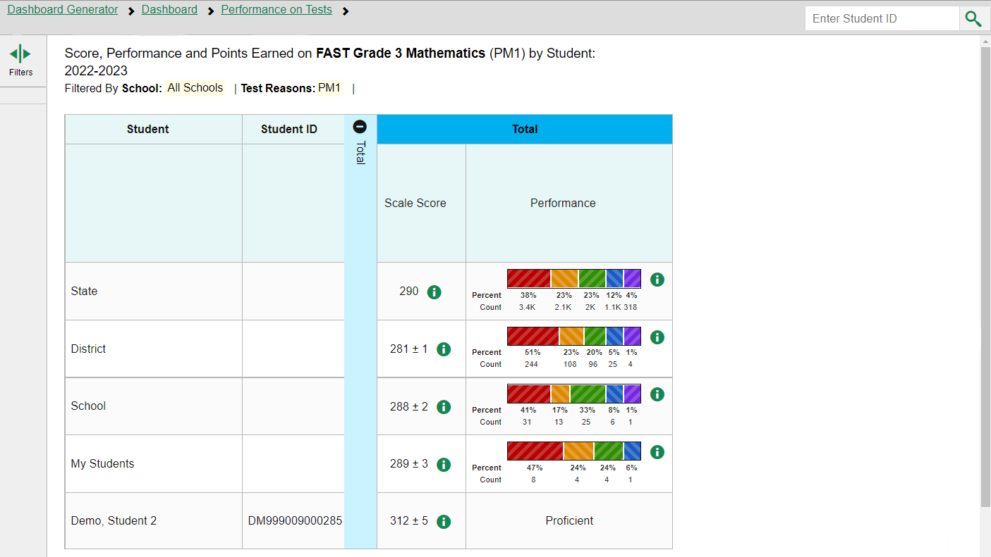
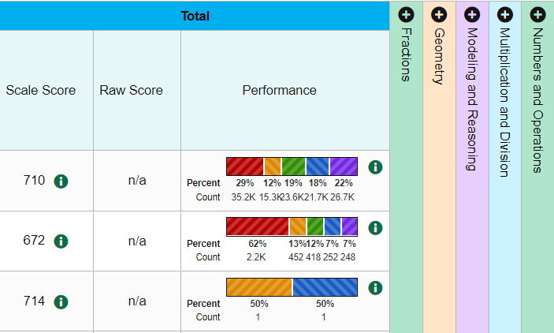
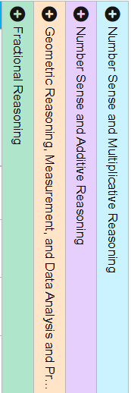
Teachers: Student Performance on Test
Notes:
This Student Performance on Test report is the end of the navigation trail for a teacher. There is no magnifying glass view button next to the Student name, nor is it underlined. Use the navigation trail in the banner to return to any previous report.

Slide 20
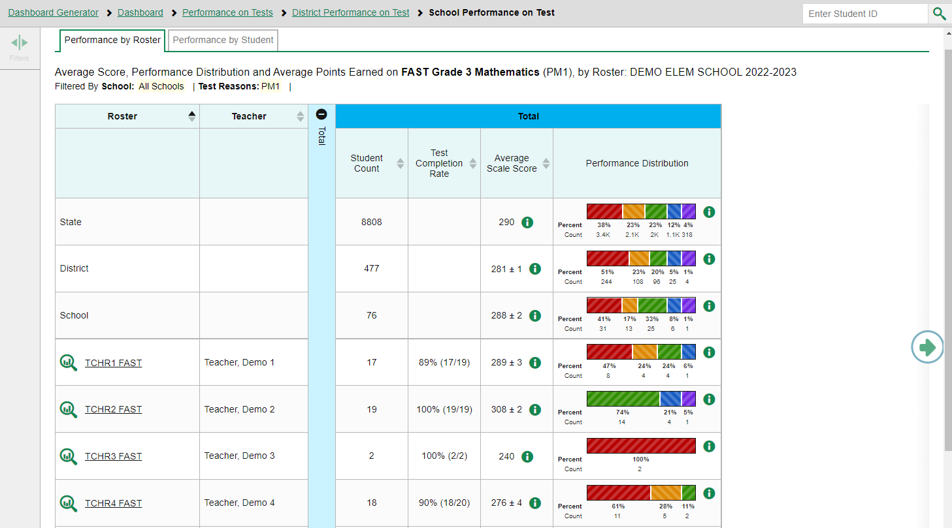
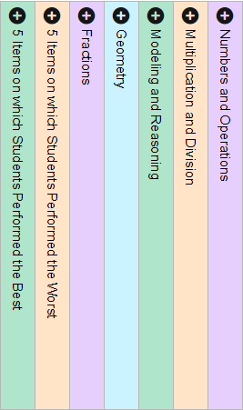
School-Level Users: School Performance on Test Report—Roster Tab
DT1Gr3Math
DT2Gr3Math
DT3Gr3Math
DT4Gr3Math
Notes:
In the School Performance on Test report, results are organized by Roster, by default. Two tabs, Performance by Roster and Performance by Student, appear at the top of the results table, allowing the school-level user to toggle between roster results or student results.
You may be able to check the Test Completion Rate for each roster in the school using this report, as well as Average Scale Score, Performance Distribution, 5 Items on which Students Performed the Best, 5 Items on which Students Performed the Worst, and item-level data in the reporting categories.

Slide 21
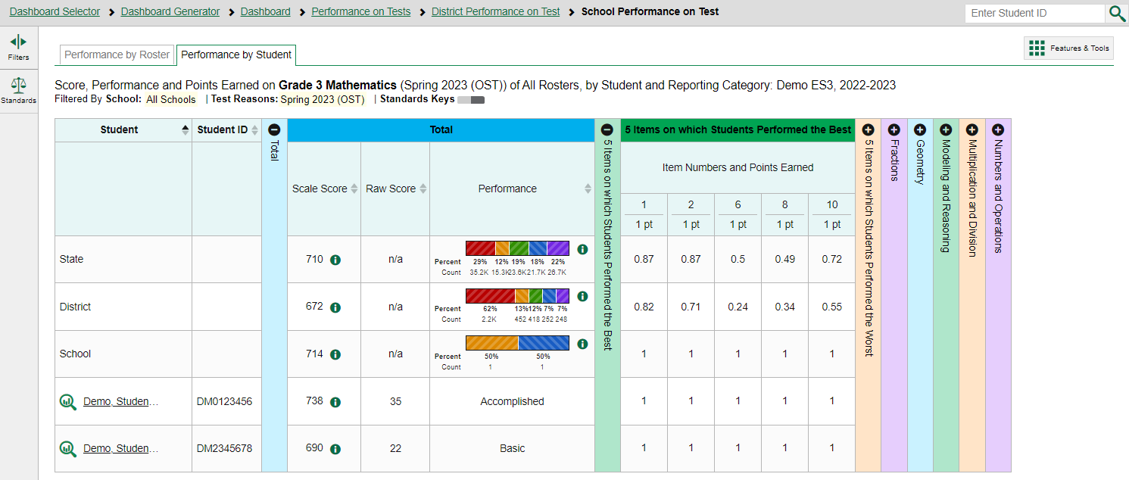
School-Level Users: School Performance on Test Report—Student Tab
Notes:
Here is the same School Performance on Test report showing Performance by Student. You see the students in the demo school who took the OST Grade 3 Mathematics test in the Spring of 2023. You may see a column displaying the Raw Score for each student on the list. This report is shown with the 5 Items on which Students Performed the Best column open, displaying the scores for
Items #1, #2, #6, #8, and #10.
There is one more drill down option at this point—to isolate a student’s test results by clicking on the Student name or the magnifying glass view button to the left of it.

Slide 22
School-Level Users: Student Performance on Test
Notes:
Here is the Student Performance on Test report showing a single student’s performance. Note that the student’s name is no longer underlined, nor is there a green magnifying glass view button next to it. This is the end of the navigation trail.
This OST Grade 3 Mathematics report is shown with the Fractions reporting category open. It includes the Raw Score and Performance Level for the Demo Student, as well as data for the test items belonging to that reporting category. The maximum point value is displayed under the item number. State, District, and School comparisons are included in this report. The point values earned by the student are displayed below the comparisons.

Slide 23
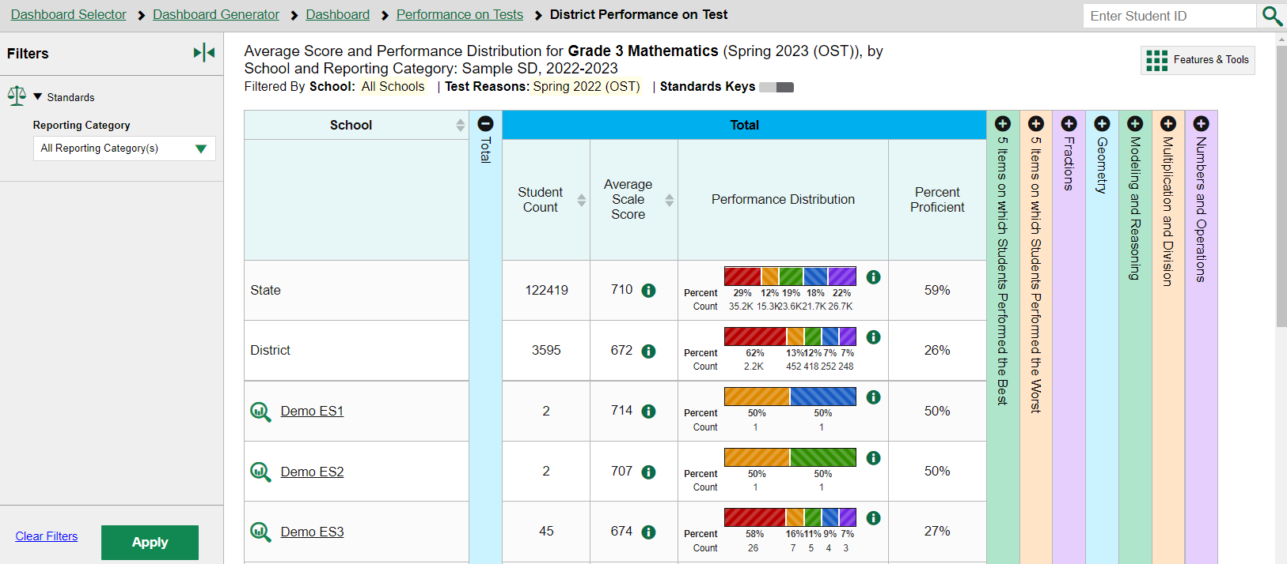
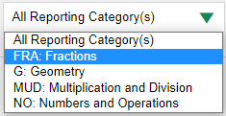
District-Level Users: District Performance on Tests Report
Notes:
When district-level users select a test from the Performance on Tests report, the District Performance on Test report opens with a display of the schools in the district and the aggregate data for each school for the test group you selected. The State and District comparison rows now display at the top of the results table, along with Student Count, Average Scale Score, and the Performance Distribution indicator.
The performance measures used in this report are Average Scale Score, the Performance Distribution bar, and Percent Proficient.
The reporting categories, displayed in different-colored columns, are explained in the More Advanced portion of this module.
This report features a Standards filter option with selections that match the reporting categories used with this Mathematics assessment.
To navigate to school-level results, click the name of a school or the green magnifying glass view button.

Slide 24
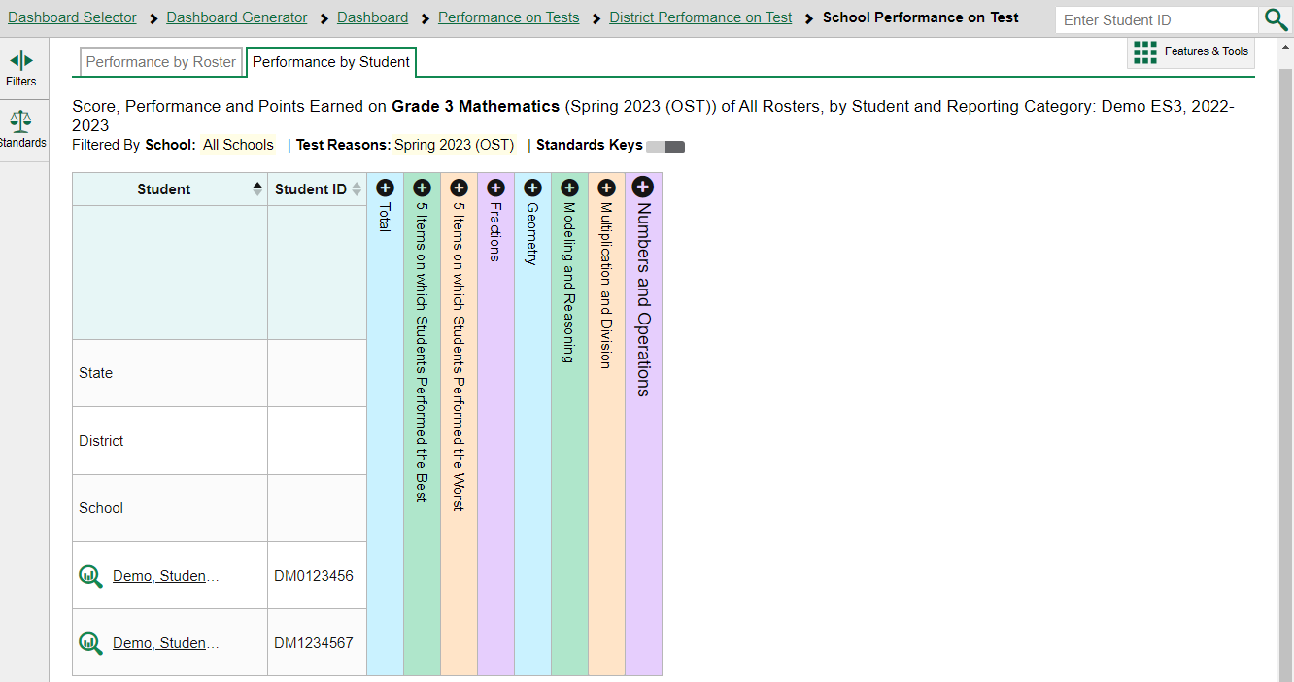
Access the Student Portfolio Report
Notes:
All users can access the standalone Student Portfolio report from any test report page. Copy and paste the student ID number into the search box and then click the search button, as shown in the upper-left image.
Teachers have a fast pass to this report from their My Students table on their Performance on Tests report page. Simply click the student’s name or the magnifying glass view button and the report displays.

Slide 25
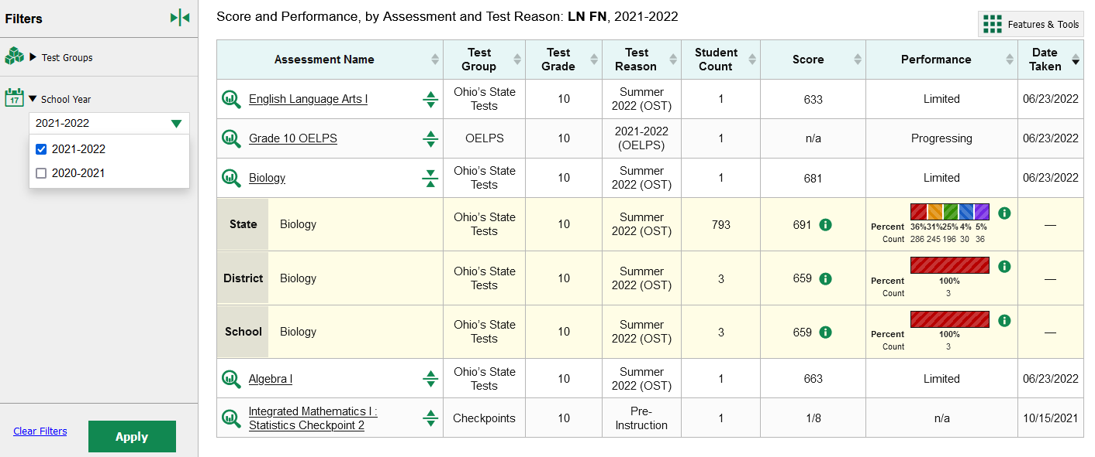
Ways to Use the Student Portfolio Report
5
4
2
1
3
6
Notes:
Now we will look closer at the Student Portfolio Report. This report is great for users who want to view all the assessment results for a specific student. Anyone can access this report by entering an SSID in the top right search box.
The Student Portfolio report lists all the tests the student has taken in the current school year.
This report is designed so that users can quickly:
Add tests from previous school years to get a complete list of all tests taken by the student.
Filter by Test Group to eliminate test groups you don’t need to see.
Compare a student’s results with state-, district-, school-, and/or teacher-level data using the expansion arrows to the right of each assessment name.
4. Sort results in any column with a set of sorting arrows in the header.
5. Generate and print an Individual Student Report or a Student Data File using the Features & Tools button.
And access specific test data directly from the report by clicking the Assessment Name or the magnifying glass button to the left of it.

Slide 26
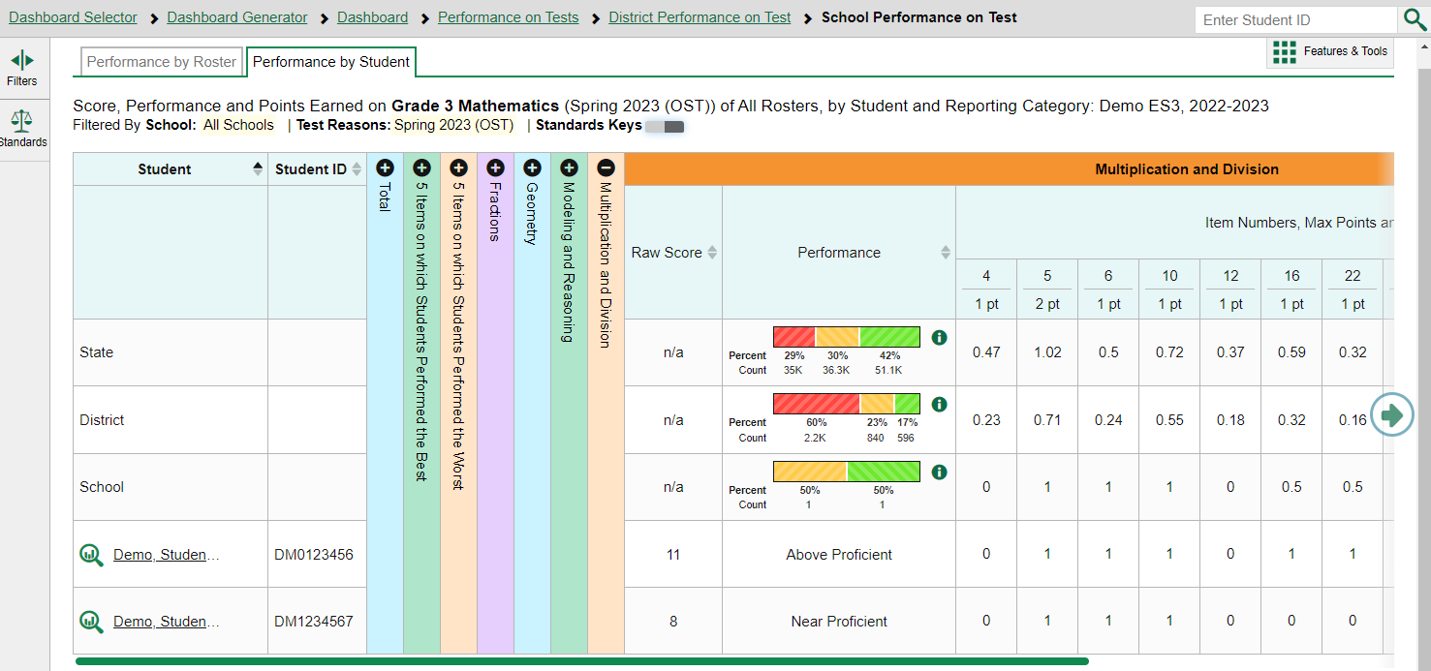
Tests with Reporting Categories
Notes:
For tests with reporting category sections, you can compare the performance of your students in each area of the test. Click each vertical section bar to expand or collapse it. In this example, you can view the Raw Score and Performance level for each student under the reporting categories for this Grade 3 Mathematics test.

Slide 27
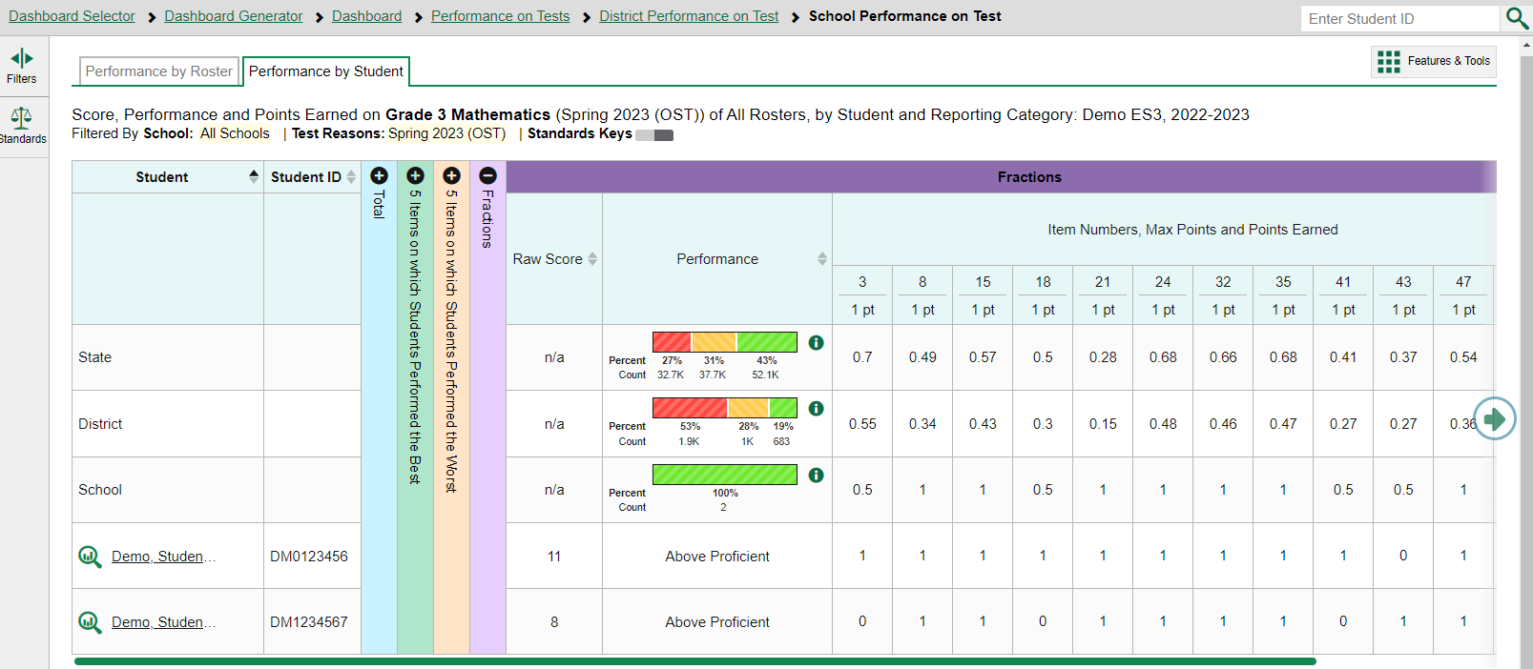
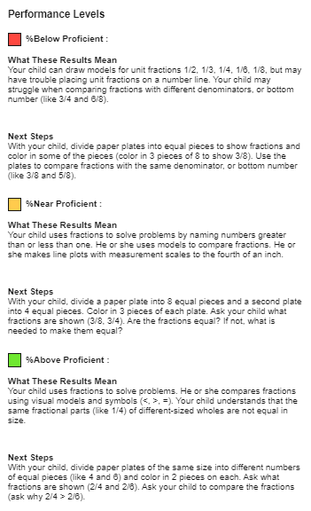
Performance Measures within a Reporting Category
Notes:
Here is the same Mathematics test with the Fractions category expanded. The chart displays the performance distribution and item scores for the State, District and School and for each roster or student. The information button, available for many report elements, displays more detail about the measures reported. The key for the performance levels in that reporting category is shown at the right.

Slide 28
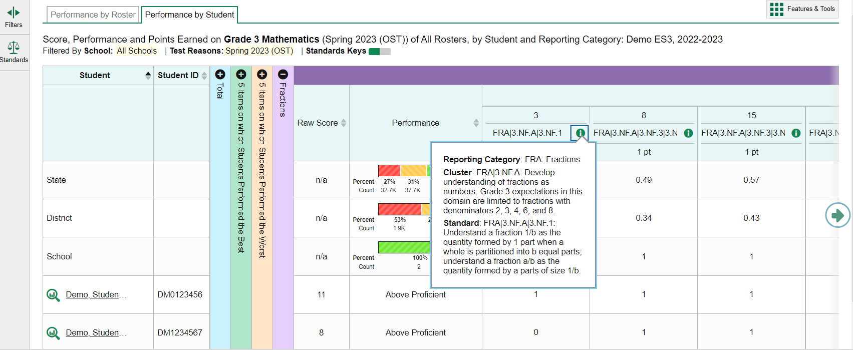
How to View Standards for Each Item in a Reporting Category
Notes:
If a report displays item-level data, you can view the standard to which each item is aligned. This allows you to determine at a glance what the item measures. To show or hide item standards, click the Standards Keys toggle in the row of filter details below the report table heading. The standards display beneath the item numbers. Click the information button beside the standard keys to view more details for the standard. You can also filter the report by Standards.
Currently item-level data is available on most OST and Readiness Assessment reports. You can learn more about analyzing the data contained within reporting categories by viewing the training module: The Centralized Reporting System—Viewing Results within Reporting Categories for Ohio Assessments. This module, located on the Ohio Assessments Test Portal, goes into detail about how to filter reports by standard and how to interpret the Writing Dimensions category data.

Slide 29
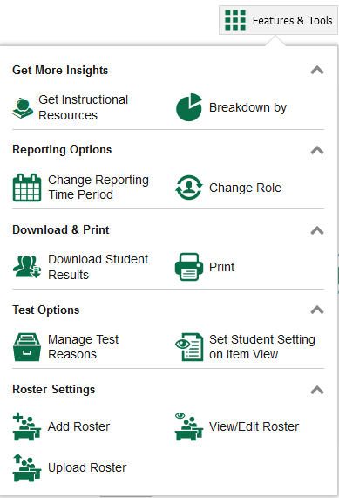
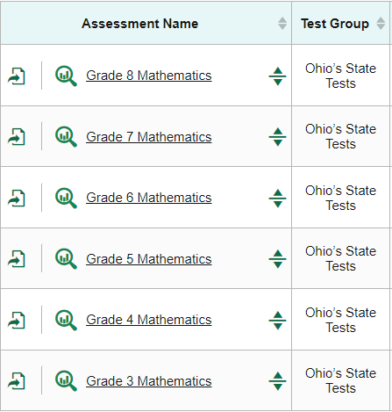
Print & Export Data
Notes:
This section covers how to print reports using the Print button and how to export data using the Export button that displays on several different reports, shown here on the Performance on Test Report. The Features & Tools menu is available at the upper-right corner of every page in Reporting. The actions displayed here vary, depending on the type of assessment and the user’s role.

Slide 30
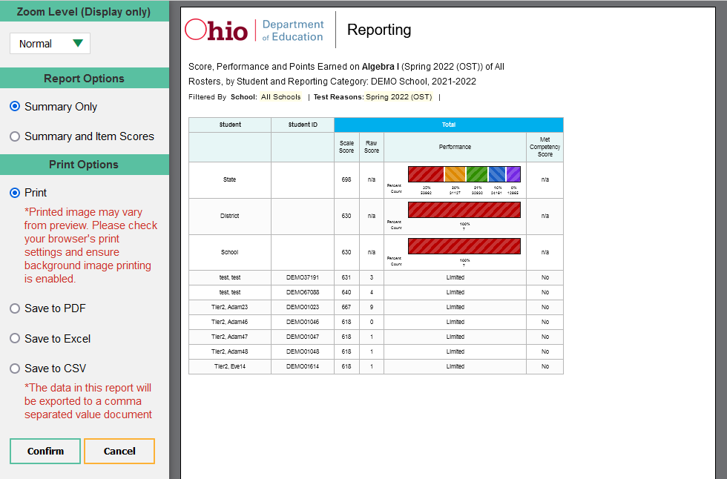
Print Anything You See on Your Screen
Notes:
You can order a print file from any page in Reporting except the Dashboard Generator. After clicking Print in the Features and Tools menu, you are presented with a preview page and Zoom Level, Report Options, Print Options to the left.
On assessments with item-level data, you can choose between summary only or summary and item scores. When selecting item scores, standard keys will also be included if you choose Excel or CSV file types.
Make your selections from the gray panel and click Confirm. When you save to PDF, Excel, or CSV, the file is available in your Secure Inbox.

Slide 31
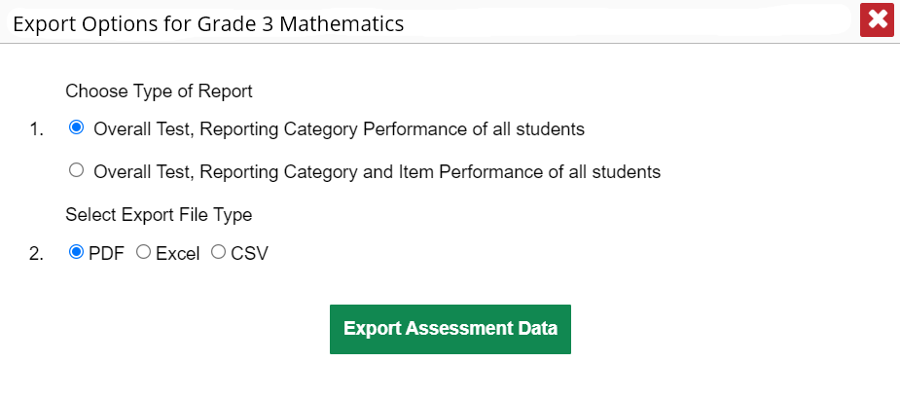
Export Options
Teachers & School-Level Users
Notes:
You can export data from any report where you see the export icon located to the left of the Assessment Name. Your export options will depend on the test report type and your user role. When a report includes item-level data, teachers and school-level users can choose between a short summary report or a report including item performance data. Make your Export File Type selections and click Export Assessment Data.

Slide 32
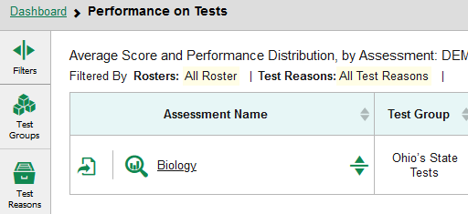
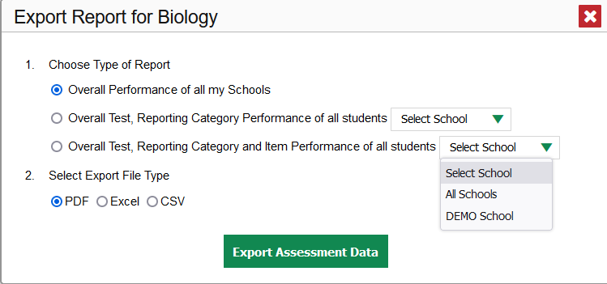
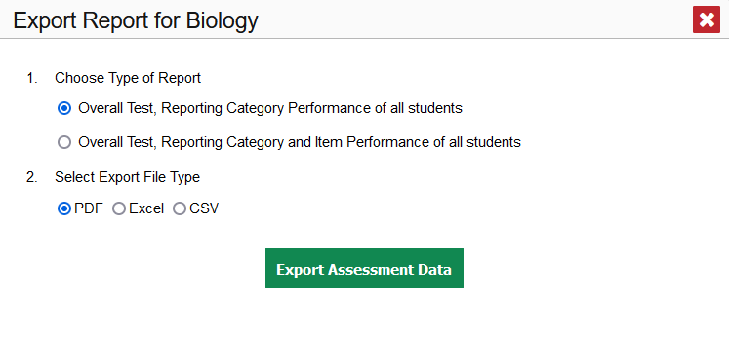
Export Options for District Users
District Users
School and Teacher Users
32
Notes:
District users see school drop-down menus on their Export Report windows, allowing them to select a single school or all schools in the district.
When exporting reports that include item-level data via Excel or CSV, the report will include standard keys.

Slide 33
Download Student Results
Two Types of Results
Individual Student Reports (ISRs)
The Student Data File
Notes:
This section covers the two options available under the Download Student Results button in Features & Tools. You can generate an Individual Student Report, or ISR, and generate a Student Data File. Let’s review the ISR first. The two processes are very similar in nature.
An ISR is a PDF that displays test results for a single test opportunity taken by a student. It may consist of a single page or multiple pages. ISRs are useful for sharing performance information with students and their parents and guardians. A Student Data File is an Excel, CSV, or text file of the information used for analysis or upload into another system.
The Student Results Generator button is the “head and shoulders” icon located in the Features & Tools menu, under the Download & Print options. It is labelled Download Student Results. When you click it, the Student Results Generator pop-up window displays.

Slide 34
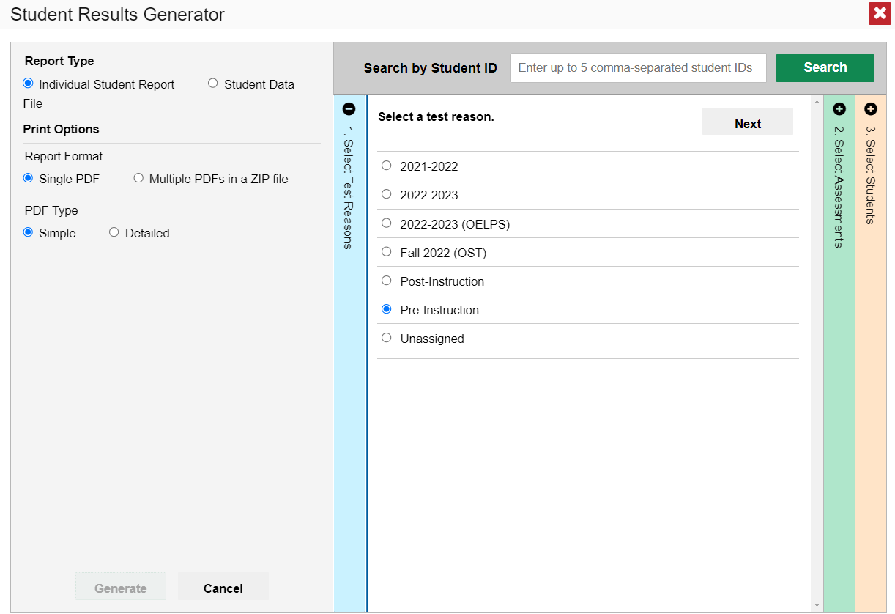
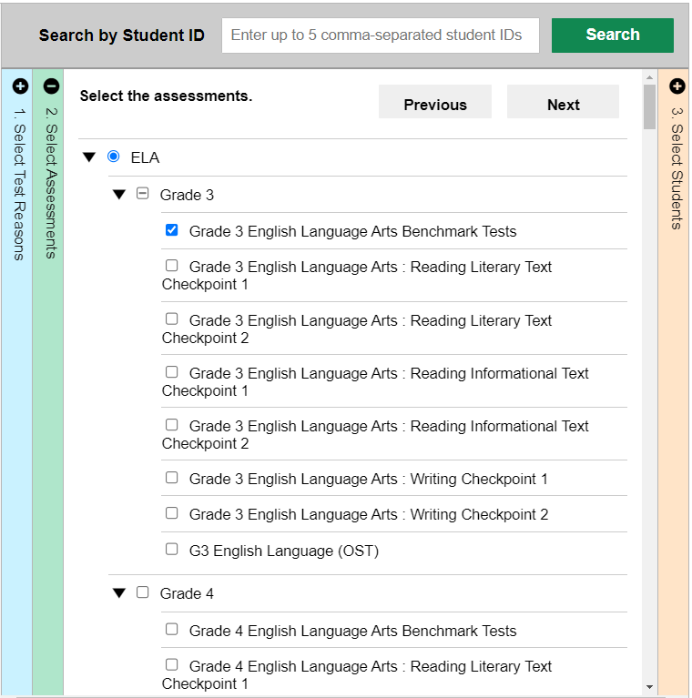
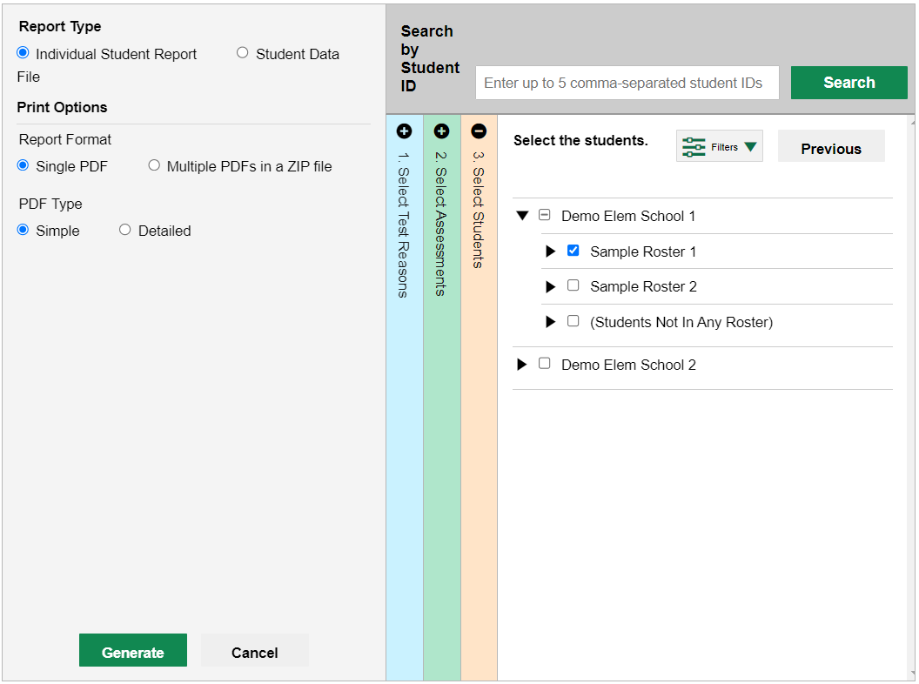
3 Steps to Generating ISRs & Student Data Files
Notes:
Here is the Student Results Generator page where you can build either ISRs or Student Data Files. Both reports, the ISR and the Student Data File, are typically built by completing three numbered and colored sections:
#1 Select Test Reasons
#2 Select Assessments
#3 Select Students.
After making your selections on three pages and selecting a Report Type and Print Options, click the green Generate button, which is now active. The report you generated is available in your secure Inbox and should be downloaded from there within 29 days.

Slide 35
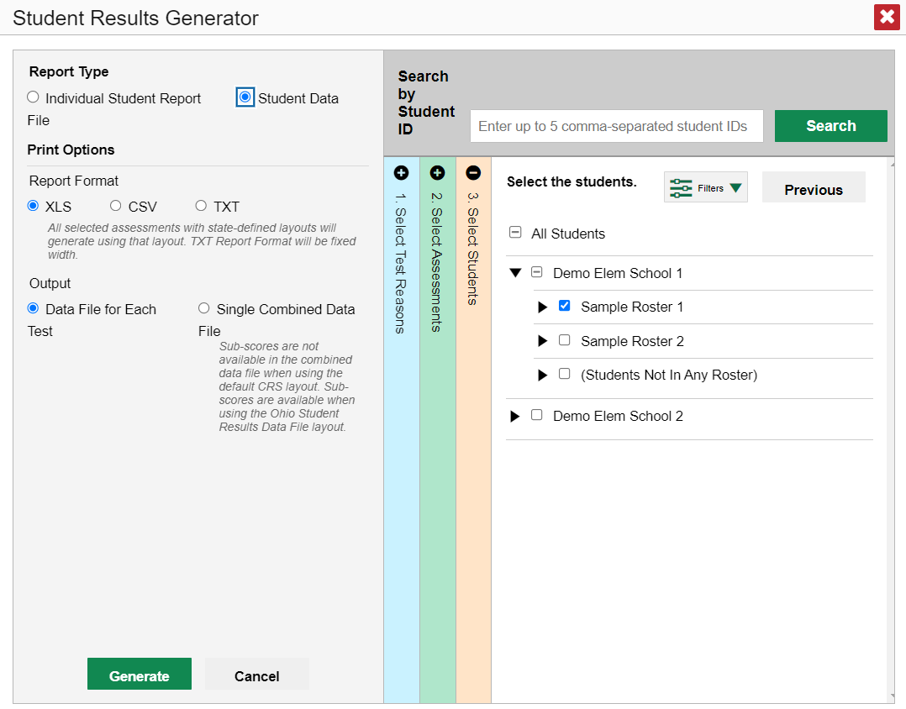
Download Student Results
ISRs
One test reason
A single subject; multiple grades
Up to 3 schools for district-level users
Language (if available)
Student Data Files
One test reason
Multiple subjects; multiple grades
Multiple schools in a district
Data file for each test or combined data file
Notes:
Shown here are the print options under the Student Data selection.
For both reports you can also enter up to 5 comma-separated student IDs in the Search box and the Student Results Generator pages will populate with data specific to those 5 students.
Shown here are the parameters that apply to ordering ISRs and Student Data Files.
For more detailed information on generating ISRs and Student Data Files, and viewing samples, please view the module: The Centralized Reporting System—Generating ISRs & Student Data Files for Ohio Assessments, located on the Ohio Assessments Test Portal.

Slide 36
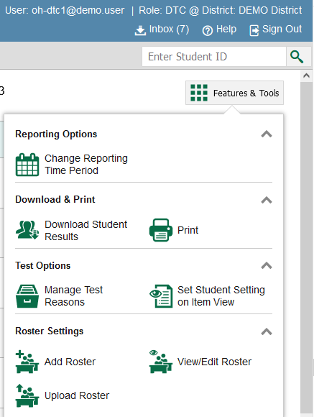
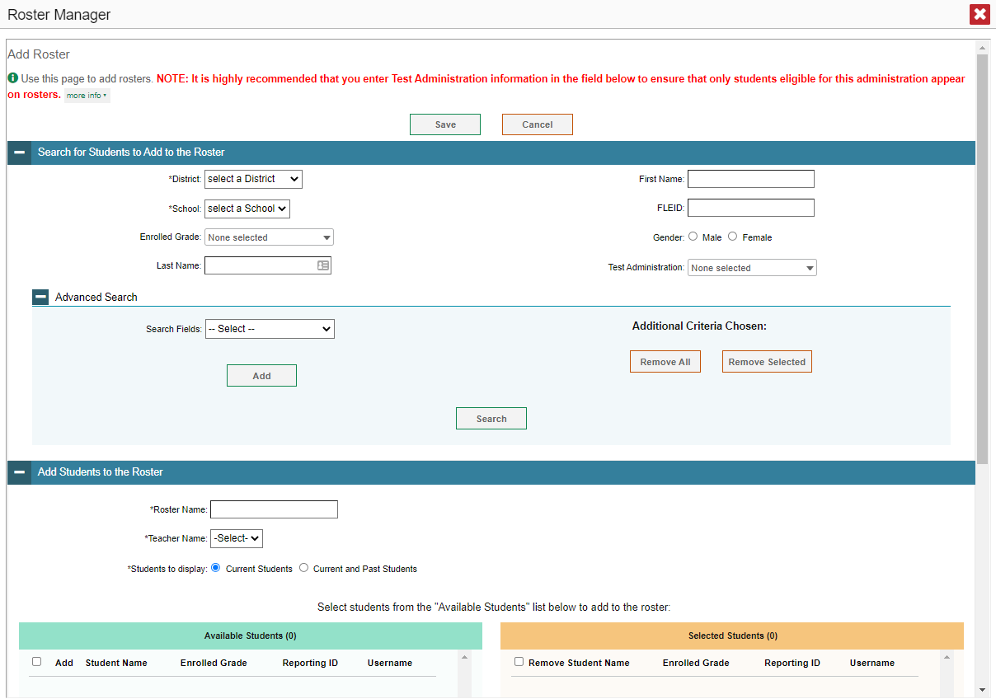
Roster Settings: Identical to TIDE
SSID:
Notes:
Much of the functionality and power of CRS is based on rosters. Although not required for basic school and district tasks such as downloading data files, they significantly enhance your ability to analyze results. For teachers they are essential for viewing results and are the basis for extra tools teachers can access.
Before we go further, a note on terminology. In the context of Cambium Assessment systems, rostering students means associating students already present in TIDE with teachers already present in TIDE. Adding students to TIDE is known as preidentifying and is a necessary prerequisite for creating rosters (and many other tasks). Students can be included in multiple rosters. For more information on adding students and teachers to TIDE, consult the TIDE User Guide.
As previously mentioned, rosters are a great way to organize students, are required to allow teachers to view their students’ performance, and allow other users to compare the performance of different rosters.
Depending on their user role permissions, some users can add, edit, and delete rosters. Classes are a common roster grouping, but Rosters are a flexible tool and can be created for any group of students. For example, rosters can be created around a category such as English learners. This allows Teachers that work with groups of students not defined by traditional classes to easily access their students.
The Roster Management pages used in Reporting are the same used in the TIDE, so if you have done this in TIDE, you already know how to do this in CRS. The Roster management process is included in the 2022–2023 Centralized Reporting System User Guide as an appendix.
You access the Roster Settings with the Features & Tools menu. The Add Roster page consists of two teal-colored sections: one labelled “Search for Students to Add to the Roster” and the other, “Add Students to the Roster.”

Slide 37
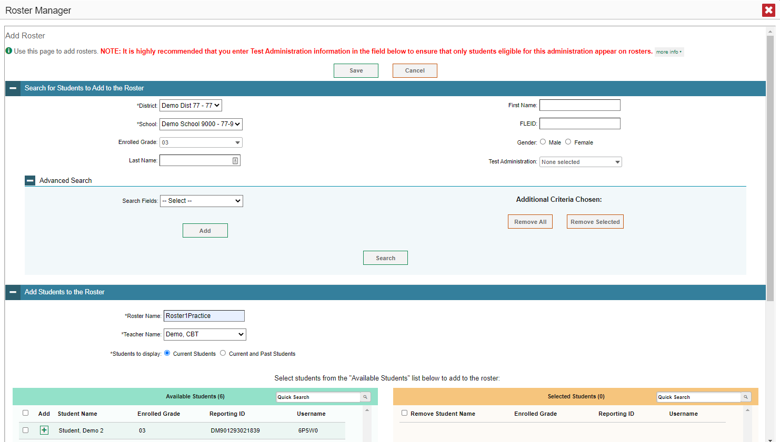
Search for Students to Add to the Roster
SSID:
Notes:
Here is the Add Rosters page in CRS. Note that this is the same interface used in managing rosters in TIDE. First you find students to add to your roster using the fields in the Search for Students to Add to the Roster section. You can search by a variety of student demographics and other fields. After making your selections, click Search to load the results to the green Available Students table below.

Slide 38
Add Students to the Roster
Notes:
Next, add the desired students to the roster by clicking the green plus sign next to their name or by marking the checkboxes. You can also use the Add All or Add Selected buttons to move the students to the roster. Remove students from the roster by following a similar process in the orange table.
Make sure to name your roster and choose a name from the Teacher Name field. Then click Save to save the roster. It will immediately be available for viewing results by roster in CRS.
Editing existing rosters uses the same process.

Slide 39
Upload Rosters Using a Template
39
Notes:
If you have multiple rosters to create or modify, it may be easier to use file uploads.
Choose the Upload Roster option from Tools and Features. The Roster Manager window displays, showing the Upload Rosters page. Like other file uploads in TIDE, this requires four steps: Upload, Preview, Validate, and Confirmation. To begin, click the Download Templates button at the upper right and select the file type you prefer. Enter the required information in the downloaded template and save it to your computer.
A sample Excel worksheet showing a filled-out template is shown at the bottom of this slide.

Slide 40
Longitudinal Report
Only students highlighted in yellow will appear on the Longitudinal Report.
Notes:
An advanced feature of CRS is generating Longitudinal Reports, which allow you to look at how results have changed over time.
When available, a Build Longitudinal Report button will display in the Features & Tools menu. Depending on your role, the test types, and the number of students in the report, it may display a report options page rather than the Longitudinal Report itself. If you are viewing a Longitudinal Report for grade level ELA tests, the Progression drop-down list appears, allowing you to select OST All ELA, OST Spring ELA, or OST Grade 3 ELA (when viewing a grade 3 ELA test). As there are multiple opportunities per year for grade 3 ELA, this allows you to customize which ELA tests are included.
Teachers viewing a longitudinal report for multiple students are presented with a Longitudinal Report with Progression pop-up window. The Progression drop-down menu is located at the top of the window followed by a table of their students and the related tests.
The cells in the columns display checkmarks to indicate which students completed each test. The students highlighted in yellow have completed all of the related tests and will appear on the longitudinal report. Longitudinal Reports are built only with students that have taken each of the included tests. You can change which students are included by changing the included tests.
Mark the checkbox for each test you wish to include in the report. Click the green Generate Report button at the top of the window to view the Longitudinal Report.
Currently longitudinal reports are available for OST grade level tests and Readiness Assessments tests.

Slide 41
Sample Longitudinal Report
Notes:
A sample report for an individual student who took the ELA Benchmark test multiple times is shown here. It shows the scores of the student each time they took the test. The overall results are shown. You can use the toggle bar that appears above the graph to switch between score and performance. At the aggregate level, you can view the average score progression as well as the progression of performance distribution across achievement levels.
Alternatively, in the table at the bottom of the report, the data are replicated, with expandable columns for the reporting categories.

Slide 42
How to Build a Demographic Breakdown Report
Notes:
There is a tool that allows users to break down data by demographic sub-group. You can create a breakdown report from any page in Reporting that displays data for multiple students. Open the Features & Tools menu and click the Breakdown by button. A Breakdown Attributes window opens, displaying the options available to you.
For example, here, you see a School Performance on Test report for the Algebra I test. You can build a report for a specific group of students based on any three attributes listed in the Breakdown Attributes window.
For a sample report, the Enrolled Grade, Gender, and Race/Ethnicity options have been selected. A checkbox is displayed next to the term, “Include unspecified values”. This option, when selected, will include any of the user’s students with no demographic information assigned to them in TIDE. Click Apply. The customized report displays, as shown on the next slide.

Slide 43
Demographic Breakdown Report
Notes:
The Breakdown page is organized according to the combinations selected. A row appears for each possible sub-group combination. The number of rows in the table will depend on how the students fall into the demographic categories.
For example, here you see a top row for ALL 20 students, followed by some possible combinations. If a combination does not appear in the table, it means none of the students fall into that sub-group. Notice that the table header has updated to reflect the chosen attributes. You see from this breakdown report that there are 20 students who are divided into seven sub-groups. You can sort the sub-groups in a few different ways -- by Enrolled Grade, Gender, and Race/Ethnicity. To look closer into a specific sub-group, click the View Details button in that row.

Slide 44
View Details Window/Breakdown Report
Notes:
A Breakdown window opens, displaying detailed results for the selected sub-group. A row of drop-down menu buttons appears above the table, displaying the attributes of the group you chose. To quickly transition to another demographic sub-group for the same test, you can apply the breakdown menu options that display above the table of results. Select an attribute you want from the drop-down menus and click Apply. The new sub-group will display.

Slide 45
More Help
Further Information: Centralized Reporting System User Guide, 2022-2023
https://oh.portal.cambiumast.com/
Email OHHelpdesk@cambiumassessment.com
or
Call 1-877-231-7809
Notes:
Thank you for taking the time to view this training module. For detailed information, consult the Centralized Reporting System User Guide, 2022-2023, located on the test portal, or contact the Ohio Help Desk.

Slide 46
The CRS Series
The Centralized Reporting System: The Basics for Ohio Assessments
The Centralized Reporting System: Generating ISRs and Student Data Files for Ohio Assessments
The Centralized Reporting System: Viewing Results within Reporting Categories for Ohio Assessments
The Centralized Reporting System: Working with Item-Level Data
The CRS Series, specifically created for Ohio Readiness Assessments:
How to Access Your Readiness Assessments Data in the Centralized Reporting System
How to Use the Advanced Features of the Centralized Reporting System to View Your Benchmark and Checkpoint Data
How to Modify Machine Scores and Hand-Score Unscored Items
Notes:
There is a 4-part series of CRS trainings for the Ohio Assessments: OST, Readiness Assessments and AASCD. They are:
The Centralized Reporting System: The Basics for Ohio Assessments
The Centralized Reporting System: Generating Individual Student Reports and Student Data Files for Ohio Assessments
The Centralized Reporting System: Viewing Results within Reporting Categories for Ohio Assessments
The Centralized Reporting System: Working with Item-Level Data
In addition to this series, there is a 3-part series of training modules that focus specifically on the Readiness Benchmark and Checkpoint tests. They are:
How to Access Your Readiness Assessments Data in the Centralized Reporting System
How to Use the Advanced Features of the Centralized Reporting System to View Your Benchmark and Checkpoint Data
How to Modify Machine Scores and Hand-Score Unscored Items
These modules can be found on the Ohio Assessments Portal.

